Slide 1
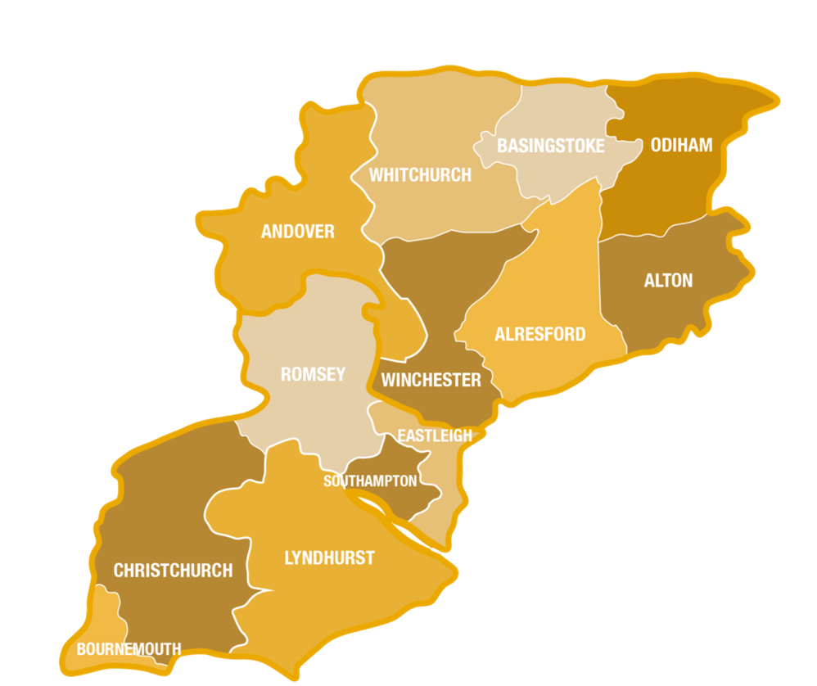

Diocesan Budget
Consultation
June 2026
Notes:
Starting process of consultation to agree our next three-year financial plan.
This will cover 2027 to 2029 and is likely to be a period of significance in the life of our diocese and wider church.
Looking for high-level feedback on assumptions and shape of budget at this stage.
Whilst don’t want to limit discussion, would ask that we keep feedback high-level – not too many examples from individual/specific contexts please!
Handout of the single side budget summary – will refer to this as we go through the presentation

Slide 2
Timescale:
11 May: Diocesan Finance Committee
12 May: House of Laity
1 June: Bishop’s Council
17 June: Diocesan Synod (AGM)
18 August: Finance Committee
7 September: Bishop’s Council
6 October: House of Laity
19 October: House of Clergy
4 November: Bishop’s Council
26 November: Diocesan Synod
Online public consultation date to be confirmed
Notes:
11 May: Diocesan Finance Committee – first look at draft headline budget and agree assumptions
12 May: House of Laity – Start of consultation
1 June: Bishop’s Council – Update on headline assumptions and feedback so far
17 June: Diocesan Synod (AGM) – AGM of the WDBF, chance to really understand detail of 2025 finances.
18 August: Finance Committee – Issue second draft
7 September: Bishop’s Council – agree second draft
October: House of Laity and House of Clergy
4 November: Bishop’s Council – Final draft recommended to Synod
26 November: Diocesan Synod – Budget approved (we hope!)

Slide 3
Context
Diocese has seen 3 years of Growth in attendance above the national average
Walking the Wessex Way Mission Strategy due to be submitted for approval in October 2026 (seeking £10m investment over 4 years)
Continue to see a healthy pipeline of vocations to lay and ordained ministry, counter to national trend.
Strategic Plan to improve clergy housing over 5 years progressing as expected
Changes to national Diocesan Funding due to be fully implemented by start of 2027
Large budget deficit at end of 2025, with CMF still well below the actual costs of Ministry in our parishes.
The next 3-years should be a period of consolidating our finances, improving our sustainability to enable us to invest in long-term growth.
Notes:
On screen are a few of the key contextual and strategic drivers for this financial plan.
Seeing really positive signs in terms of growth in attendance and vocations.
Saw a brilliant increase in CMF on 2025 (over 2024).
Our strategic plans are developing with a view to seek £10m of investment from the SMMIB later this year.
Our 5 year strategy to improve clergy housing is going well – a few hiccups inevitably along the way, but the plan is working at a macro level.
National funding changes for dioceses coming into effect this year and next which will reduce our deficit slightly
But we cannot escape the reality that we had a large budget deficit for 2025 (larger than expected) which is not a sustainable model for years to come.
We need the next 3 years to be a period of consolidating our finances, improving our sustainability so that we can invest in growth.

Slide 4
Assumptions & Major Changes:
5% increase in CMF
3% increase in salaries, stipends & pensions
3% increase in all other areas
Investment income rebased for 2027
Diocesan Finance Review (national)
Clergy Housing Strategy
Notes:
The budget model is based on the following assumptions:
5% increase in CMF: held at 3% for last 3 years, having made large reduction in total request back in 2024. This has helped address the culture of CMF, but now the gap between income from parishes and costs of parish ministry is growing – need to close this delta.
3% increase in salaries, stipends, and clergy pensions: Seen large increases in stipends in recent years (over 7% last two years). With new national formula, hope that future increases will be closer to 3%.
3% increase in other areas: More detailed work will be carried out on each budget line as we go, but for now a headline rate of inflation of 3% is proposed as a starting point.
Rebased investment income for 2027 based on performance: This may change again. Hope we’re being cautious. Will be reviewing our investment managers later this year as not happy with CCLA – so please do let us know if you have any suggestions/expertise in that area.
National Diocesan Finance Review: Should be fully implemented by next year, reducing our contributions to national church. The savings are mainly offset by the recent increases in clergy stipends, but there is some small positive benefit to us.
Clergy Housing Strategy: Will be worked through by end of 2028 – this is the piece of work to address the decades of underinvestment in our housing stock, get all Quinquennial Inspections completed, and major works finished. On schedule to do this by end of 2028, meaning the housing budget should then reduce significantly, back to what we hope will be a more manageable run-rate.

Slide 5
Associated Workstreams
Diocesan Team Review
Walking the Wessex Way: application to the Diocesan Investment Programme
The Path to Sustainability
Review of Diocesan Investment Managers
Notes:
At the same time, the following workstreams/activities are also underway.
Review of the Diocesan Team: Working party working well. Whilst not about making savings, we do believe some savings can be found. Some of these are already included in the draft budget, others are still be worked through. Will help but not transform our financial position. Synod will be fully updated on the recommendations in due course.
WWW Strategy: As mentioned, work on our bid is underway, to help gain around £10m of investment over the next 4 years (2027 -2010).
The Path to Sustainability Work is starting soon with first deanery meetings next week. Working with those 7 priority deaneries identified to explore if there are options for improving growth, reducing costs or increasing giving. We will see what that might lead to.
And as mentioned we will be reviewing our Investment Managers later this year as not happy with CCLA’s performance.

Slide 6
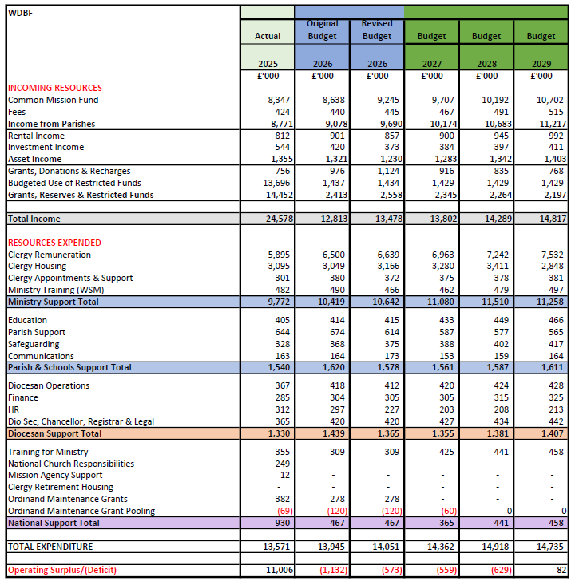
Notes:
You should all have a hard copy of this single side summary of the plan.
This shows the overall shape of the plan based on current thinking. As you can see we show deficits in 2027 and 2028, reducing to breakeven in 2029.
BUT we must remember that this is on the basis of a 5% increase in CMF and 100% collection rate – so it’s not going to happen.
Every time we do a budget we debate whether we should budget for a shortfall in CMF or not. Every diocese has this debate every year! If we don’t budget for a shortfall, it implies we expect income we know we won’t get. If we do budget for a shortfall it implies we’re expecting PCCs to give up and therefore undermines the covenantal nature of the CMF between our PCCs.
We’re therefore suggesting that we present the budget in this way, but note that the bottom line is aspirational and therefore we can’t all just relax. As always, in year adjustments will be needed to manage expenditure to the realities of our income.

Slide 7
“It is important to note that 2024 was the thirteenth successive year in which the aggregate of PCC incomes have exceed their aggregate expenditure. Between 2012 and 2024 aggregate surpluses across parishes have totalled £457m. The £56m aggregate surplus in 2024 was the highest figure in an individual year since 2007 when it was £60m.”
GS Misc 1443
Notes:
Before moving to questions, we wanted to show you this diagram taken from a report to General Synod last year.
It shows the total income and expenditure of all PCCs across the whole country in 2024.
As the quote makes clear, 2024 was the 13th successive year PCC income exceeded expenditure. In 2024 it was £56m… which interestingly is not that far off the total deficit of the 42 Dioceses that year.
We know that this picture is not universal, but what it suggests is that at a macro level at least, the CofE is not in as much financial danger as Diocesan level accounts would suggest. The resources are there, just the income isn’t coming to where the costs are incurred.
This picture is the same for our Diocese. In fact in the last 4 years, PCCs income across our diocese has been nearly £2.9m more that total PCC expenditure. Again, the picture will be mixed in different contexts.
We know that the draft budget is a challenging – a 5% increase in CMF for 3 years is not easy. BUT the alternative is to cut and reduce our ministry. We don’t want to recommend that, if there isn’t a real need to do so.

Slide 8
Where to find out more: winchesterdiocese.org/parish-resources/common-mission-fund https://winchesterdiocese.org/governance/finance-reports
Notes:
Please let us have any feedback or comments you would like us to share with the diocesan team

