Slide 1

Look at the following 3 artworks. All of them are focused on the theme of migration and boundaries.
Each artwork is followed by a series of questions to help you explore your feelings about the piece.

Slide 2
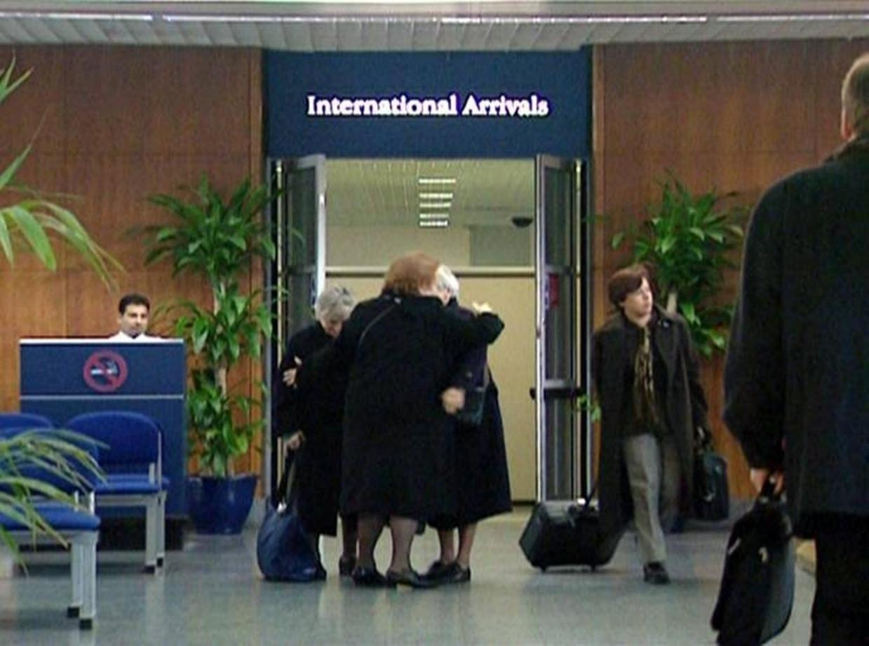

Threshold to the Kingdom 2000
Mark Wallinger

Slide 3
Threshold to the Kingdom 2000 is not a painting, but a video. It shows slow motion footage of people arriving at London City Airport with a soundtrack by Miserere, a seventeenth-century setting of the Bible’s fifty-first psalm by the Italian composer Gregorio Allegri (c.1582–1652).
Shot in a single take from a fixed position, the video presents a view of the airport’s international arrivals doorway, which is indicated by a sign above the doors.
Throughout the video the electric doors open and close, revealing passengers and flight crew members as they move into the public arrivals lounge. Some of those arriving are greeted with waves and hugs by people in the lounge, other people fade and disappear the air. The artist said that he wanted to show the powerful relief you feel when you finally reach home, or the place that you’re hoping to reach.
The video’s title ’Threshold to the Kingdom’ makes reference to the function of the airport’s international arrivals doorway as an entry point to the United Kingdom, and the work’s dramatic music and slow-motion footage create the impression that these passengers have completed the immigration process to enter the country.
Alternatively, the video’s title and the music being played could suggest that the passage to a heavenly kingdom. The fifty-first psalm contains a plea for mercy, for forgiveness and for acceptance.
Questions:
Can anyone share any experiences of showing your passport at an airport or airport security procedures?
Why do you think the artist makes some people in the video fade and disappear?
What difference does the choice of music make?

Slide 4
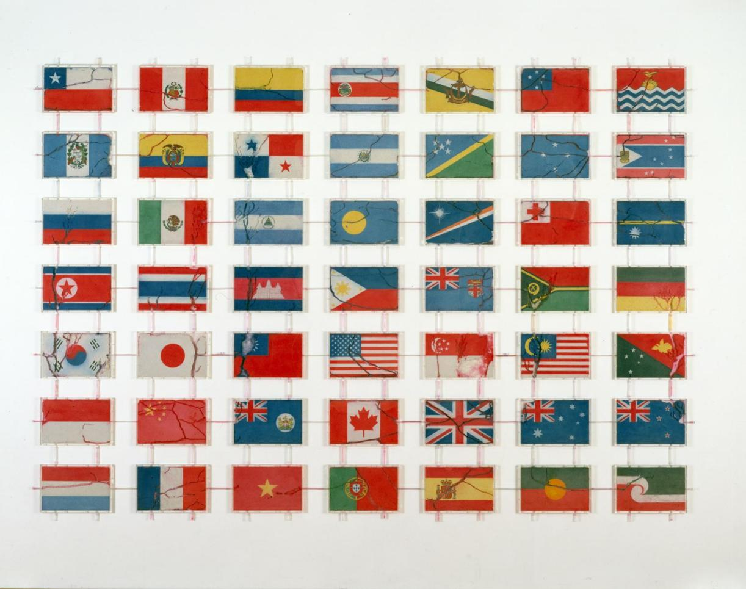
Pacific
Yukinori Yanagi

Slide 5
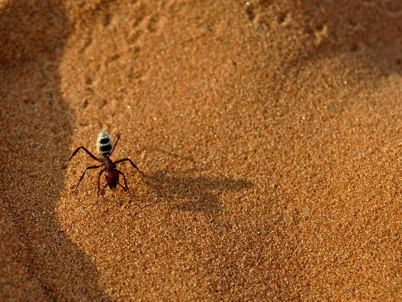
Pacific is a large installation made up of 49 plastic boxes arranged in a grid on the wall and connected using resin tubes. Each box contains a picture of a national flag made from coloured sand. The flags represent some countries that once had indigenous groups that live in the country but have not historically had sovereignty over any territory (for instance, the Maori of New Zealand).
Pacific was produced by allowing lots of ants to move between the boxes, creating tunnels in the sand and producing cracks across the faces of the flags.
During the work’s installation the boxes were placed on a temporary wall, behind which, visible to viewers, were feeding containers holding live ants. The ants were released into the boxes and were allowed to move through the artwork, pushing their way through the sand and creating tunnels. Afterwards the feeding containers were removed and Yanagi used a spray adhesive to fix the sand permanently in place.
The artist said that he wanted people to think about the ants as people migrating across the world. When the ants wear away the clear boundaries between the flags, this serves as ‘a simple, equal and hopeful way of expressing the gradual unification of all the world’s nations.’
Questions:
Do you think this artwork will make people think about the world differently? How?
Is this artwork a positive or negative view of migration?
Could you create a similar artwork?

Slide 6
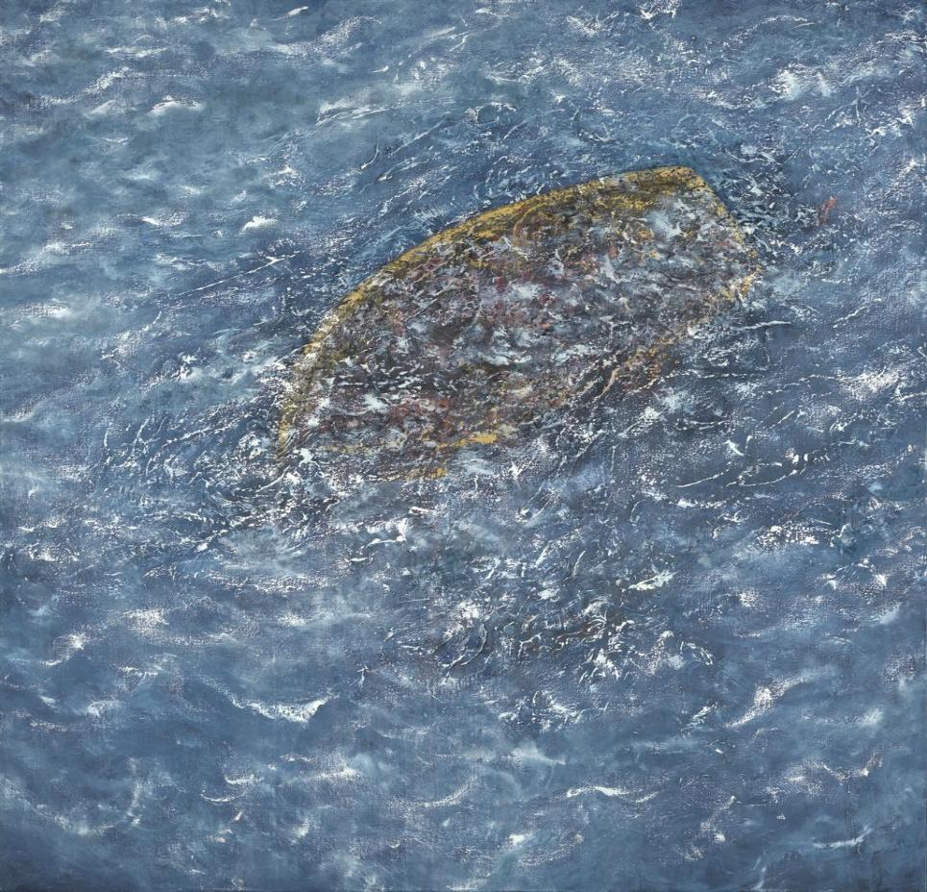

2016
Maggi Hambling

Slide 7
Called ‘2016’, which was the year it was made, this painting shows a golden boat sinking below the surface of the ocean.
The artist has painted swirls of black, white, gold and flesh-toned colours, suggesting the boat’s inhabitants are spilling over its edges into the water.
The remainder of the painting is filled with choppy waves that extend outwards into a seascape viewed from above. This ‘bird’s eye’ perspective is a bit like the aerial view photography captured from hovering news helicopters as they bring news to people in their homes of migrants losing their lives at sea whilst trying to make it to a safe country.
The artist described the work as a mixture of various images in the news in 2016 of asylum seekers losing their lives at sea. She has explained, ‘I kept seeing pictures, on television and elsewhere, of these people, and hearing on the news that a whole boat had gone down … Boats were being abandoned left to drift and disappear.’
Questions:
What do you think the artist was feeling when she painted this picture?
Is there any hope in this painting?
If the painting showed some people holding on to the boat, would it make the painting more or less hopeful for you?

