Slide 1
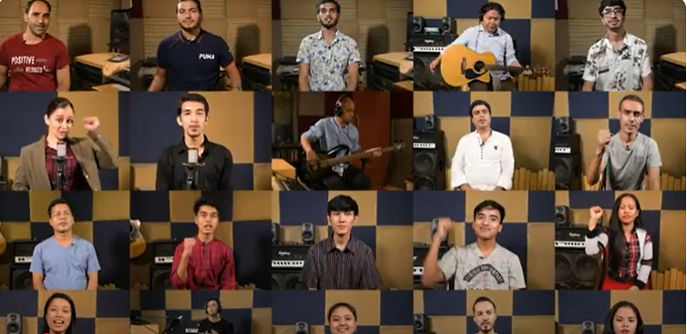
Shine Your Light

Slide 2
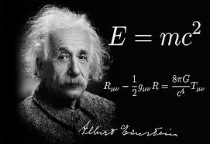
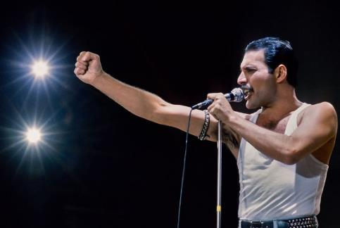


Slide 3



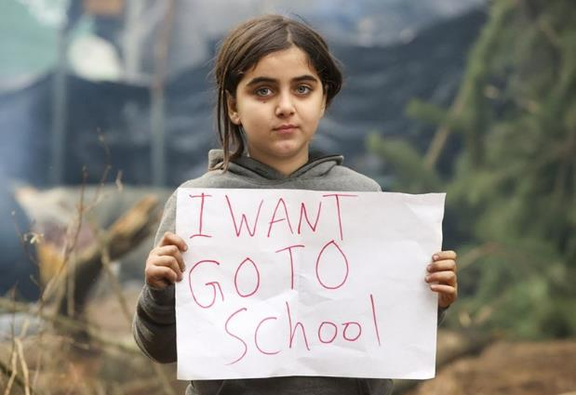
Notes:
The Lord said, ‘I have surely seen the affliction of My people who are in Egypt, and have given heed to their cry because of their taskmasters, for I am aware of their sufferings. So I have come down to deliver them from the power of the Egyptians...’ Exodus 3:7-8a (NASB)

Slide 4
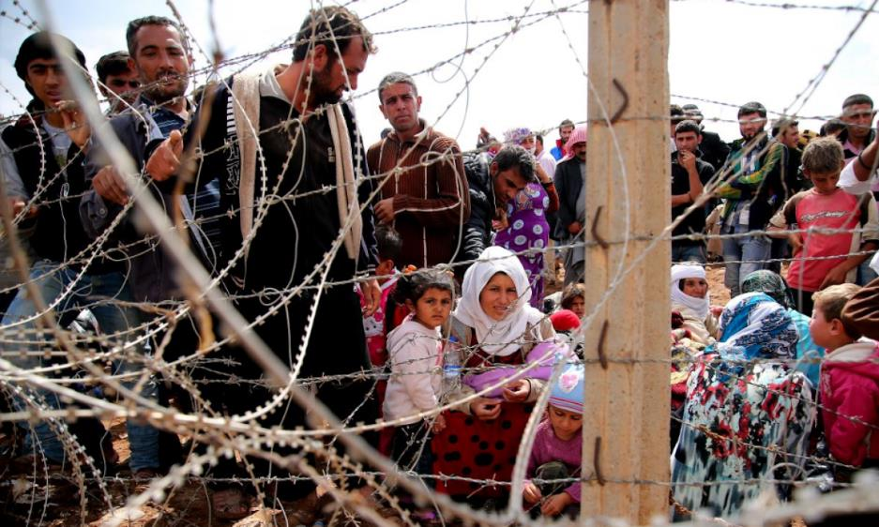
Notes:
After forty years as a shepherd, ‘... Moses was pasturing the flock of Jethro his father-in-law, the priest of Midian; and he led the flock to the west side of the wilderness and came to Horeb, the mountain of God.’ Exodus 3:1 (NASB)

Slide 5
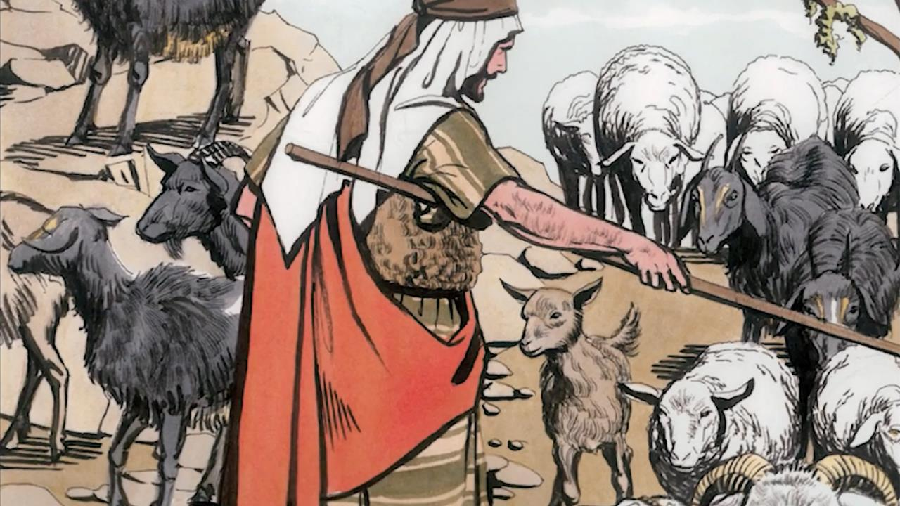
Notes:
… and He will separate people one from another like a shepherd separates the sheep from the goats. He will put the sheep on his right and the goats on His left.

Slide 6
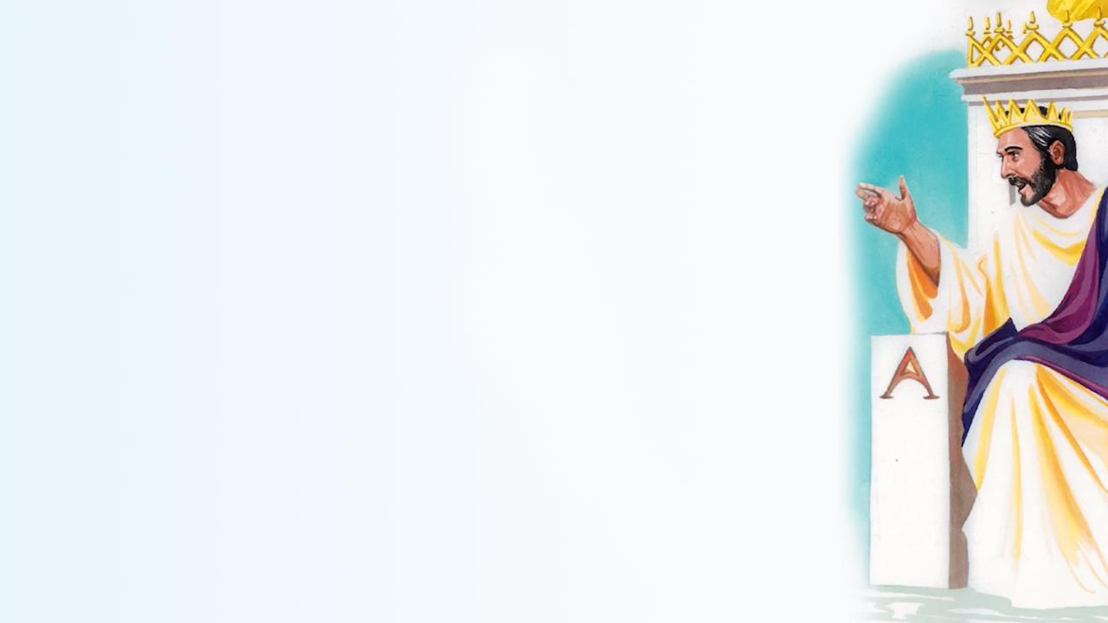
Notes:
‘Then He will say to those on his left…

Slide 7
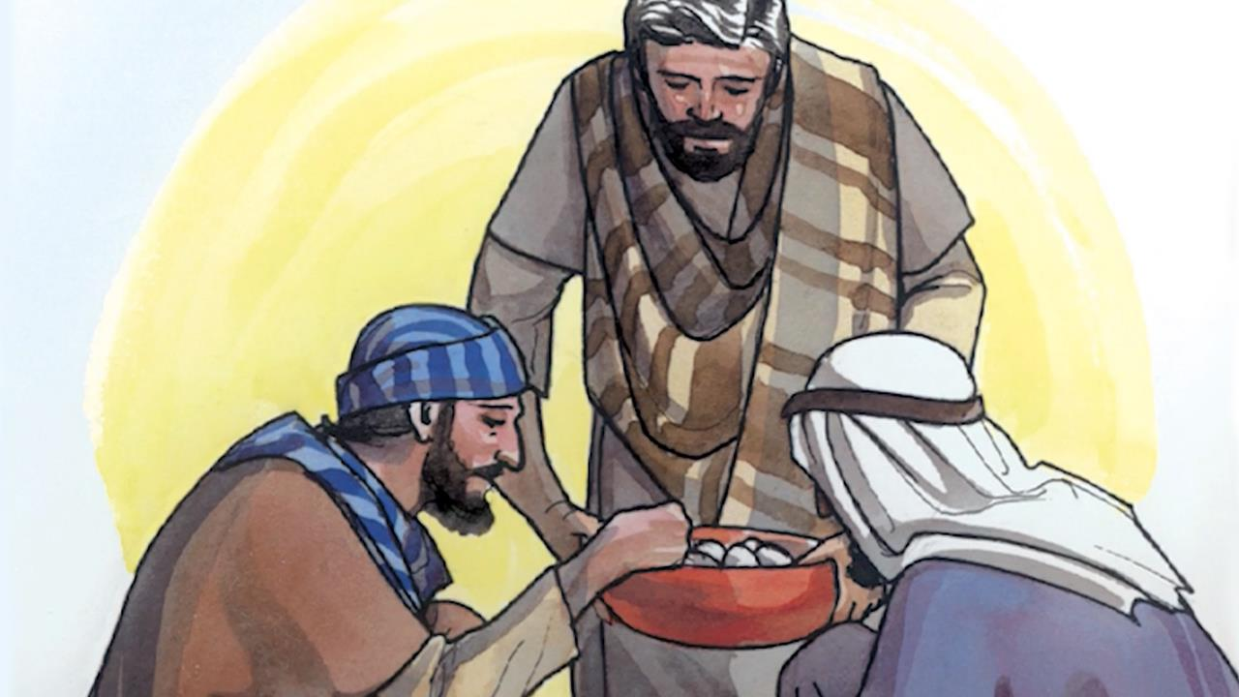
Notes:
‘For I was hungry and you gave me food, I was thirsty and you gave me something to drink …

Slide 8
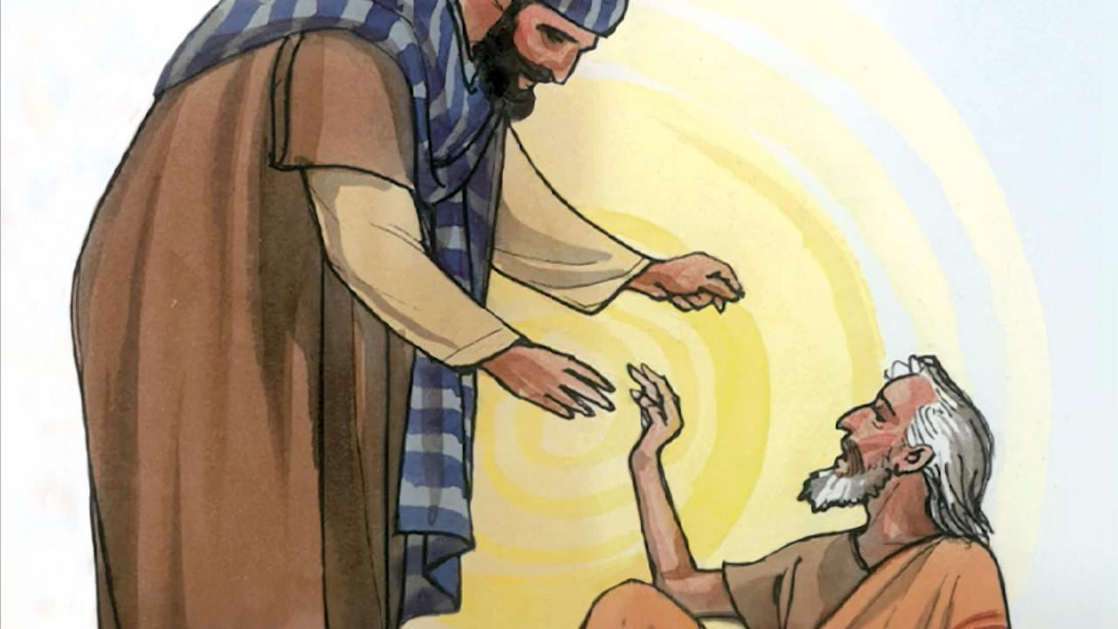
Notes:
‘… I was a stranger and you invited me in, I was naked and you gave me clothing …

Slide 9
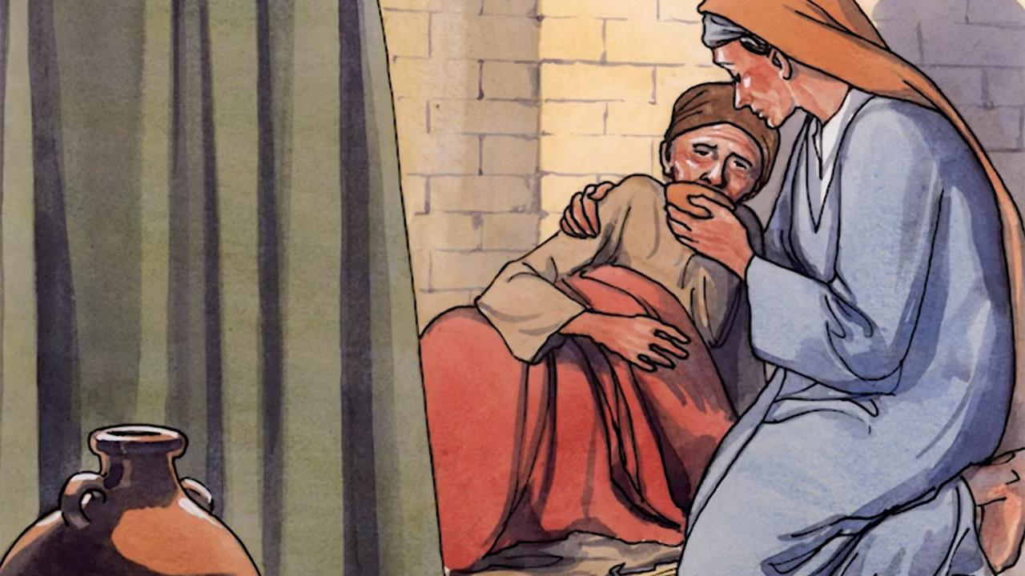
Notes:
‘… I was sick and you took care of me …

Slide 10
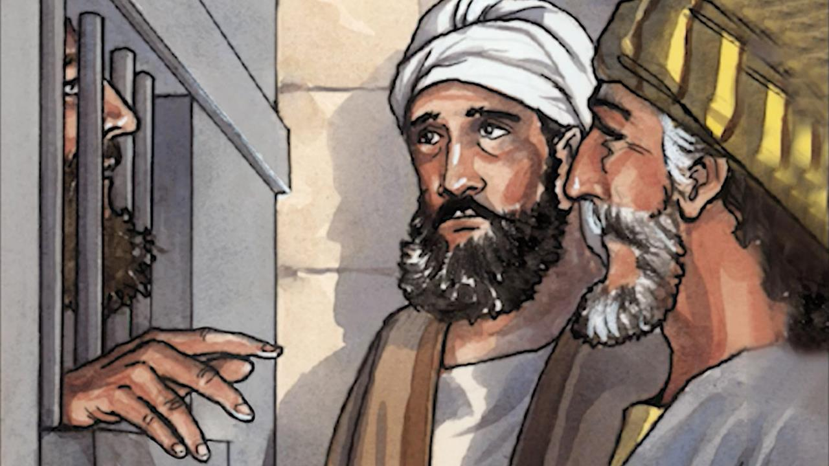
Notes:
‘… I was in prison and you visited me.”

Slide 11
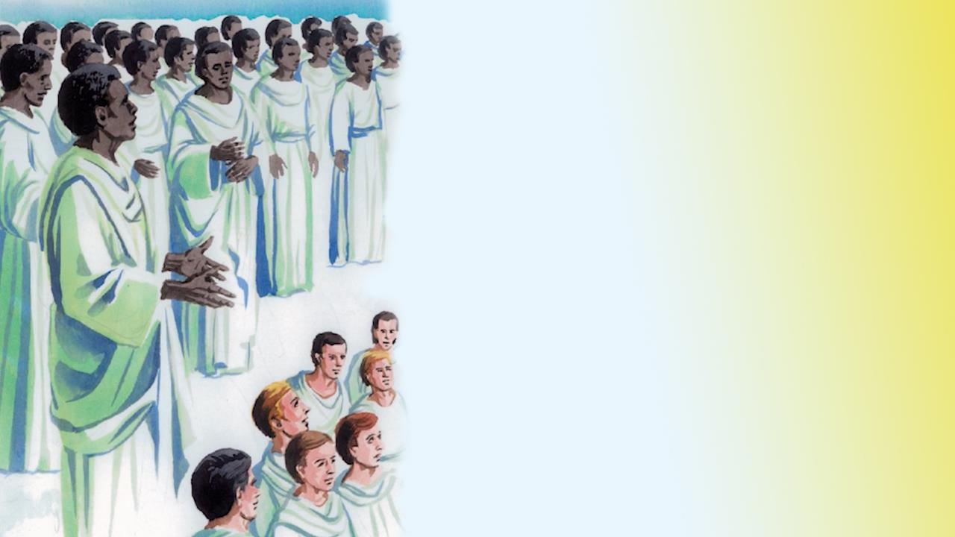
Notes:
Then the righteous will answer Him, ‘Lord, when did we see you hungry and feed you, or thirsty and give you something to drink? When did we see you a stranger and invite you in, or naked and clothe you? When did we see you sick or in prison and visit you?’

Slide 12
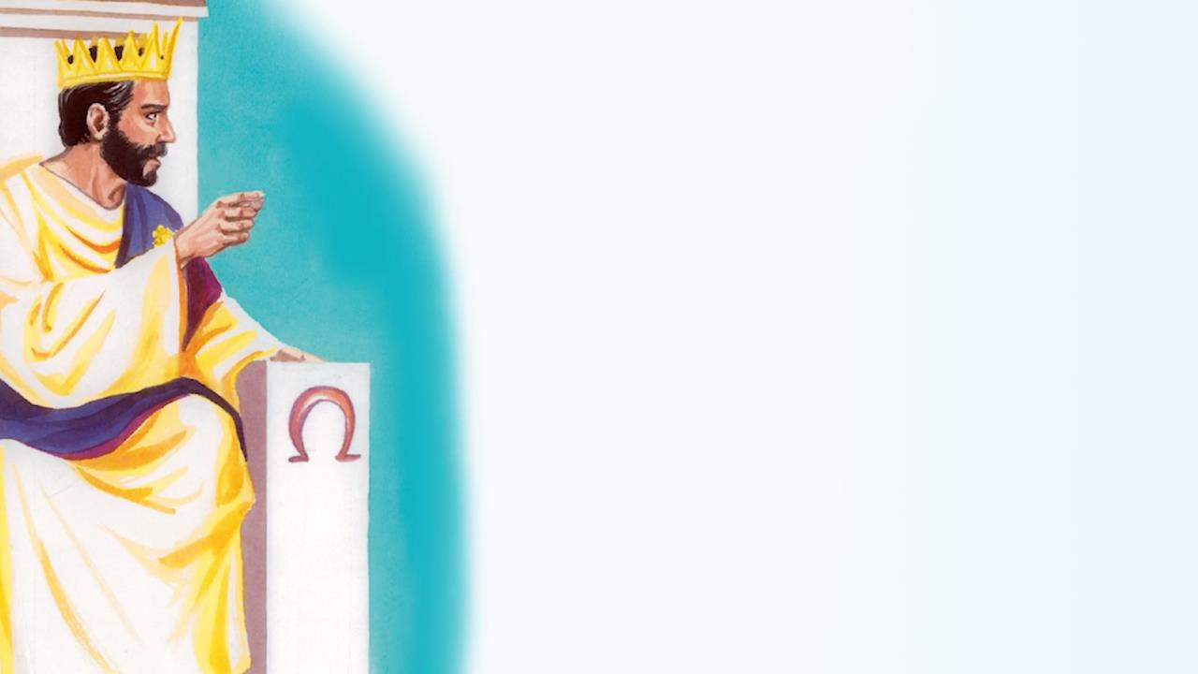
Notes:
Then the King will say to those on His right, ‘Come, you who are blessed by my Father, inherit the kingdom prepared for you from the foundation of the world.

Slide 13
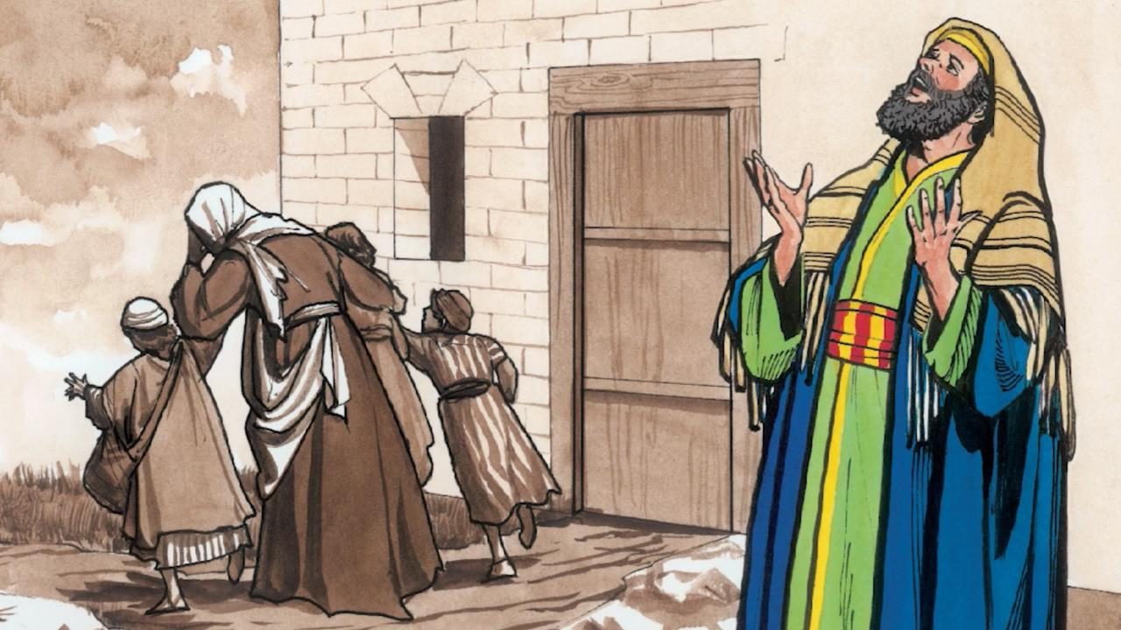
Notes:
‘For I was hungry and you gave me nothing to eat, I was thirsty and you gave me nothing to drink.

Slide 14
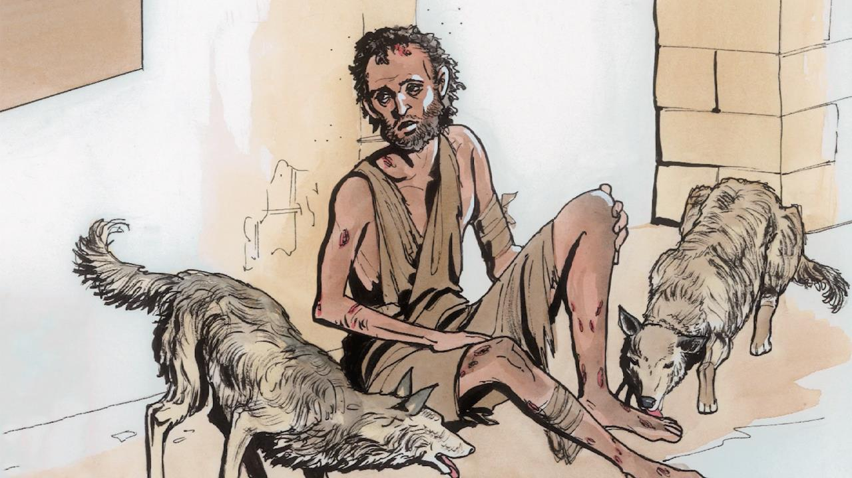
Notes:
‘I was a stranger and you did not receive me as a guest, naked and you did not clothe me, sick and in prison and you did not visit me.”

Slide 15
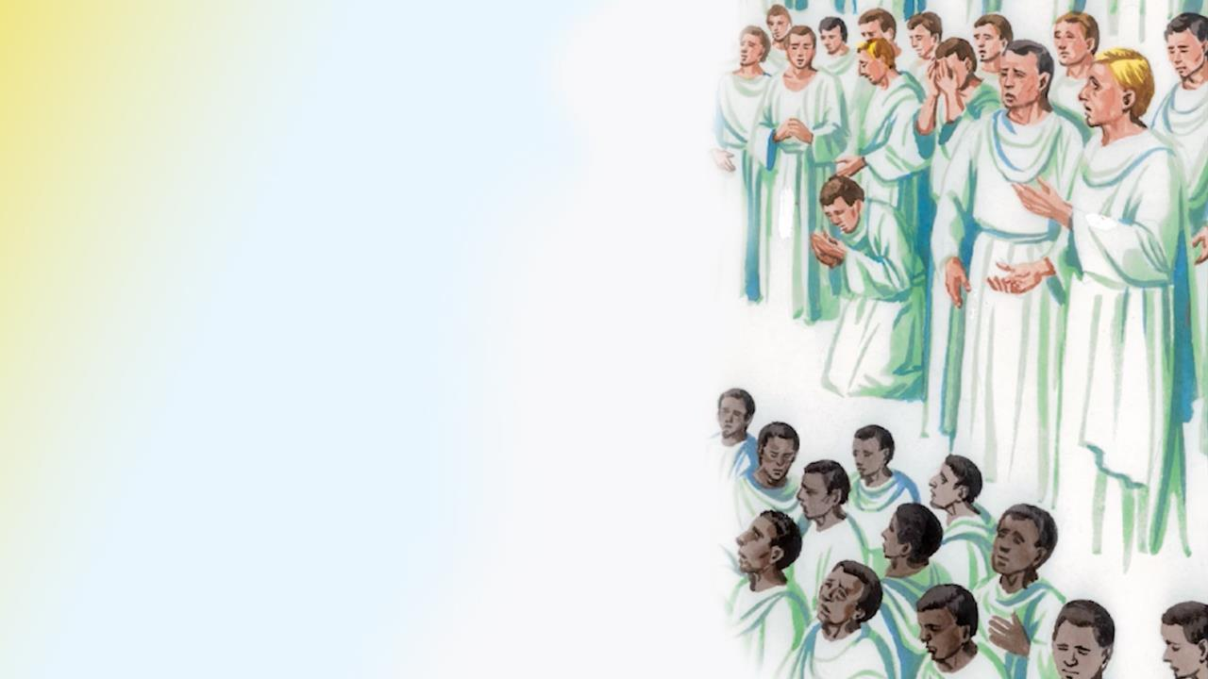
Notes:
‘Then they too will answer, Lord, when did we see you hungry or thirsty or a stranger or naked or sick or in prison, and did not give you whatever you needed?”’

Slide 16
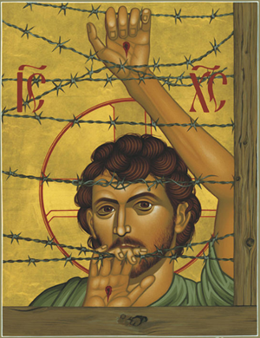
Notes:
God told Moses: ‘But I know that the king of Egypt will not permit you to go, except under compulsion. So I will stretch out My hand and strike Egypt with all My miracles which I shall do in the midst of it; and after that he will let you go.’ Exodus 3:19-20 (NASB)

Slide 17
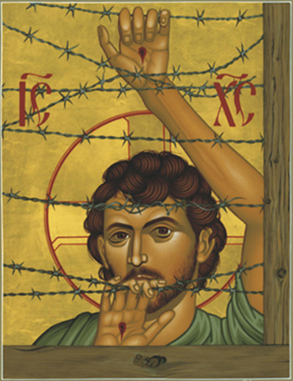
Dear God,
Please remind me that whenever anyone is suffering or in need of kindness,
Jesus is present with them.
Give me the courage to show compassion to those in any kind of need,
especially when I am tempted to blame them
and say that it is their own fault.
Amen
Notes:
Then the Lord said to Moses and Aaron in the land of Egypt, ‘This month shall be the beginning of months for you; it is to be the first month of the year to you.’ Exodus 12:1-2 (NASB). God gave directions to His people through Moses and Aaron so that this last plague would pass over and not harm them. Exodus 12:1-28 (NASB)

