Slide 1

Refugee King

Slide 2

Paddington

Slide 3


Slide 4
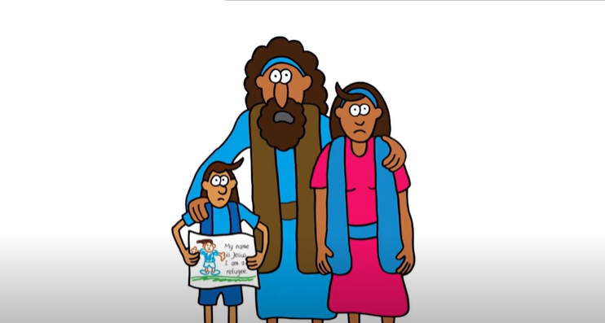
Jesus was a Refugee

Slide 5
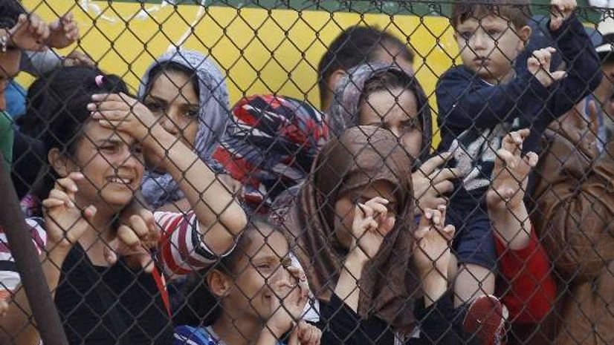

Slide 6
