Slide 1
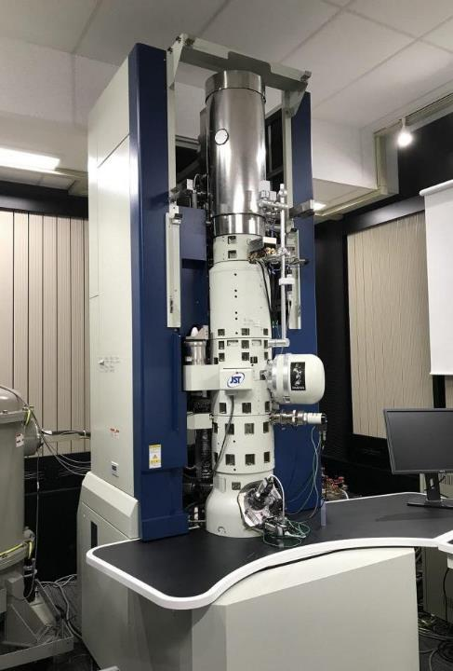

Does anyone know what this is?

Slide 2
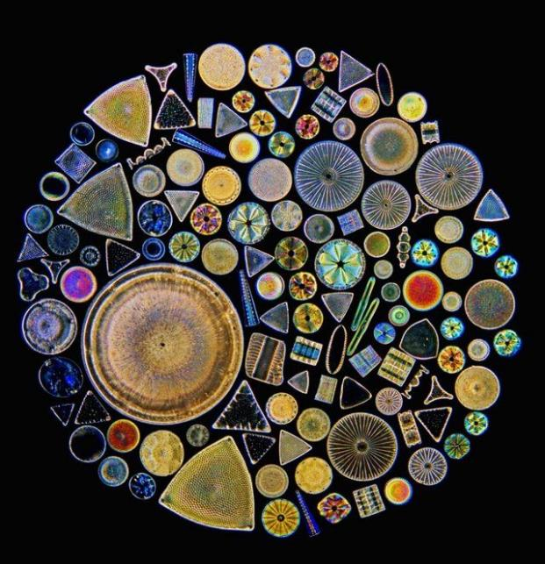

Slide 3

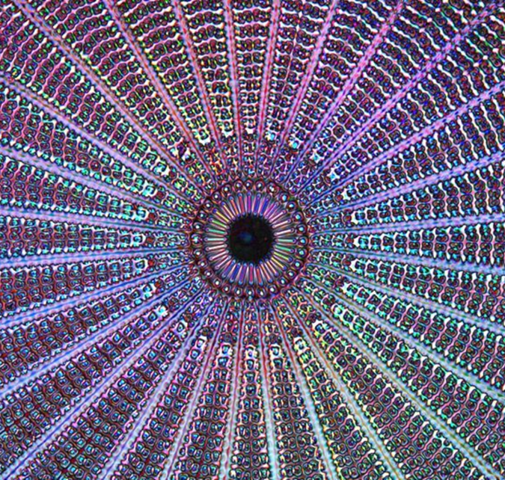

Slide 4
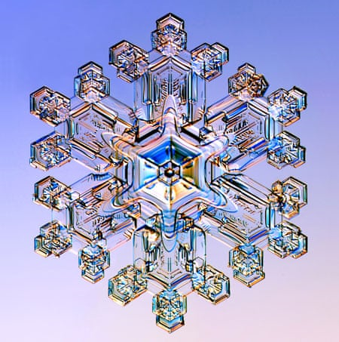
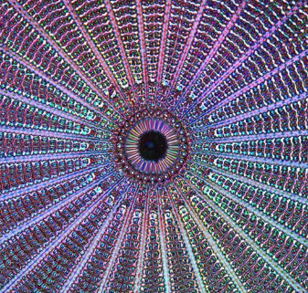

Slide 5
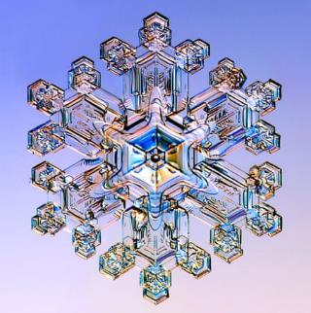
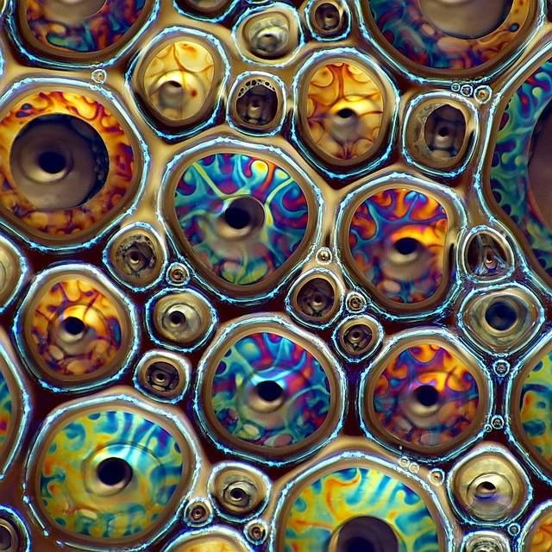

Slide 6
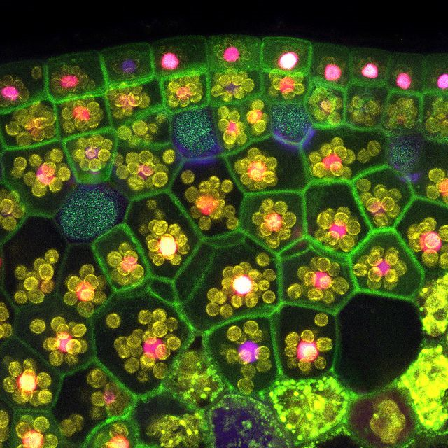
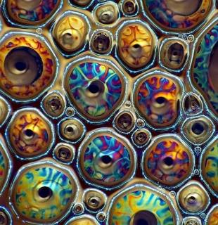

Slide 7
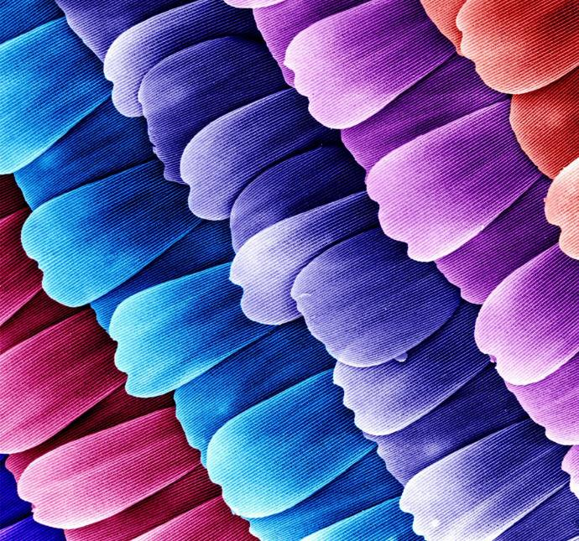
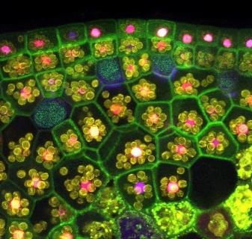

Slide 8


Slide 9
These are all amazing, beautiful images - still part of creation to wonder at but not things we can see naturally.
How about the world around us that we can see and experience everyday…..do we take the time to look and appreciate it?

Slide 10
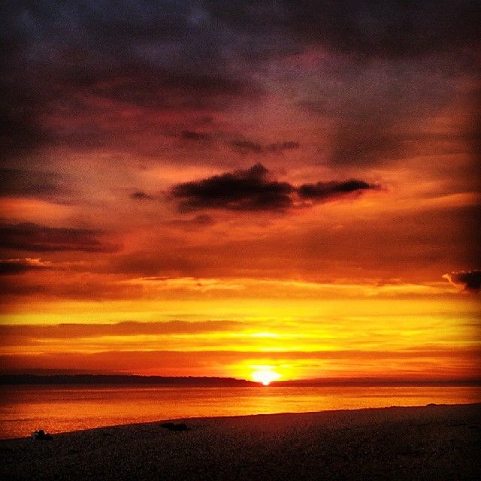

Slide 11

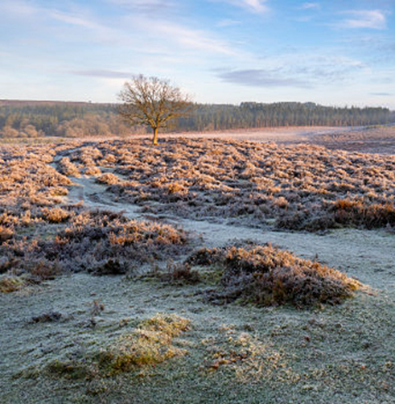

Slide 12

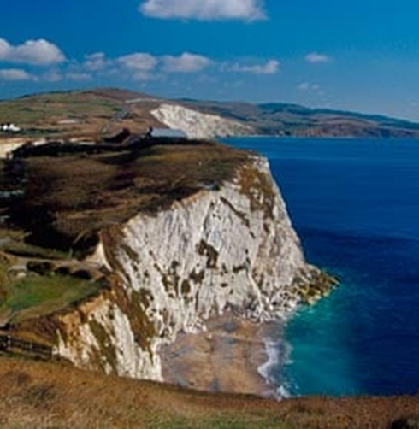

Slide 13
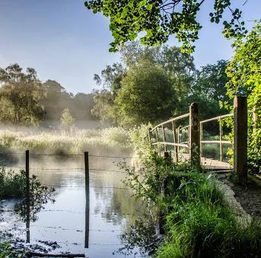
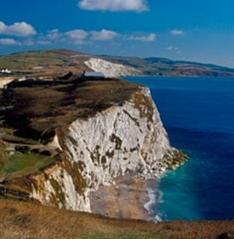

Slide 14
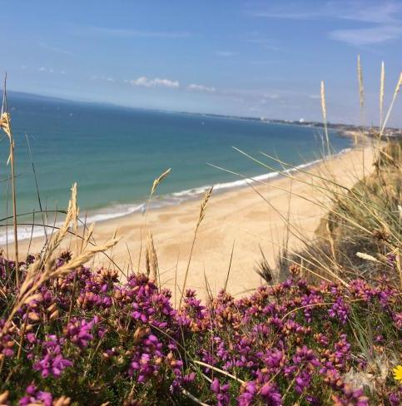
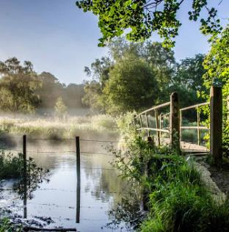

Slide 15
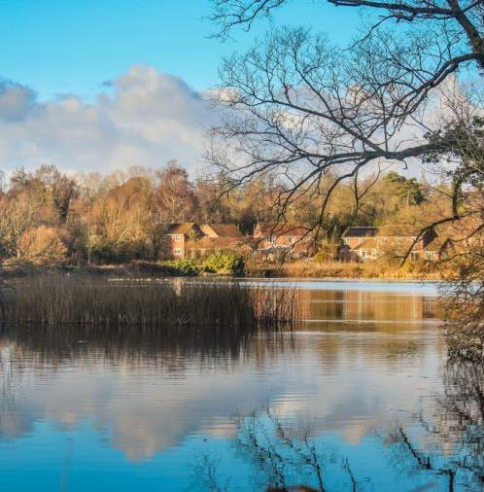


Slide 16



Slide 17
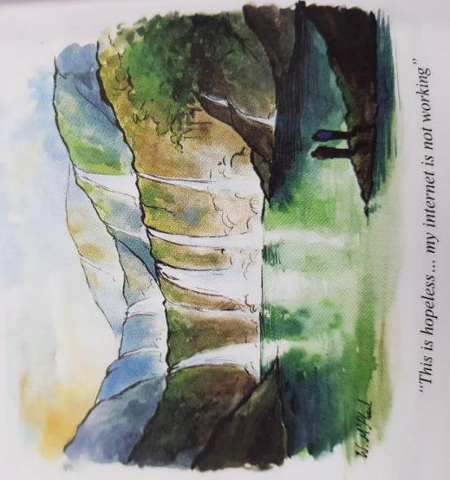

Slide 18
Psalm 10 vs 46 ‘Be still, and know that I am God…’
What beautiful and calming places do you know where you can sit and be still?
Father of Creation
Thank you for our world. Help us to take time to enjoy it and appreciate it’s beauty. And for that beauty to help us experience your presence and peace in our hearts – for us to know what it feels like to be still.
We ask this in Jesus’ Name, Amen.

