Slide 1
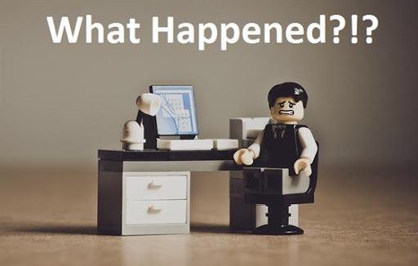

Have you ever been frustrated by a device not working properly?

Slide 2
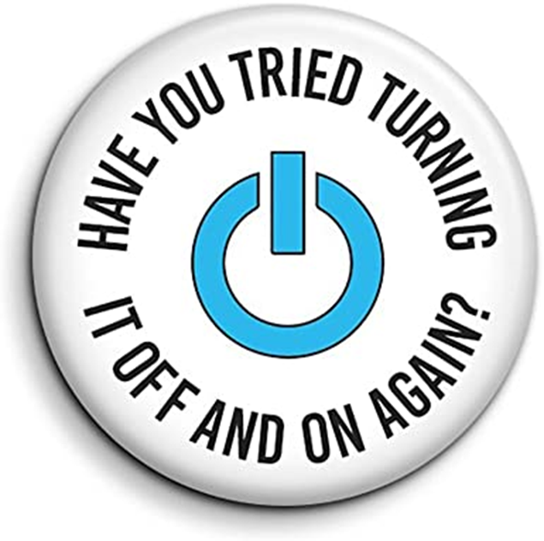

Slide 3
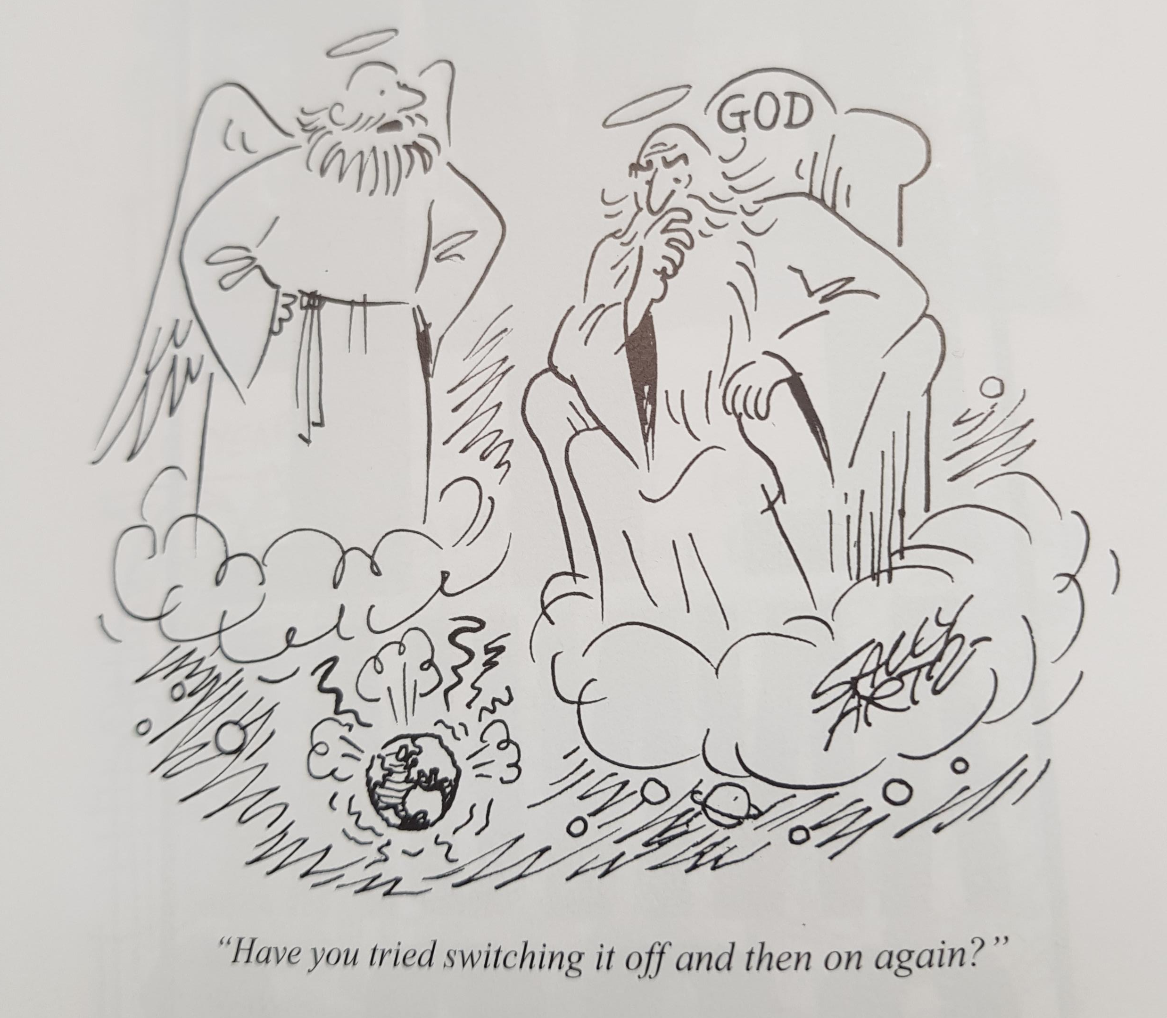
Do you think the world is working in the way that God would like?
Why do you think God might feel like he needs to agree to this suggestion?

Slide 4

How can we play a part in resetting our world for the better?
It starts with us…

Slide 5

Door moments
‘…The Son of Man came not to be served but to serve…’
Matthew 20 vs 28
Stepping out to serve others…

Slide 6
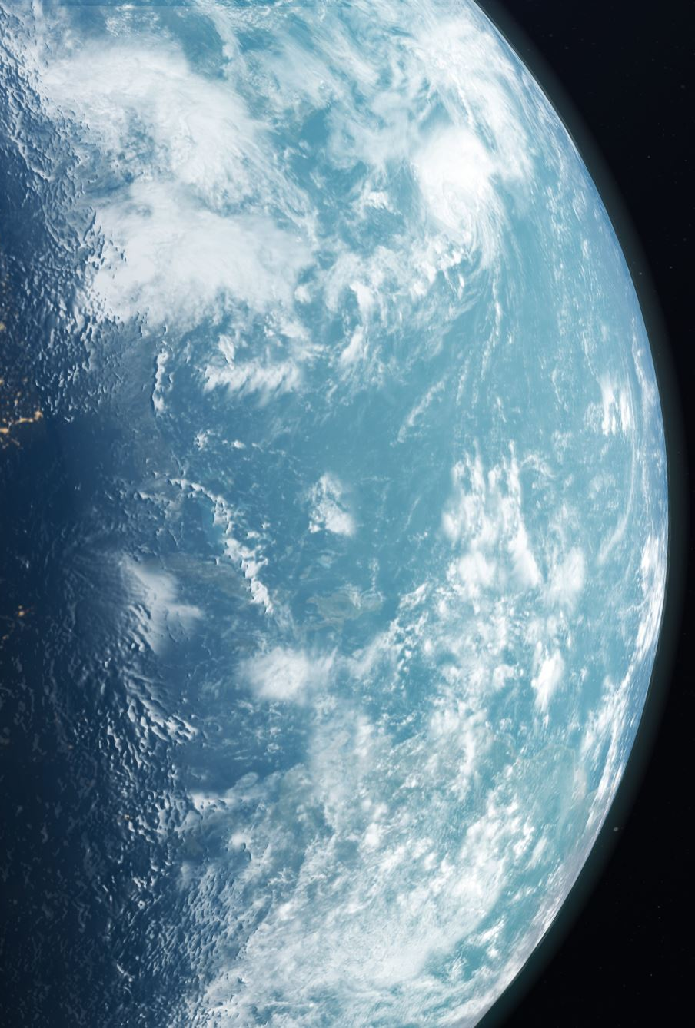
Why should we serve others?
What would the world be like if we all served each other?

Slide 7
Lord of service
Thank you that we are able work with you to share your joy with the world, through serving others.
Help us not take for granted the gift it is to offer others love and hope.
Help us have eyes to see the needs around us and to respond to those needs with joy and enthusiasm.
Thank you for your gift of Jesus, the perfect servant. We ask that you help us to follow His example.
Amen

