Slide 1
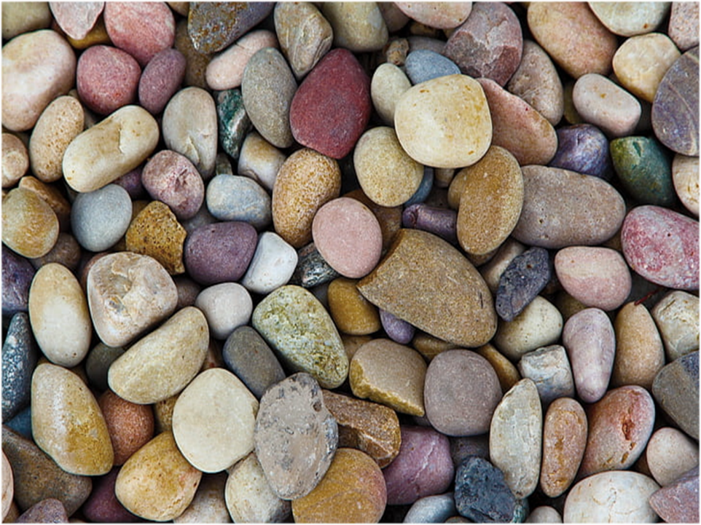
Stones
Notes:
This guided reflection can either be done with the children present; lead over the internet or sent home for children and families to look at for themselves. All of the words are beneath each slide.
If you have time, you might want to paint a stone as an example.

Slide 2
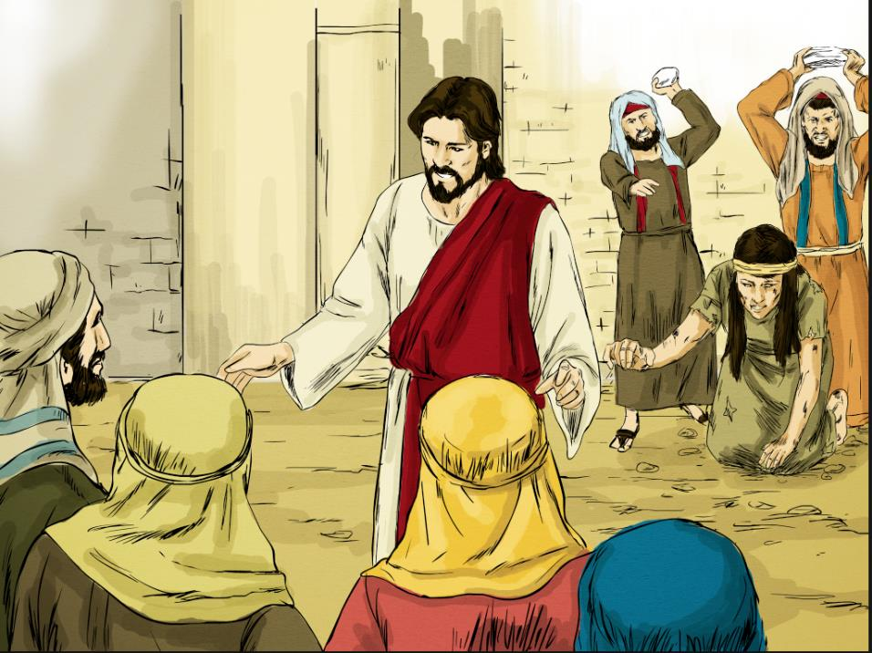
Notes:
One time Jesus was telling people about God’s values when a gang of religious leaders appeared, dragging a woman behind them. The woman had broken the rules and the religious leaders wanted to throw stones at her as a punishment. You may think this is a horrible and frightening idea but believe it or not, there are still parts of the word where things like this happen today.

Slide 3
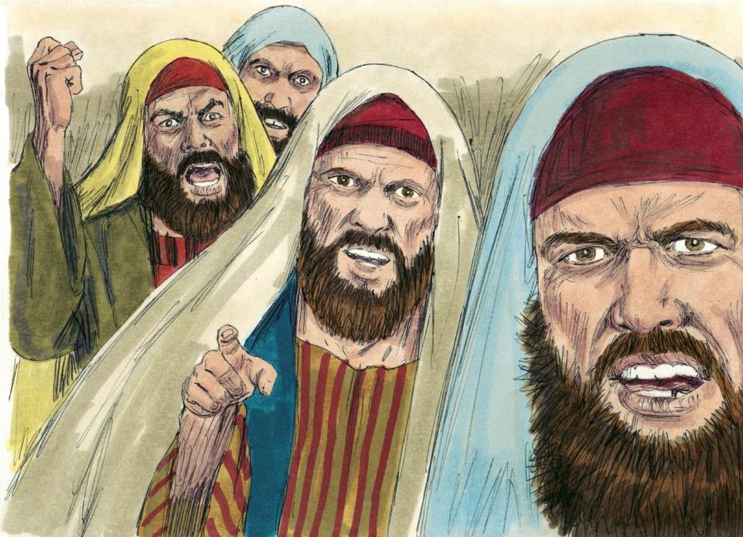
Notes:
The angry gang challenged Jesus and said, ‘God sets the rules and this woman must be punished for breaking the rules. How can you claim to be from God if you don’t believe in punishing people when they break God’s rules? You decide what we should do!’

Slide 4
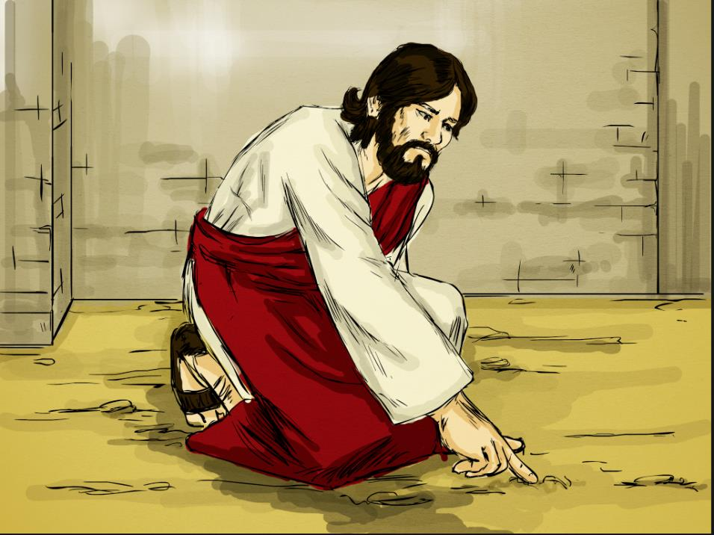
Notes:
Jesus didn’t answer straight away. He just knelt down and wrote on the ground with his finger while he thought about it (no one knows what he wrote – the story leaves it as a mystery). Perhaps he was thinking about how rules can be important but sometimes people use them as an excuse to bully others. Perhaps Jesus knew that the angry gang just wanted to make themselves feel important by punishing someone else. This is called ‘self-righteousness’ – when you try to make yourself feel special by making a big fuss about someone else’s mistakes. Have you ever felt like that – be honest? People sometimes do this towards their brothers and sisters if they have them. We’ve probably all something like this at one time but sometimes, when gangs of people get really filled up with self-righteousness, they can do very bad things.

Slide 5
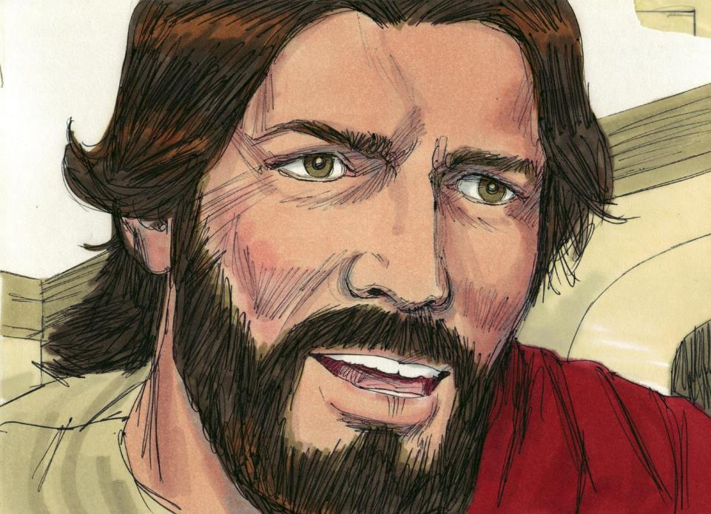
Notes:
After a little while, Jesus stood up and said, ‘Okay, here’s what I think – the one of you who is so perfect that you have never done a wrong thing should be the first one to throw a stone.’

Slide 6
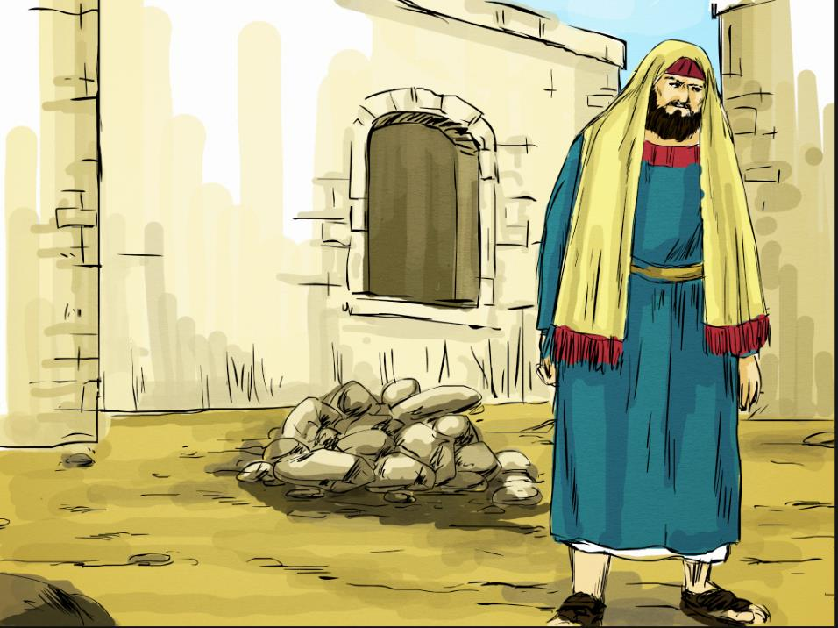
Notes:
One by one, the gang dropped their stones and sulkily walked away.
Why do you think they did this?
What lesson had Jesus taught the gang?

Slide 7
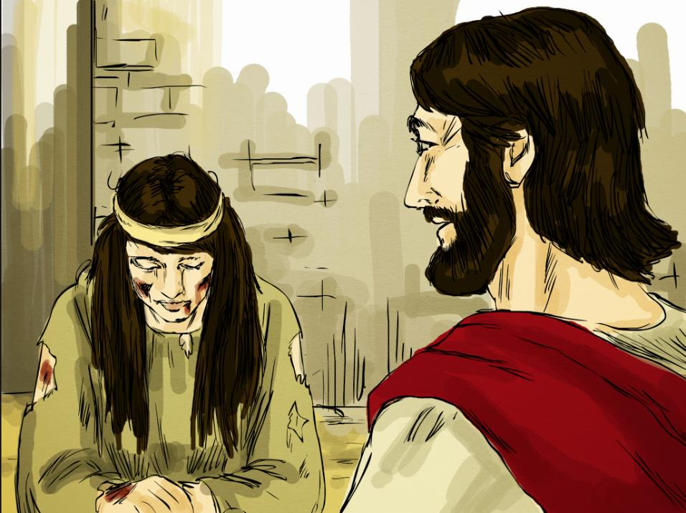
Notes:
When the gang had all gone, Jesus turned to the woman and told her that she was forgiven for breaking the rules and she should try to make a new start.
Jesus knew that God loves all people and that they learn to follow his rules by being shown kindness, not by having rocks thrown at them.

Slide 8
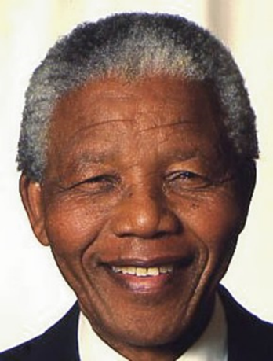
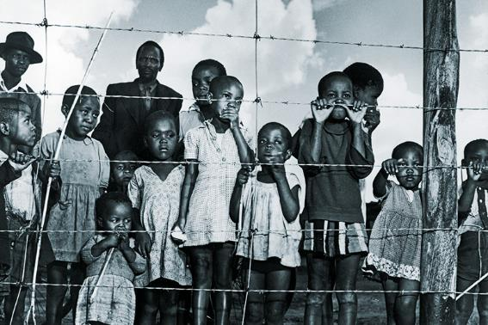
Notes:
Here is a story that has something to do with rocks and stones.
It’s about a famous leader called Nelson Mandela.
Nelson Mandela was born in South Africa in 1918. At that time, the government in South Africa ran a system called ‘apartheid’.
Apartheid is when black people have to live apart from white people. Most black people had no jobs, were very poor and could not vote because of this.

Slide 9
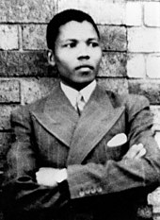
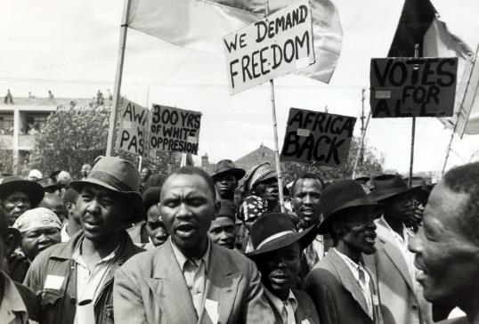
Notes:
Nelson grew up in a village and went away to study law when he was a young man.
He wanted to help free black people from apartheid. In 1962, he was arrested for taking part in protests against apartheid.

Slide 10
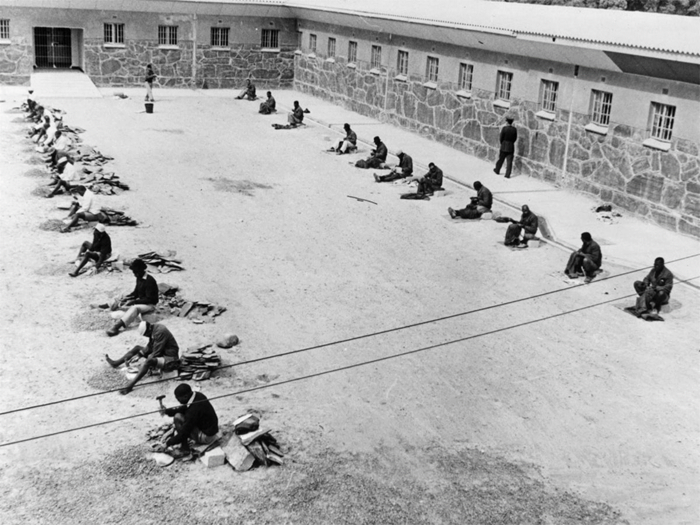
Notes:
Nelson spent 27 years living in a tiny prison cell.
The only time that he was allowed out was when the prisoners would be lined up in the prison yard and made to sit in the hot sun smashing up rocks into small pieces as a punishment.

Slide 11
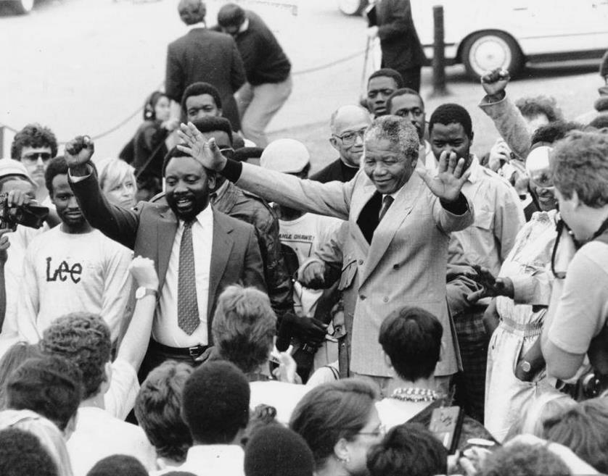
Notes:
Eventually, Nelson Mandela was realised in 1990 after the laws in South Africa had changed.
The white people thought he might be very angry and encourage violence but instead, told everyone that they needed to work together.
He became president of South Africa in 1994 – and black people were allowed to vote for the first time.

Slide 12
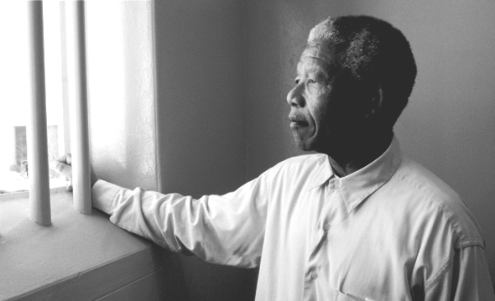
“As I walked out of the door toward the gate that would lead to my freedom, I knew if I didn't leave my bitterness and hatred behind, I'd still be in prison.”
Notes:
This is a famous quote from Nelson Mandela. What do you think it means? How would he still be in prison?

Slide 13
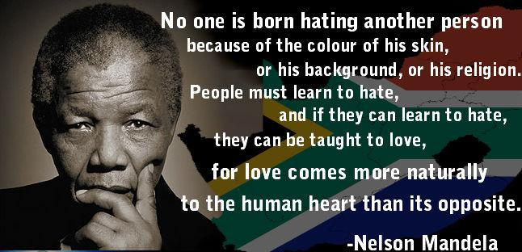
Notes:
Here is another famous quote from Nelson Mandela. Can you think of any connections between what Nelson Mandela said and the first story that we heard about Jesus and the people who wanted to throw stones?

Slide 14
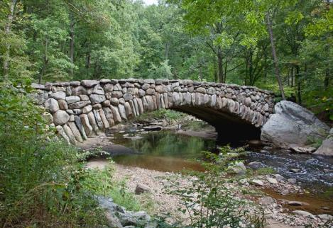


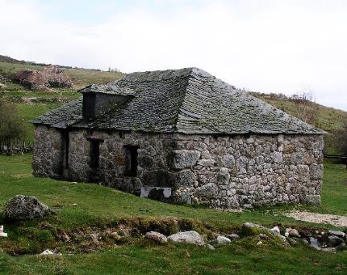
Notes:
Stones can help us to build good things like homes and bridges.
Stones can also be used to hurt people like we heard in those two different stories.

Slide 15
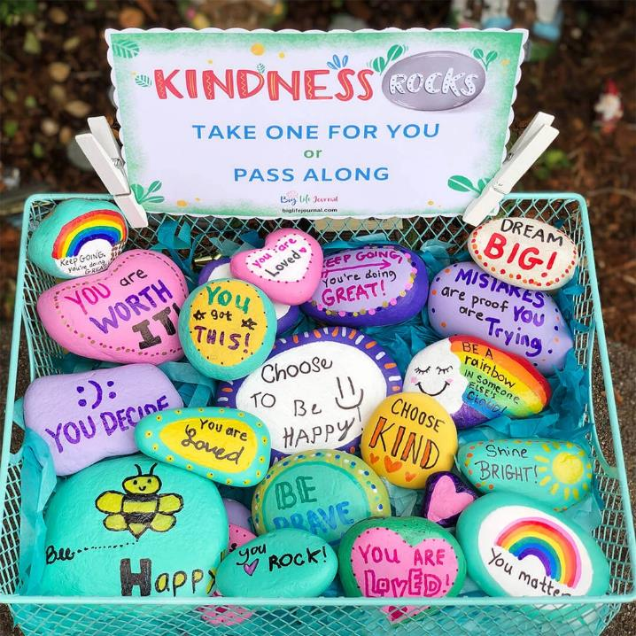
Notes:
In the same way, we can use words of hate to hurt people and crush their feelings.
Or we can use words of love to build them up.
Introduce activity – Children to make their own kindness stone. A basket of these could be put in a place where children can come and exchange the one that they’ve made for one which someone else has made.

Slide 16
God of love,
Help us to have kind hearts and not hearts of stone.
Guide us to use our words with care
So that we can build each other up
And shine your light into the world.
Notes:
Closing Prayer
God of love,
Help us to have kind hearts and not hearts of stone.
Guide us to use our words with care
So that we can build each other up
And shine your light into the world.

