Slide 1


Slide 2
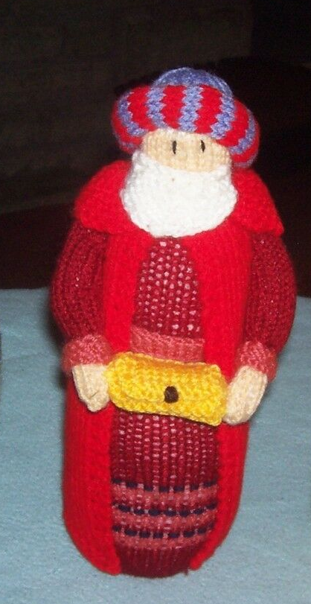

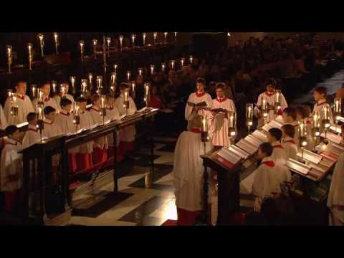
Who do you think this is?
What do you know about them?

Slide 3
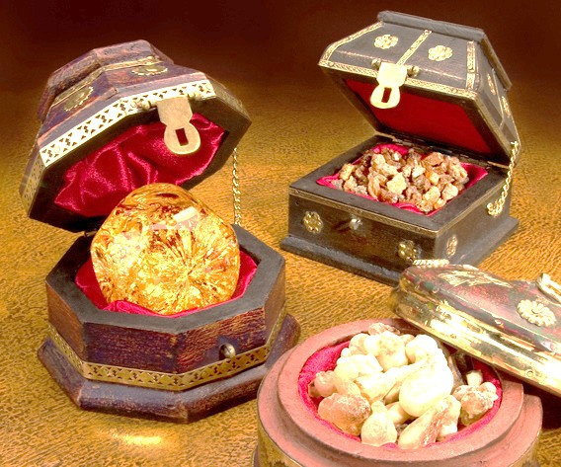

Slide 4
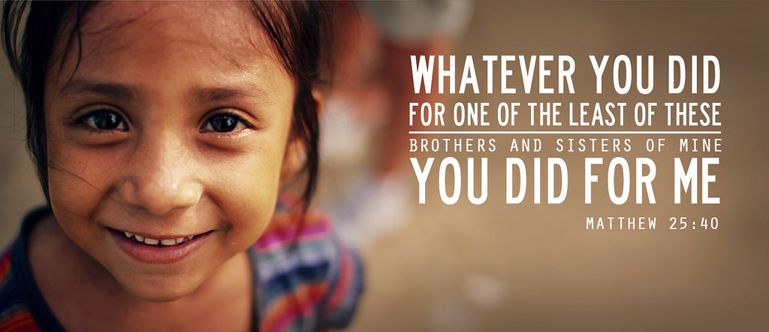

Slide 5
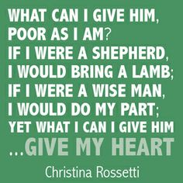
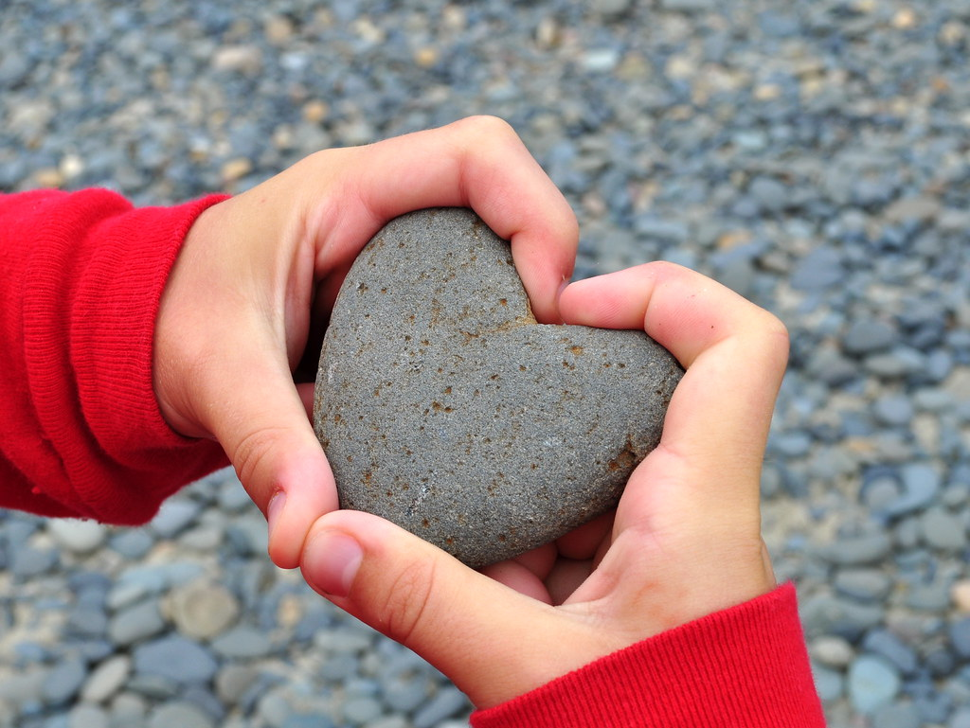

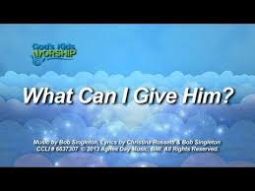

Slide 6
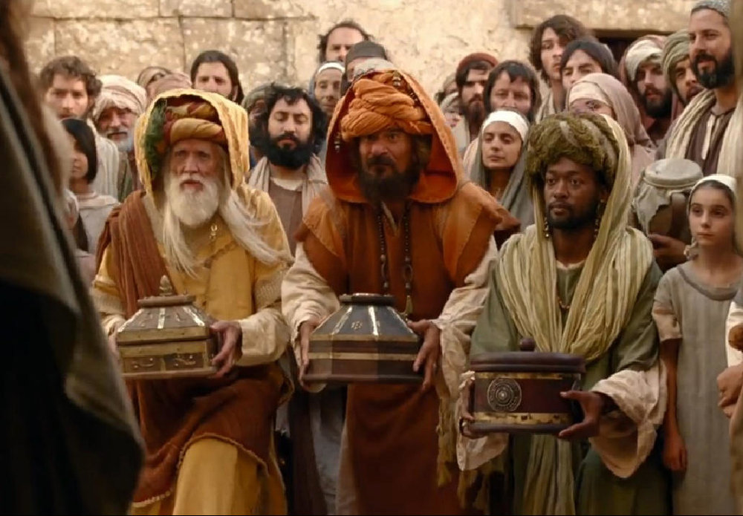
Father God,
Thank you for the story of the wise men who came to visit Jesus.
Thank you that they made the effort to go on a long journey and for their gifts.
Help us to make an effort to show love to other people.
Help us to be generous with our time and energy.
Amen

