Slide 1

OVERVIEW
Information about Simon Says Child Bereavement Support Charity
Online resources
How you can help children

Slide 2
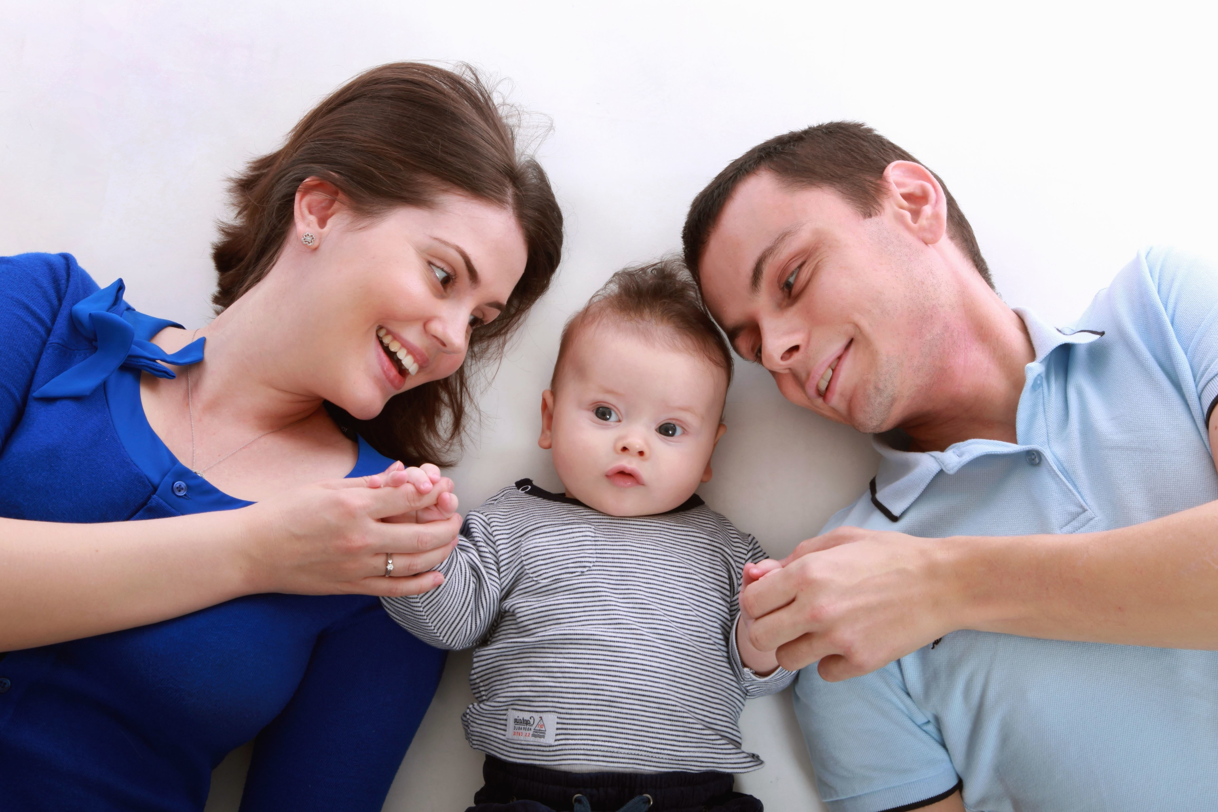

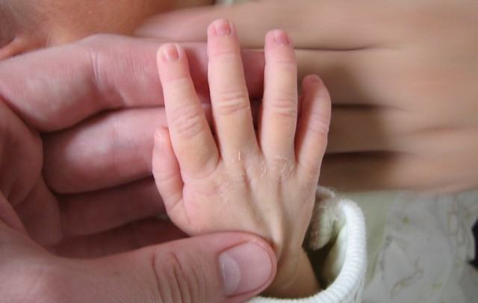
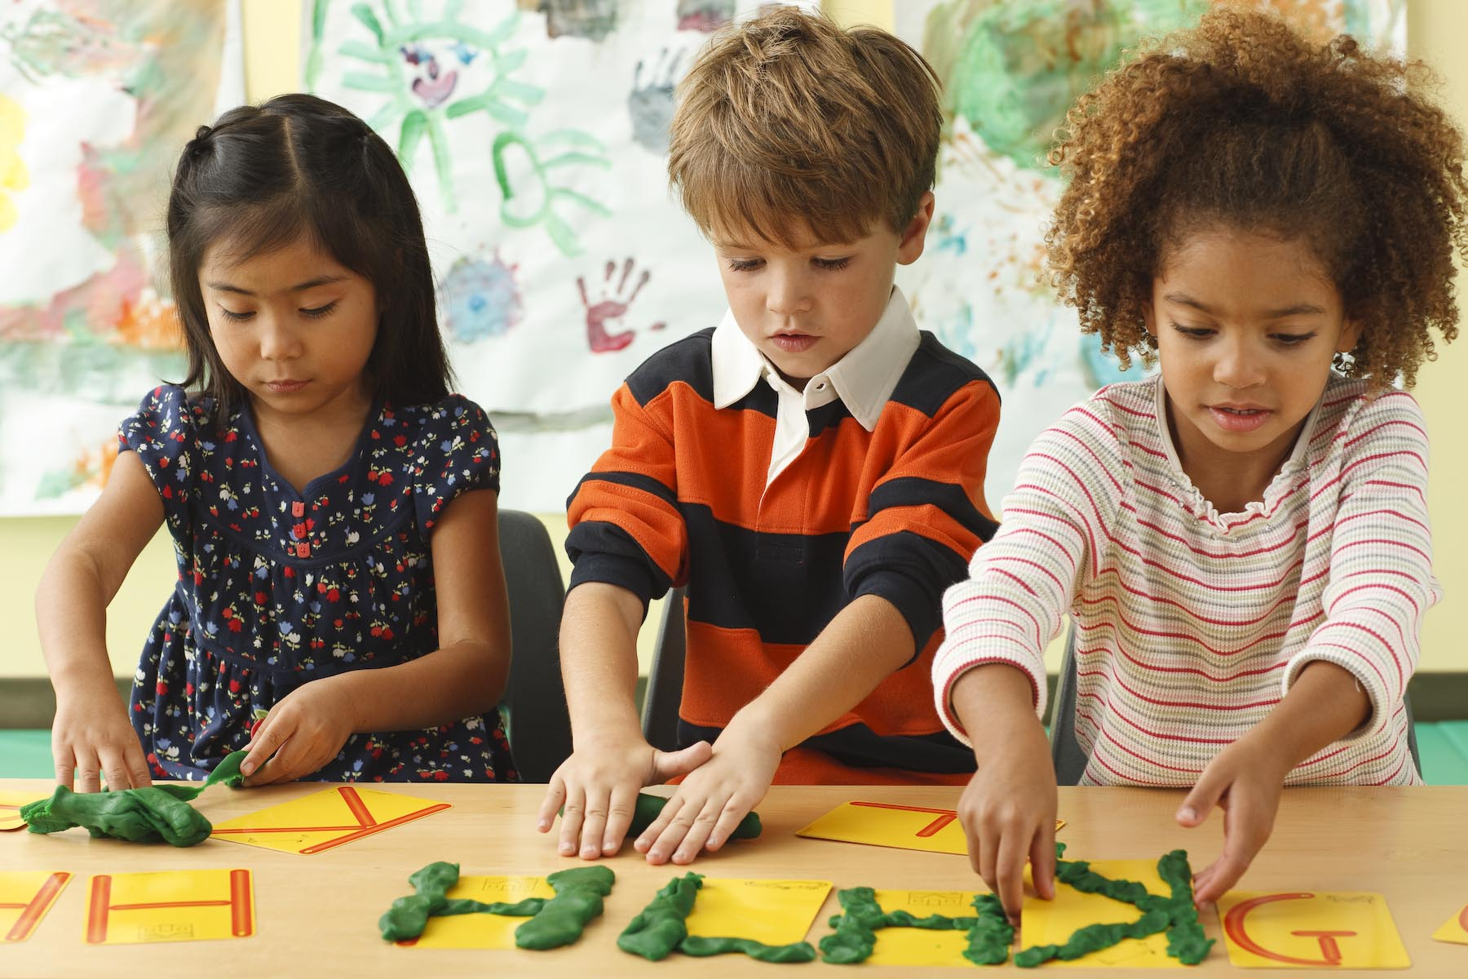
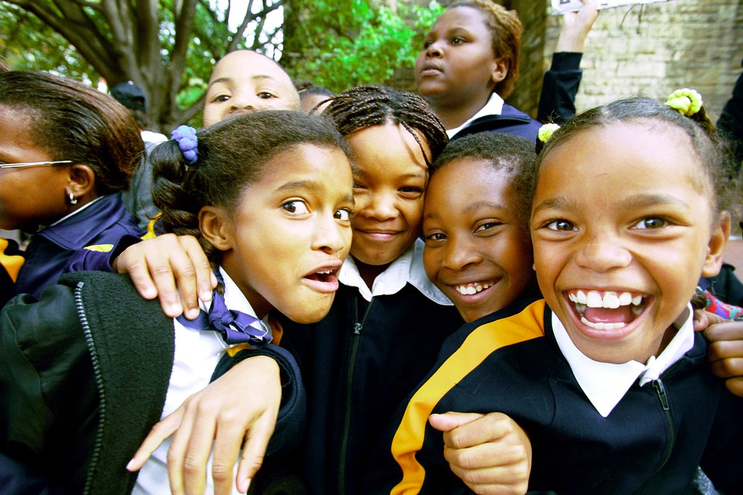
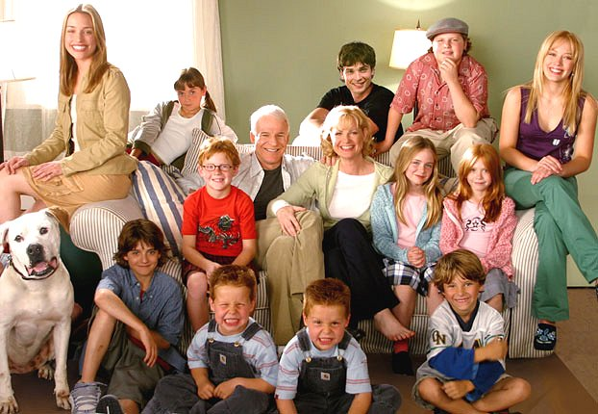
nATIONALLY
Every 22 MINUTES a child in the UK is bereaved of a parent
5821 people died by suicide
That’s around
23,600 a year
66 EVERY DAY
That’s 16
EVERY DAY
Food for thought:
How many bereaved students do you have at your school?
How do you capture this data?
How do you cascade it to staff?
How do you pass it on to the next school?
6608 babies and young children under 5 died
3200 babies were stillborn
*Source: Child Bereavement UK: Office for National Statistics; National Records of Scotland; Northern Ireland Statistics and Research Agency
That’s around
9 babies
EVERY DAY
That’s more than
18 EVERY DAY
7653 babies, children and young people died
869 school aged children died (5-16)
That’s around
21 EVERY DAY
Notes:
When working with people who are grieving, statistics can only paint one part of the picture. They can give some indication of the number of children who experience bereavement each year – and how our services respond. They cannot, of course, begin to describe the huge range of responses and reactions that bereaved people experience.
Based on 2017 statistics
When you apply these statistics to the classroom you are looking at 1 in 29 children is bereaved of a parent before they leave school, this DOES NOT take into consideration any other relationships, when you do this it is much higher and when you include a pet bereavement (often young children’s first experience of death) it is the majority of the class.
With these statistics in mind you DO have bereaved pupils in your school – but how do you know who they are?

Slide 3


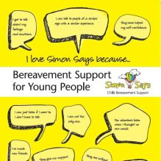

What do we do?
TELEPHONE SUPPORT LINE
Support booklets
023 8064 7550
support schoolS
Support groups
Notes:
We have support group in:
Andover 0-18
Basingstoke 0-18
Chandlers Ford 0-11
Gosport 0-18
New Milton 0-18
Portsmouth 0-18
YPG 11-18
ActiveMe360 Weekly sports group – 4-16 (held in Chandlers Ford)

Slide 4
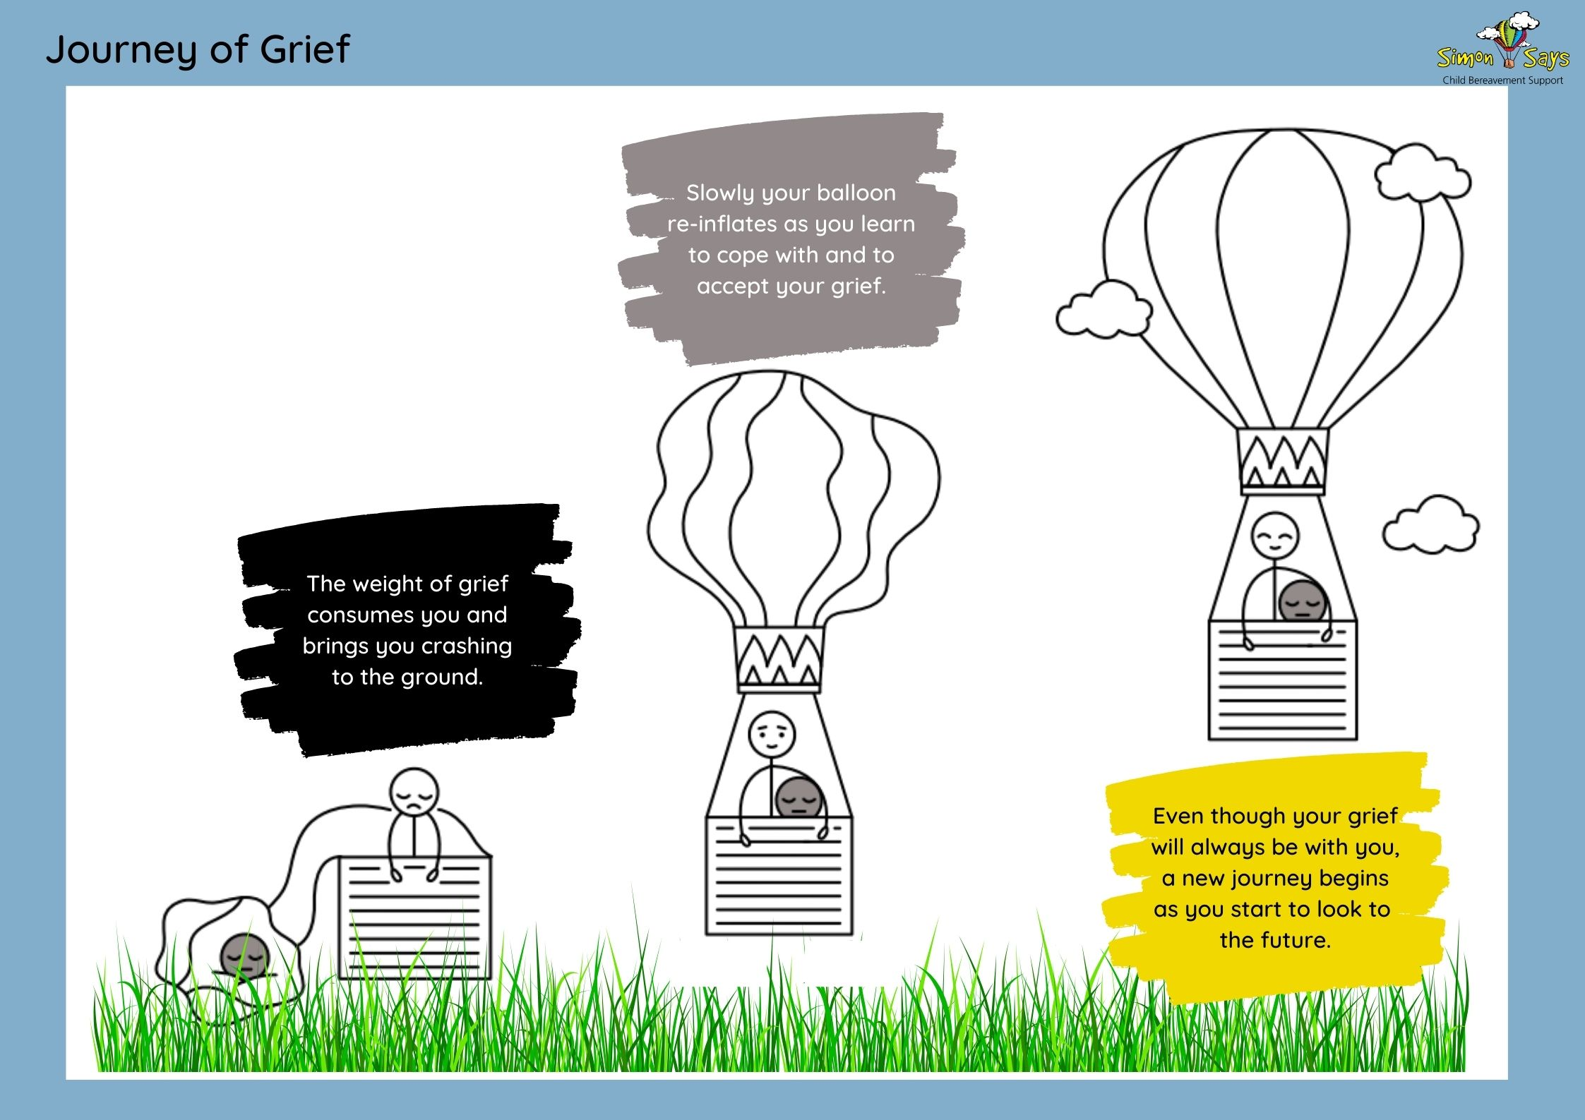
Notes:
At Simon Says we help children to be able to tell their story, to accept their grief, realise there is a future and help them grow into that.
You never get over your loss, you learn how to move on with your new life, it will always be a part of you and will shape the new you.
One of the biggest problems with grief is you cannot take away the pain, humans by nature are often fixers and this is something you cannot fix but instead you can help the young people by joining them on their journey so they know they are not alone.

Slide 5
Talk about it!
Let’s equip our children & young people with the skills and knowledge they need, so they know how to cope when they encounter bereavement.
Be prepared!
Let’s plan and equip our staff and school community to know how to respond to a bereavement when it happens.
Notes:
There are 2 key things we can do to help children:
1) The first is Educate them. As a society rarely do we talk about the topic of death and dying, we do not model how to have those difficult conversations so when we encounter death we often do not know what to do and what to say. Death is the one thing we can be guaranteed of, we are all born and we will all die. We need to normalise death and support children and young people to talk about the topic in a natural and organic way, we need to normalise death.
2) The second is to be prepared for when we encounter a death – that may be of a parent, staff, pupil or a key member of the local community. Every school has a fire evacuation plan to look after the physical wellbeing of the school community in a time of crisis but few have needed to action it. So why do schools not have a bereavement plan in place to look after the emotional wellbeing of the school community? If you have already planned how you are going to respond as a school when you are in a time of crisis it will be so much easier than trying to navigate and make decisions when you are in shock and emotional.

Slide 6
How to Create a Whole school approach
Bereavement Policy – It ideally should outline your schools attitude towards bereavement, the support you will put in place to help children gain an understanding of this topic AND how you will support your bereaved families
Ensuring staff feel comfortable with the content of lessons and know who to turn to if they do not.
Highlight areas of the curriculum you CURRENTLY teach where you touch upon death but do NOT use this is an opportunity to teach and talk about bereavement
Communicate with parents BEFORE lessons are taught so they have the opportunity to raise questions with you and talk through any concerns they may have. Consider holding a parents information evening or inviting Simon Says to attend a parents evening/open day/hold a fund raising event…
*bereavement-policy-guidelines-2020-final-3.pd*

Slide 7
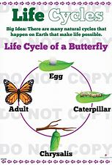
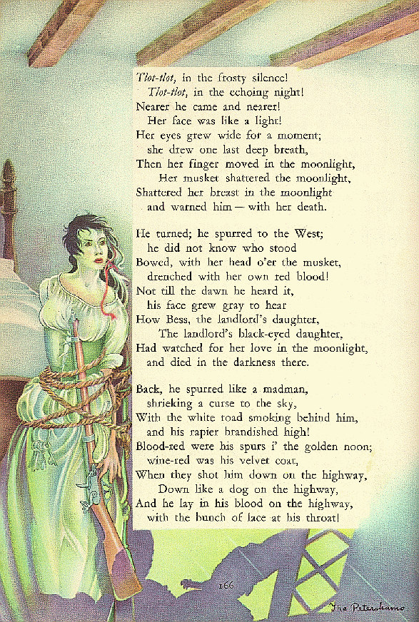

Consider your curriculum
Key Stage 1 | Key Stage 2
Dead or alive? | Death is a natural part of life
Death is normal and natural | Feelings you may have when a loved one dies
Encountering grief | Big feelings and looking after yourself
Funerals and saying goodbye | What are you going to achieve with your life?
Feeling connected | Funerals, coffins and customs
 | Memories
When you teach about life cycles - Do you look at life spans and explore the concept all living things die?
When you study the Highway Man – Do you talk about death and suicide?
Notes:
Lessons for Key Stage 1 and 2 are designed to fit in with and alongside the curriculum you currently study within school. Areas where the topic of death, dying and bereavement naturally occur but at present these are not used to extend children's learning and understanding in this direction.
For example in Key Stage 1 you may explore the life cycle of an animal but this is an ideal opportunity to introduce the concept of life spans – that everything that is living will at some point die, death is normal and natural, living things are born they die and they have a lifespan in between but this is different for insects and animals; some live for days where as others live for 100s of years and humans are somewhere in between), giving them a chance to depict their life story so far leaving pages for the story yet to be written and reassuring most of us live to be old and wrinkly!!
In Key Stage 2 you will probably explore topics such as the Titanic, World Wars, Romeo and Juliet or look at the poem The Highway man but do you then use these as opportunities to think about the feelings you may go through when someone you love dies or explore the fact that the heroine in The Highway Man and Juliet sacrifices themselves and for love – is this not SUICIDE!! Soldiers killing each other in wars – is this not MURDER?! These are great opportunities to get the children thinking about, discussing and exploring some BIG Questions in a safe and secure environment – like: Is anything worth dying for? Can death ever be happy? Is murder every ok? Lots of these question they will explore do not necessarily have an cut and dry answer, there will not necessarily be a right or wrong but they are meant to be thought provoking and allow children to talk about the bereavement related issues. They would then move on to looking at learning different coping strategies they can draw on when they encounter big feelings they do not know what to do with.
GO TO OUR WEBSITE TO SHOW RESOURCES AVAILABLE
https://www.simonsays.org.uk/covid-19-support/
https://www.simonsays.org.uk/information-for-schools-may-20/

Slide 8

Support we offer
Advice and guidance on individual cases – 02380 647550 or education@simonsays.org.uk
Monthly support groups and weekly ActiveMe360 club
Resources on our website under the Education Tab:
- Bereavement policy and Guidelines Document
- Primary School Resource Guide – a guide to help you set up a school bereavement support group (and one for Secondary schools)
- EYFS, Key Stage 1 & Key Stage 2 Lesson Plans
COVID resources on our website, including a COVID support group guide
Assemblies and workshops for pupils
Bereavement and Loss training for schools
Notes:
If you remember the video from earlier when it talked about being bullied and people being unkind – this is unfortunately NOT uncommon and we hear many stories. In our experience it is often as a result of children and young people NOT knowing what to do or what to say to a person who has been bereaved
SO PLEASE invite us in to do an assembly or workshops with your students – no charge but PLEASE donate funds to us as a result of your next fundraising event
You could even share the funds between Simon Says and the new bereavement support group you are now going to set up ☺

Slide 9






Thank you
023 8064 7550
www.simonsays.org.uk
simon says child bereavement support
simonsayscbs
SimonSaysCBS
simon_sayscbs

