Slide 1
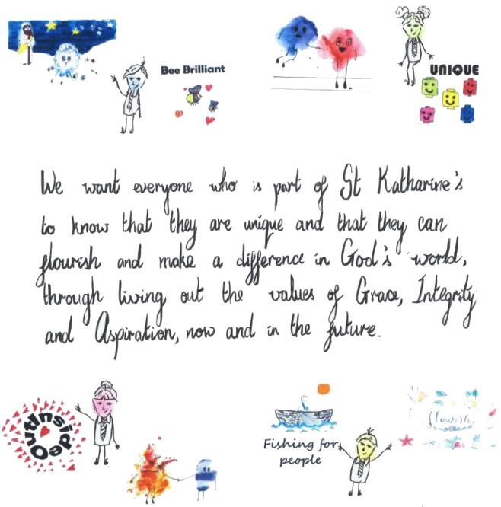

Slide 2




Slide 3
Adoptive parent group feedback
Do not shame, eg leaving out of group activity/sitting at side for all to see; going down the rainbow or loss of reward time
Meet parents to discuss background and useful info – opportunity to reflect and review as they move through school
Curriculum hotspots through year, eg PSHE – who do I look like?
How is adoption taught and how is it placed in the context of other types of families?

Slide 4
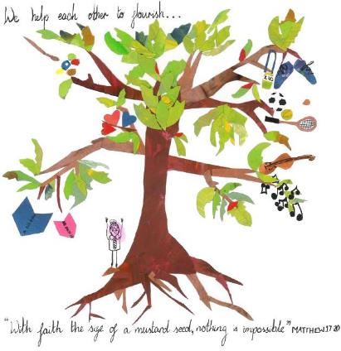
Getting it right for all children
Adoption-friendly school
Trauma
Attachment
Culture, understanding
Parents
Whole school approach – all adults

Slide 5
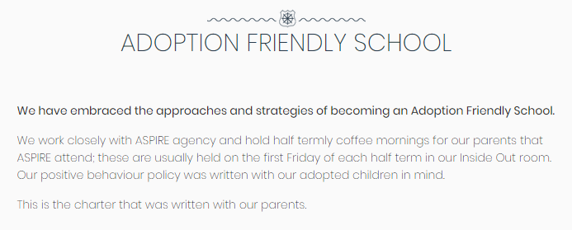
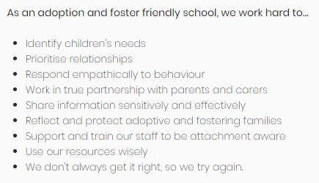

Slide 6
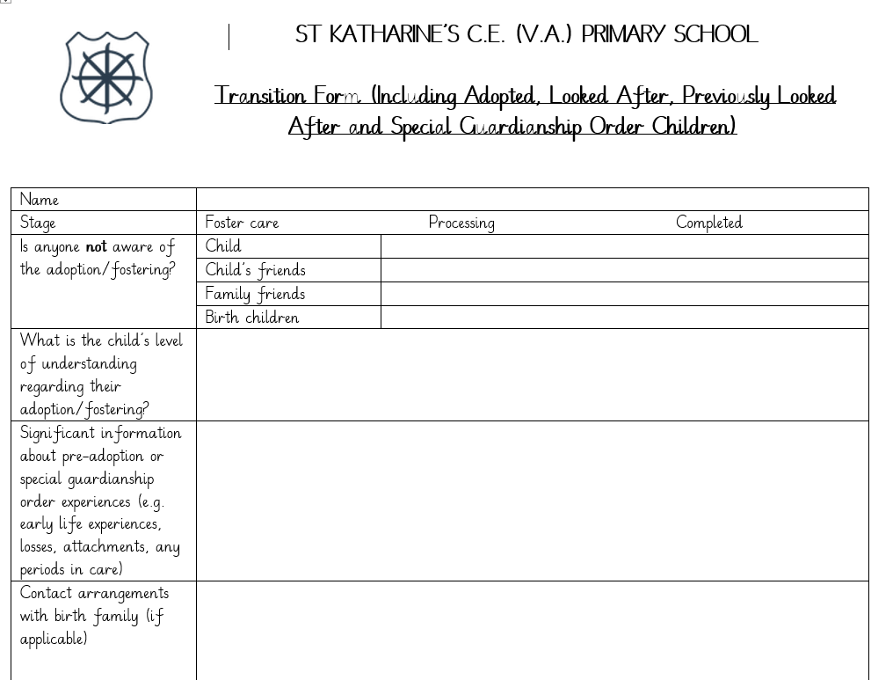

Slide 7
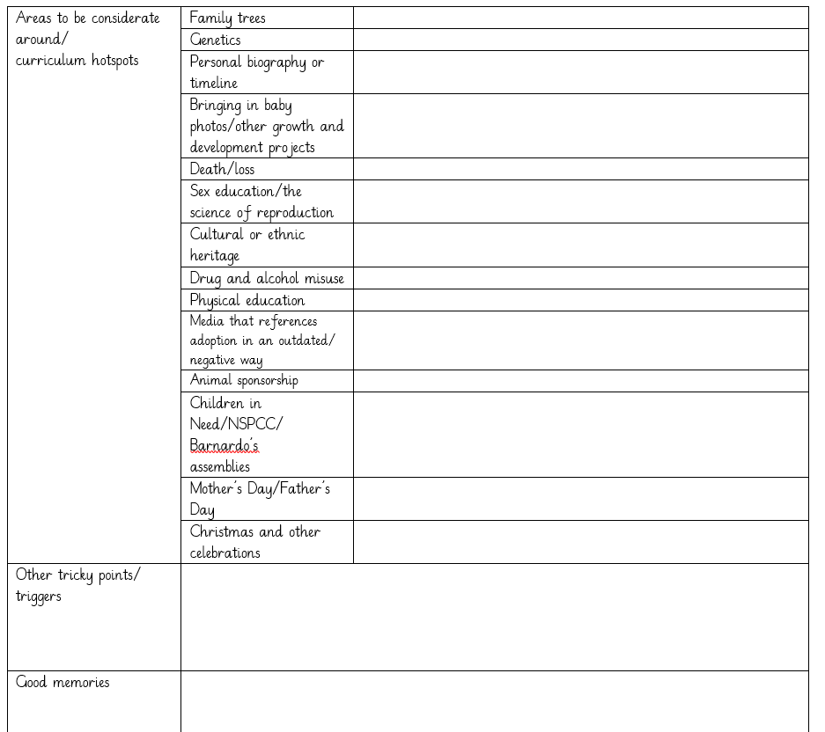

Slide 8
Rethinking behaviour management
Behaviour systems and charts on the wall can feel like public shaming
Time out or taking away from the class can send children deeper into a stress response – can recreate early trauma – they need an adult by their side

Slide 9
Behaviour as communication
Behaviour… | that may be expressing .. (not in order)
Continual talking & noises | I don’t feel safe
Not sitting still/getting up | I don’t trust you
Hurting others | I feel rubbish/stupid
Taking things | I am overwhelmed
Anger outbursts | This reminds me of the past
Controlling situations | I want you to like me
Telling lies | I need to protect myself

Slide 10
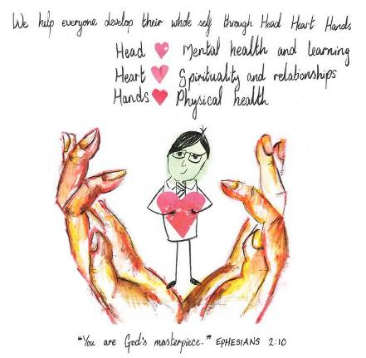
Head, Heart, Hands
If your default response to behaviour that is beyond the normal range is empathetic, kind and keen to understand what is being communicated, you will never go far wrong. Your knowledge of the person is more important than your knowledge of the label.” (Paul Dix)

Slide 11
Sanctions
“Heavy sanctions meet the needs of some adults…but they rarely meet the needs of the child.”
Paul Dix

Slide 12
What’s in | What’s out
Rainbow recognition EY – yr2 | Moving down the rainbow or onto the raindrop
Recognition boards yr3 - 6 | House points Clouds, raindrop, names on board
Using other recognition strategies – in the moment
Head, Heart, Hands clubs | R and R time (Rights and Responsibity time – like Golden Time)
Steps to support positive behaviour/repair time | Loss of sparkle time or R and R time

Slide 13
What can we do?
Know our adopted children and adoptive parents - they are all different and have different needs
Prioritise relationships
All adults – the atmosphere created by how we speak to and relate to children – not just adopted children – and to each other, as adults

Slide 14
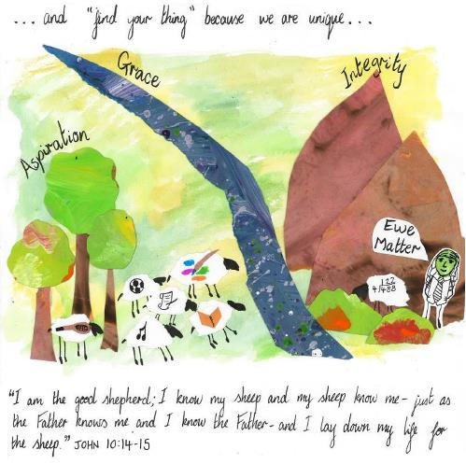
‘Find the joy’ with the child – what will they allow themselves to take joy in? How do they express that joy?

