Slide 1
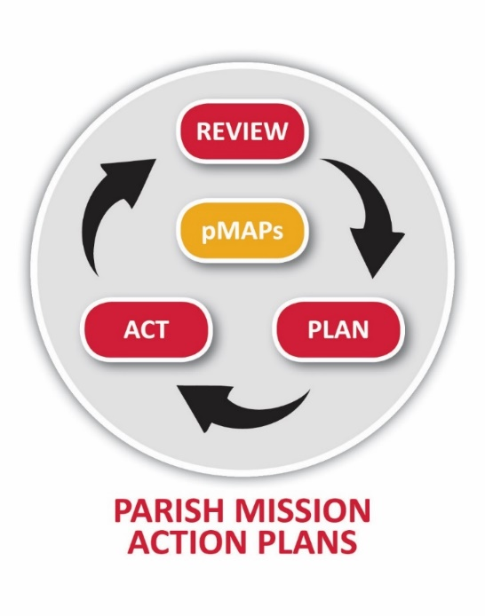
pMAP19

Slide 2


Slide 3
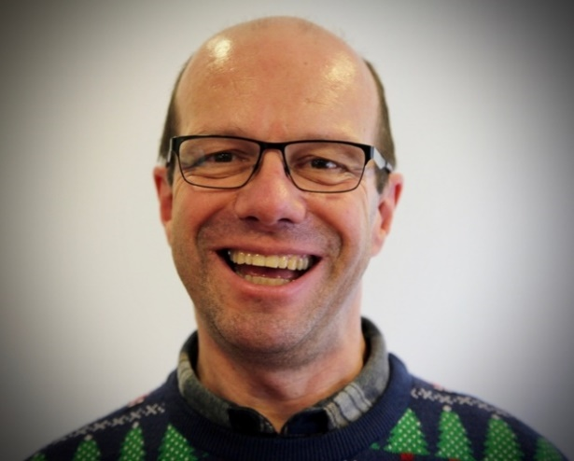
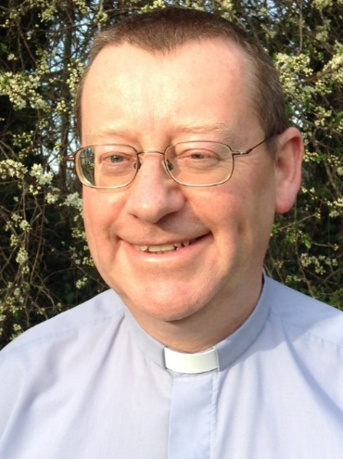
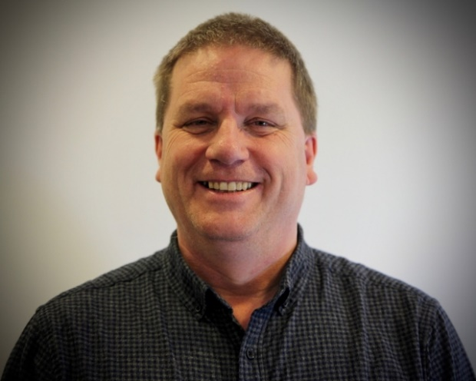

Slide 4
To help you create your pMAP
Understand what the pMAP19 process is
Recognise the resources available
Grasp the timetable
Connect with the diocesan strategy
Engage with some of the issues for the church today

Slide 5
Timetable
  7.30 Welcome and opening prayer
  What is the Diocesan Strategy?
  Why Re-imagine the church?
  What is the pMAP19 process?
  8.15 Workshops
  8.45 FAQs
  8.55 Prayer
  9.00 End

Slide 6
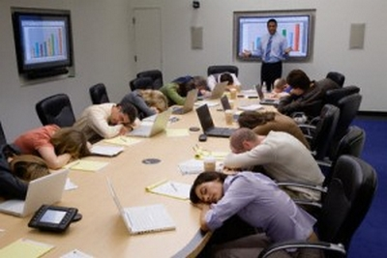
Just a reminder, our strategy is…

Slide 7
Our Vision
Living the Mission of Jesus
In 3 dimensions:
Passionate personal spirituality
Pioneering faith communities
Prophetic global citizens

Slide 8
4 Strategic Priorities
Under God, delighting in His grace and rooted in the Diocesan rule of life, we will be a Diocese in which:
We grow authentic disciples
We re-imagine the Church
We are agents of social transformation
We belong together in Christ

Slide 9
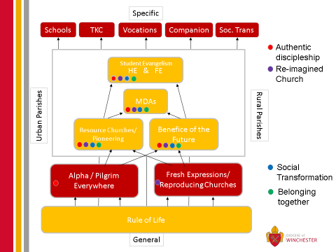
12 Mission Commitments

Slide 10
Mission Action Plans
pMAP
dMAP
aMAP

Slide 11
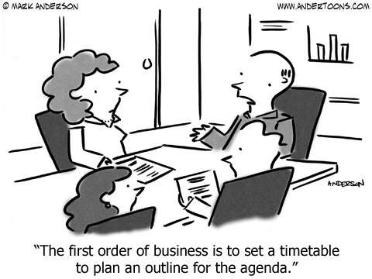

Slide 12
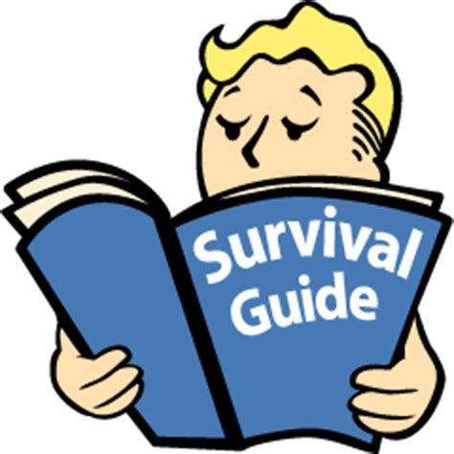

Slide 13
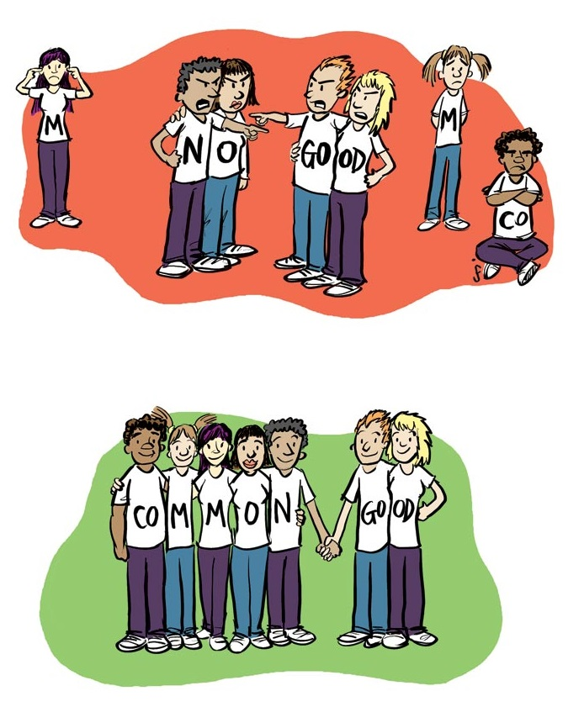
Sustainable Growth for the Common Good

Slide 14
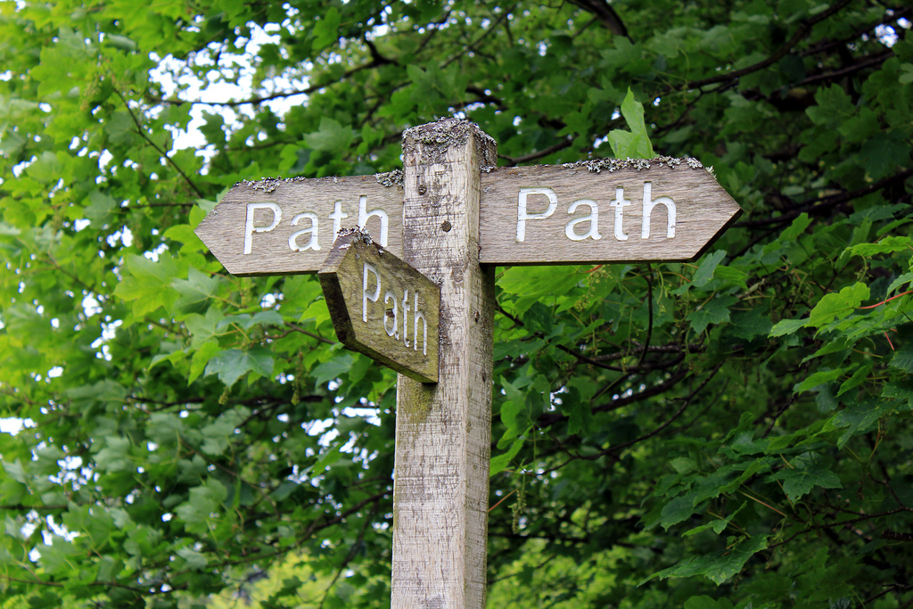
Discernment

Slide 15
Jesus
“The Son can do nothing on his own, but only what he sees the Father doing; for whatever the Father does, the Son does likewise.”
(John 15:19)

Slide 16

Discipleship is following Christ into participation in God’s mission in the world in the power of the Spirit.
The key task of missional church practice is ‘the discipline of spiritual discernment’.

Slide 17
Led by the Holy Spirit …
Christians in Antioch send Paul and Barnabas on mission
Paul and his team are guided where go
The Jerusalem Church recognises God’s mission includes the Gentiles (Acts 15)

Slide 18

What is God doing in your area of his mission?

Slide 19
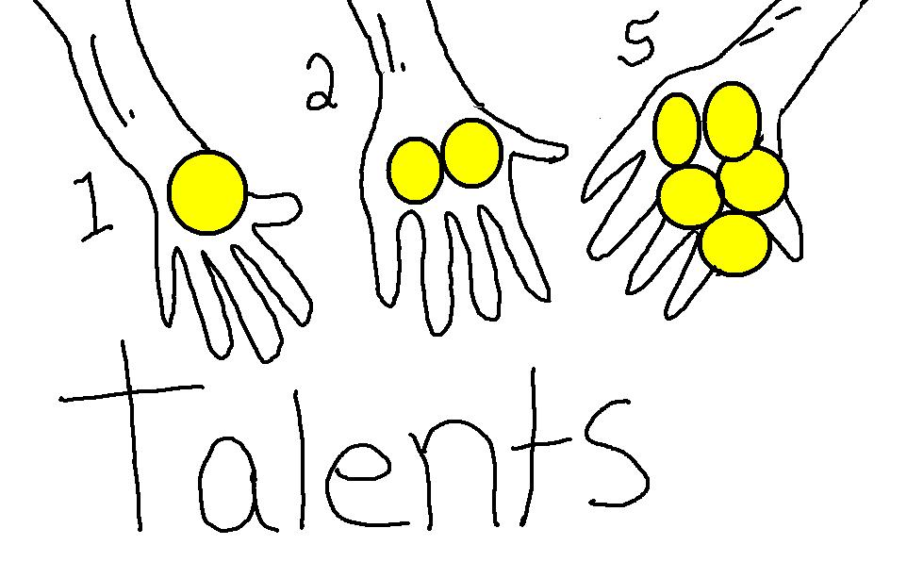
Stewardship

Slide 20

…..God gives the growth

Slide 21
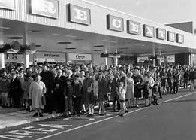
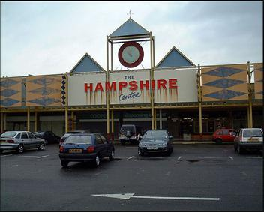
Why we need to re-imagine the church
Castlepoint etc

Slide 22
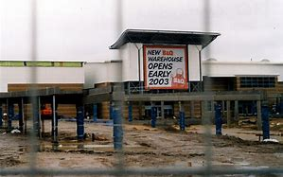

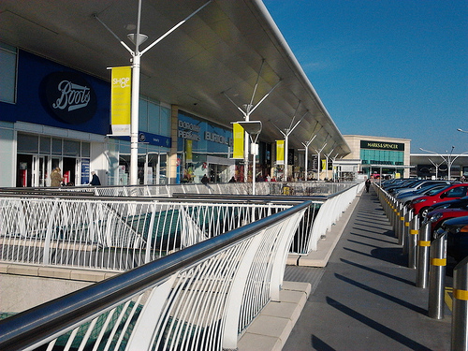
Why we need to re-imagine the church
Castlepoint etc

Slide 23
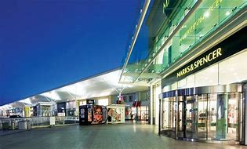
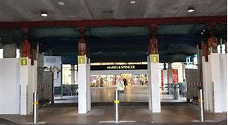
Why we need to re-imagine the church
Castlepoint etc

Slide 24

Setting God’s People Free

Slide 25

How does it work?
What will you need to do?

Slide 26

1. Setup Phase

Slide 27

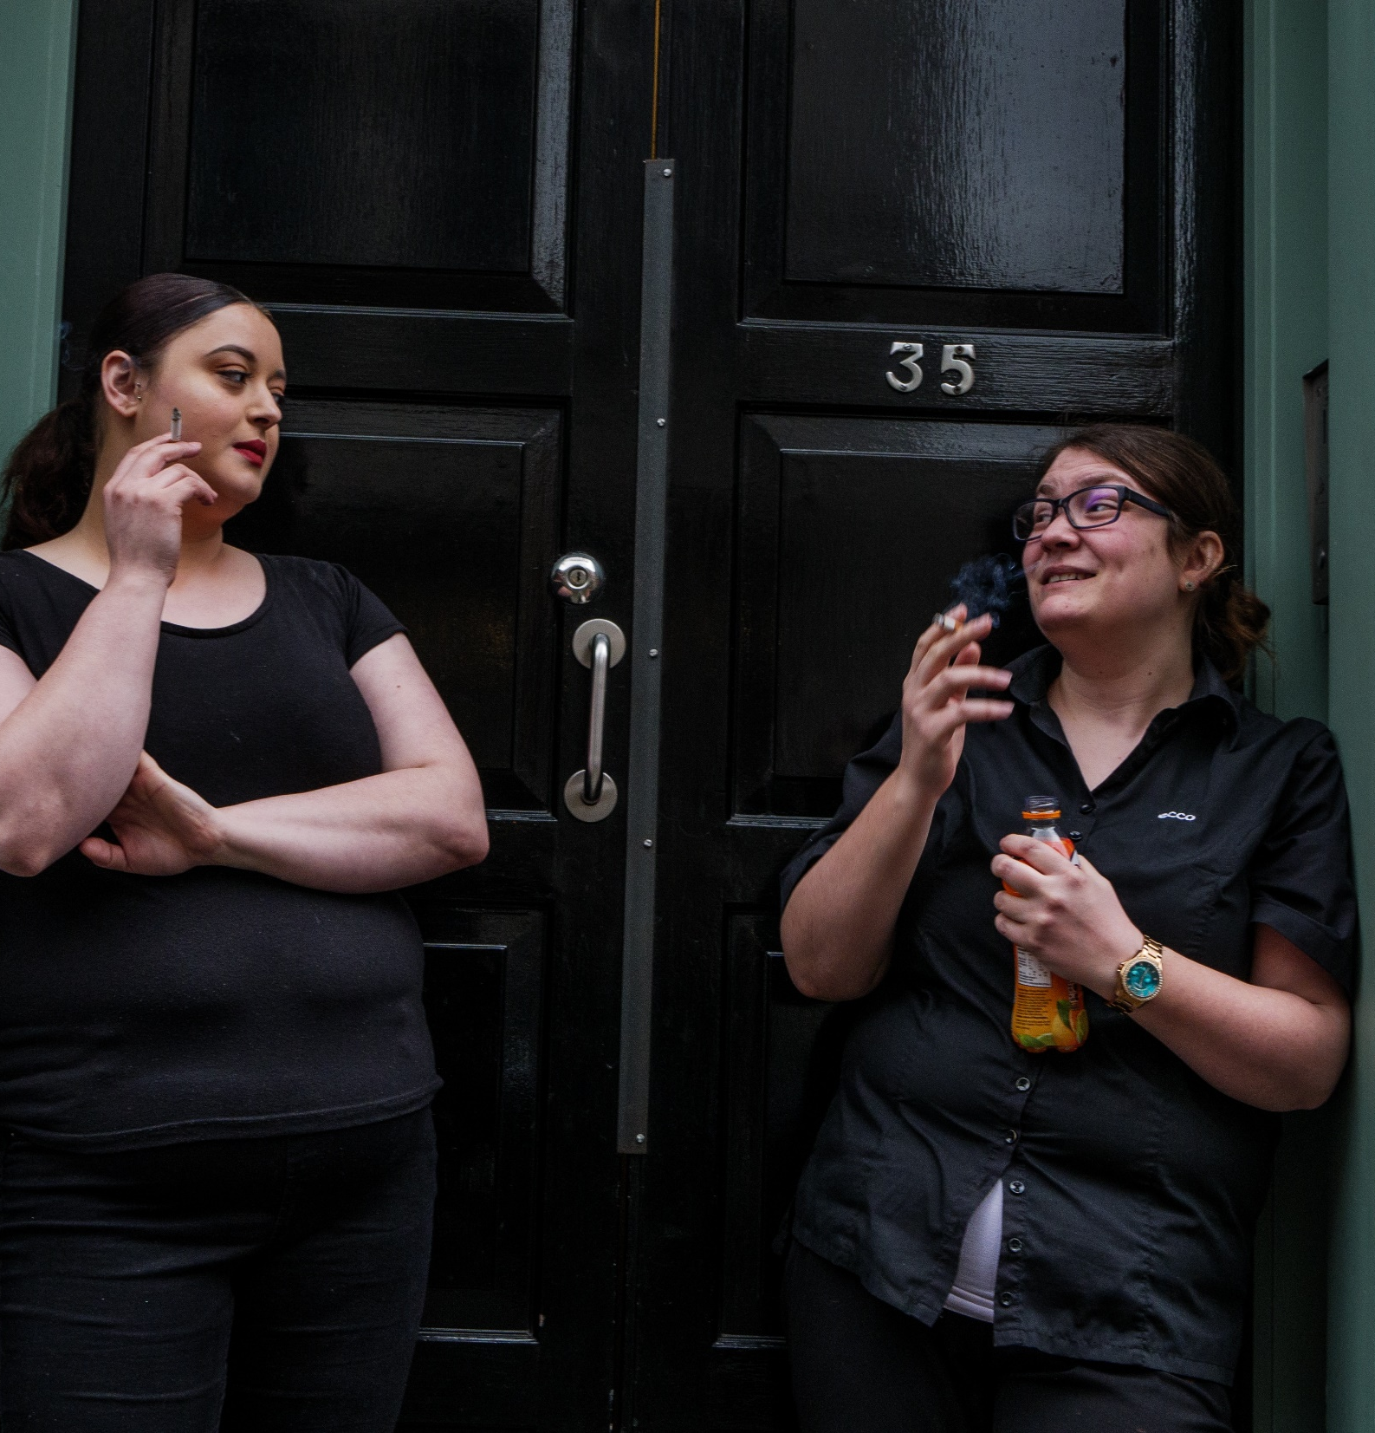
2. Review Phase

Slide 28
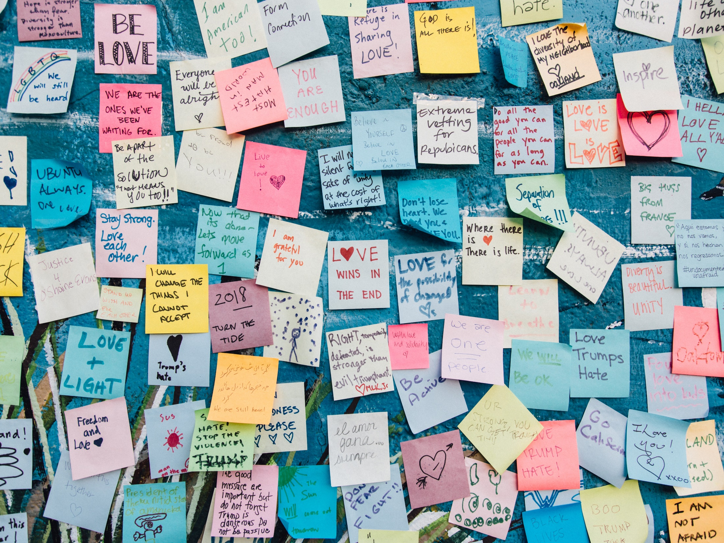
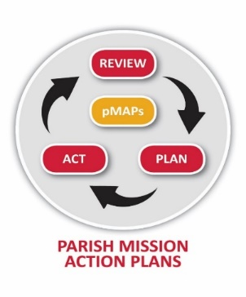
3. Plan Phase
3. Plan Phase
Gathering ideas
Connecting with the diocesan direction
Discerning your response

Slide 29
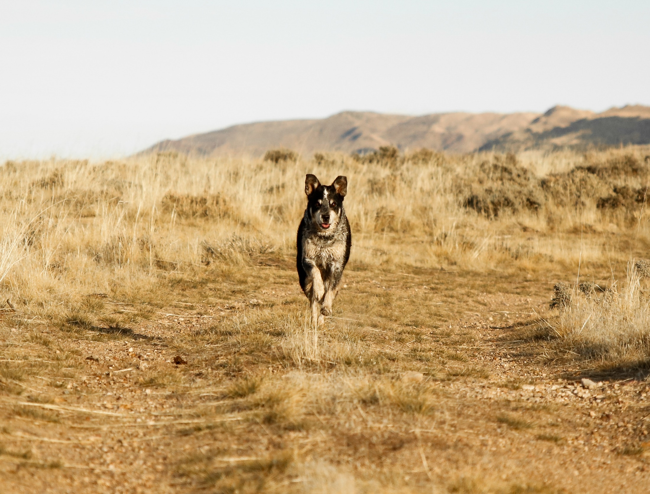
4. Act Phase

Slide 30
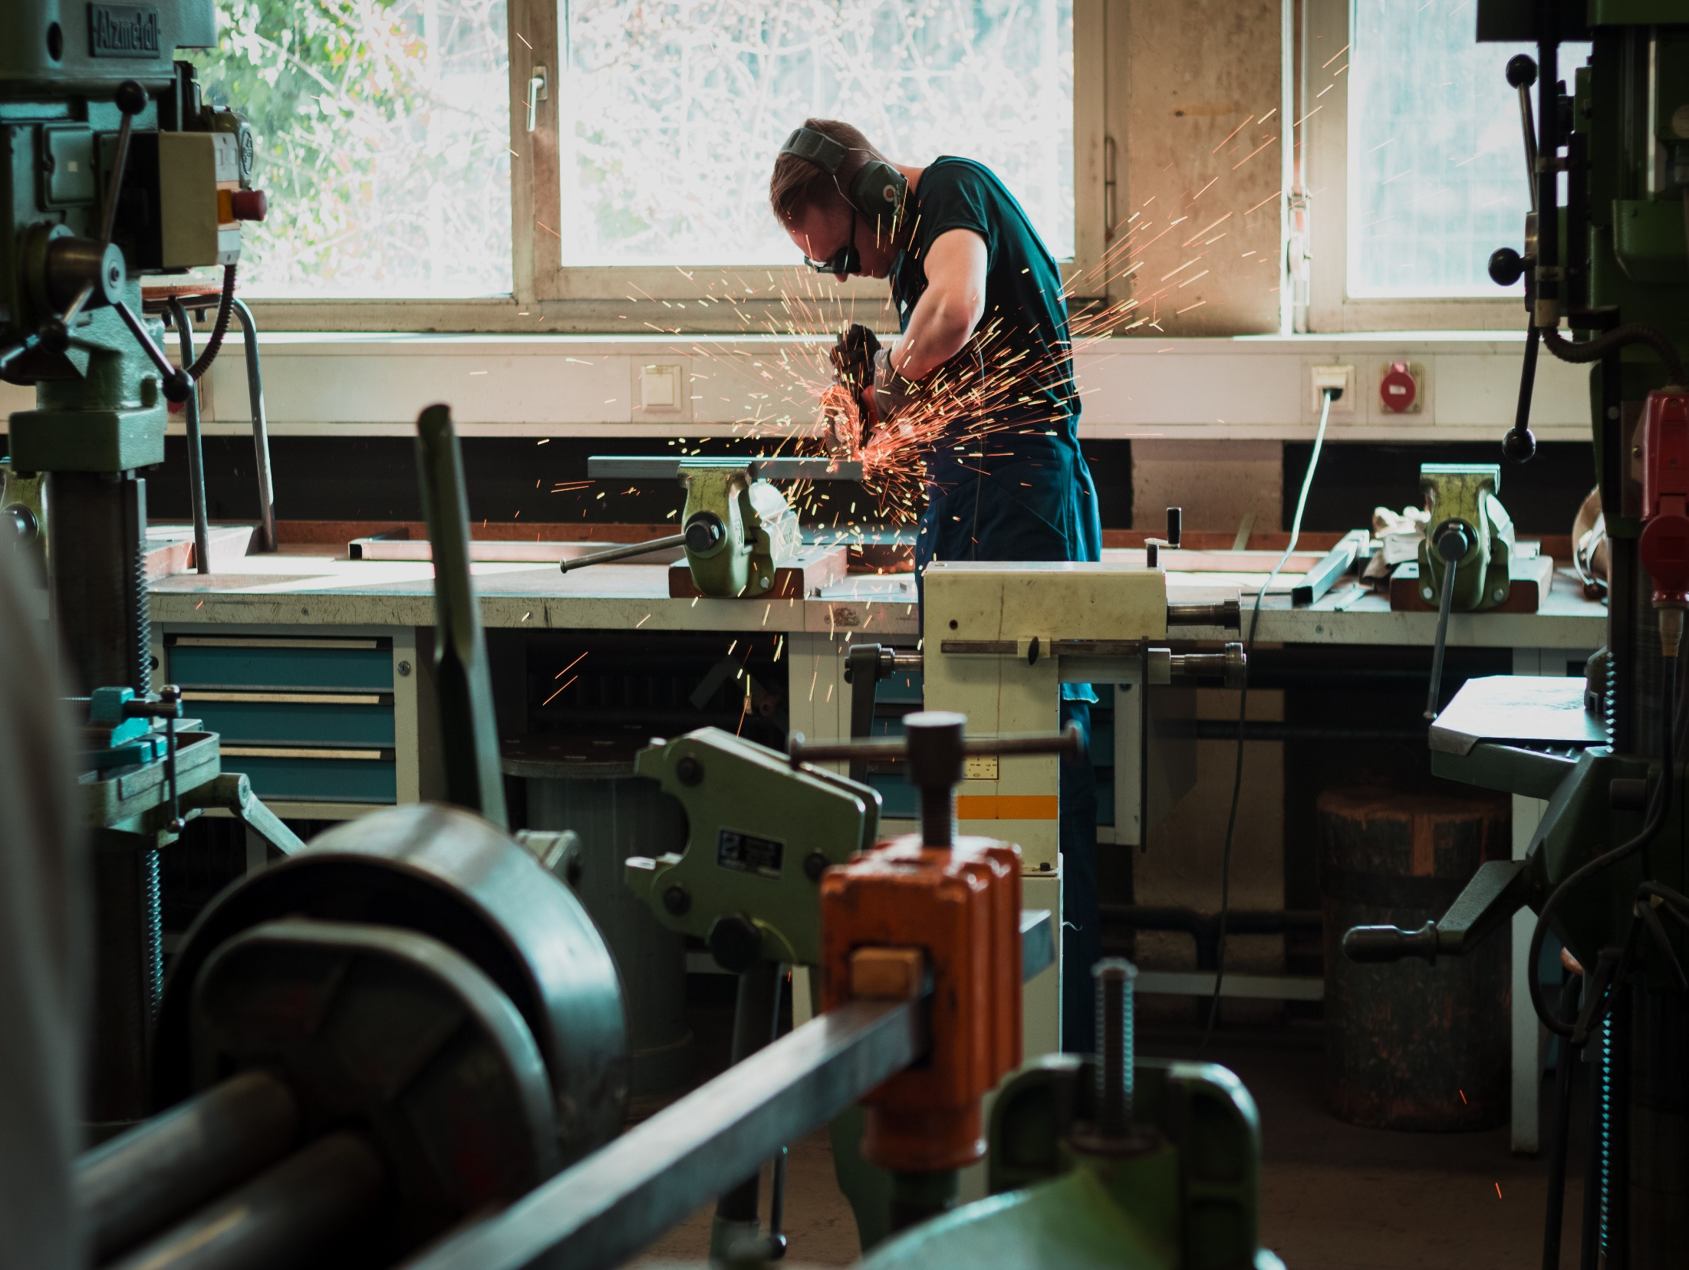
I have a pMAP from last time
2. I am starting new

Slide 31
FAQs

Slide 32

Keeping it fresh

Slide 33
How does it work?
What will you need to do?

Slide 34
O Lord, we beseech you mercifully to hear the prayers of your people who call upon you; and grant that they may both perceive and know what things they ought to do, and also may have grace and power faithfully to fulfil them; through Jesus Christ your Son our Lord. Amen.

Slide 35

For more help over specific details, please contact:
Revd Phil Dykes phil.dykes@winchester.anglican.org

