Slide 1
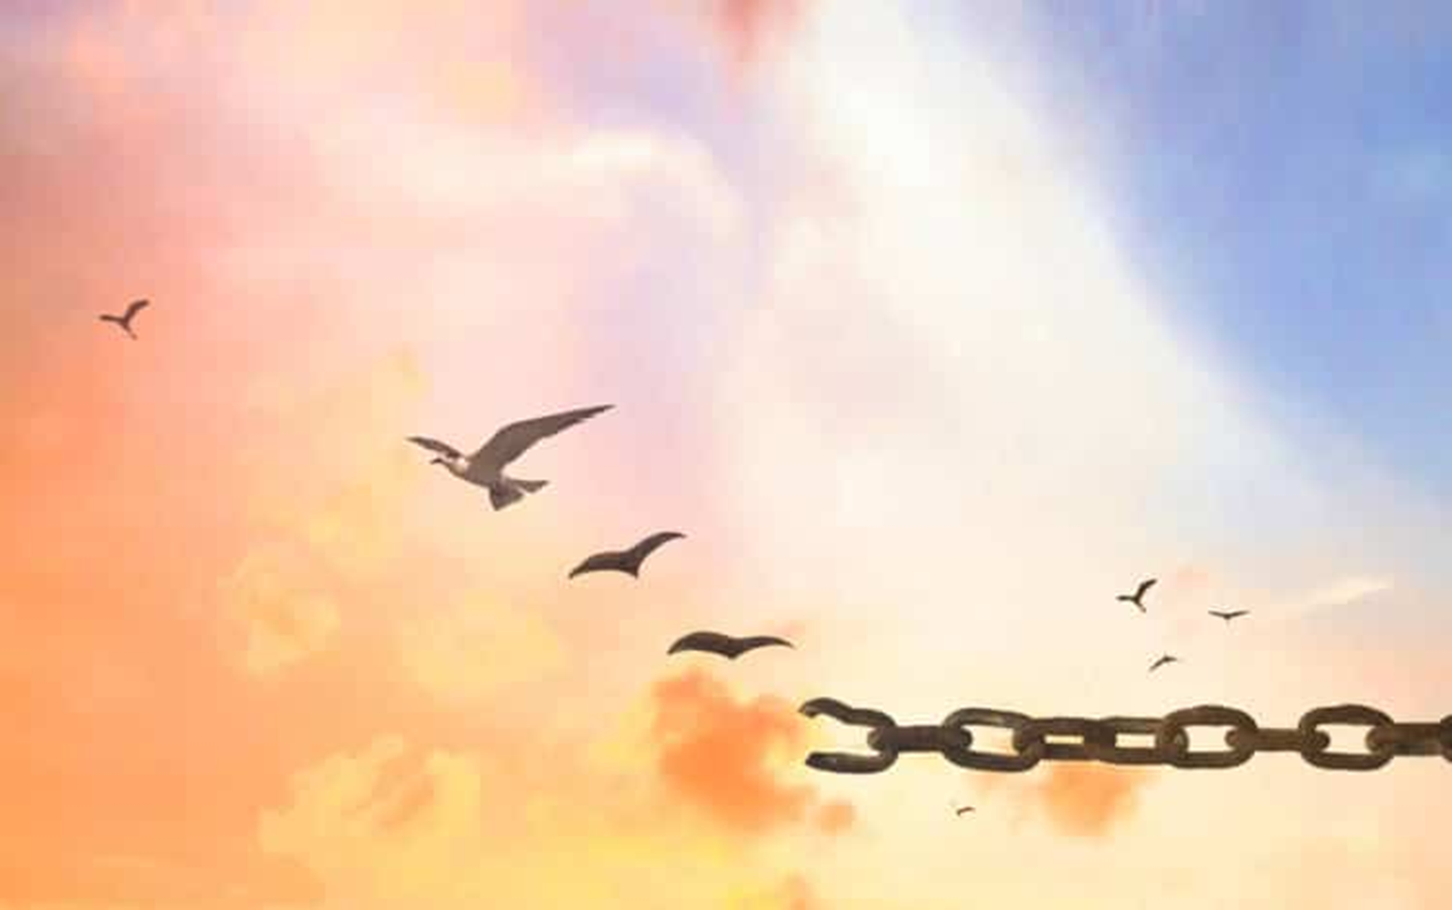
Letting go and moving on…

Slide 2
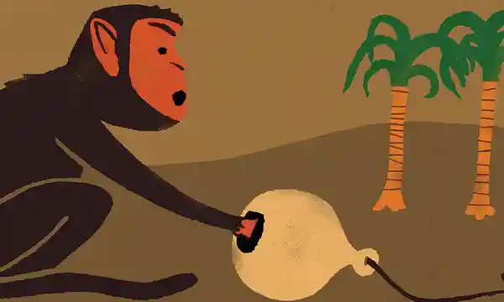
Notes:
Once there was a forest ranger who was fed up with a cheeky monkey who used to hide in the treetops and throw nuts down on his head.
The forest ranger decided that he would teach the monkey a lesson by catching him in a trap. To do this, he chained a jug to a tree and put a banana inside it. Now the hole in the jug was just big enough for the monkey to put his hand inside to take hold of the banana but not big enough for the monkey to get his hand back out again while holding onto the banana.
When the monkey came along later that day and found the jug with the banana, he excitedly grabbed the banana and then, of course, he was stuck. Now you might be thinking that the obvious thing for the monkey to do was just to let go of the banana so that he could be free….but the monkey couldn’t….having found the banana, he just couldn’t make himself let it go….he just couldn’t bring himself to let go of it…and so he was stuck….and so he sat, stuck there for several hours.
Now I’m going to leave that story there and we’ll come back to it in a little while. Next I want to tell you a story that Jesus told, some of you will know this story well but today I want us to think of a different aspect of it.

Slide 3
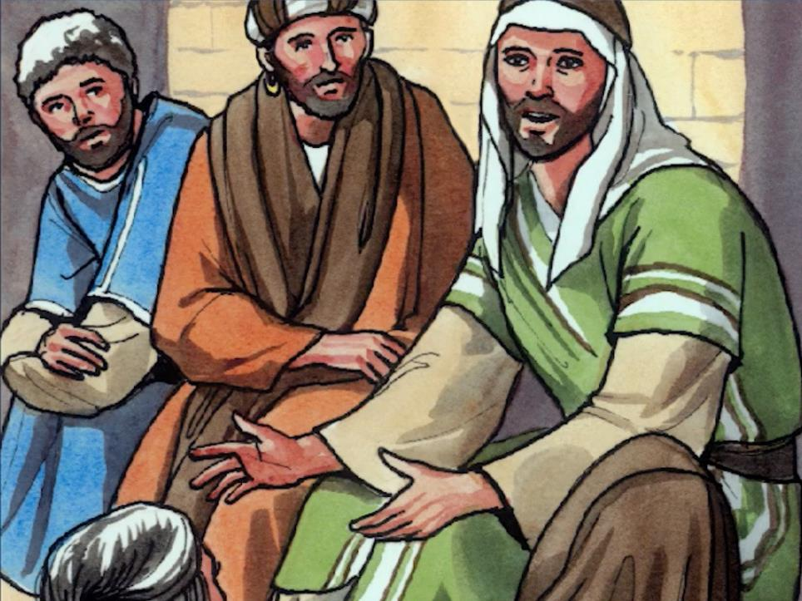
Notes:
Then Jesus said, ‘Once there was a man who had two sons.’

Slide 4
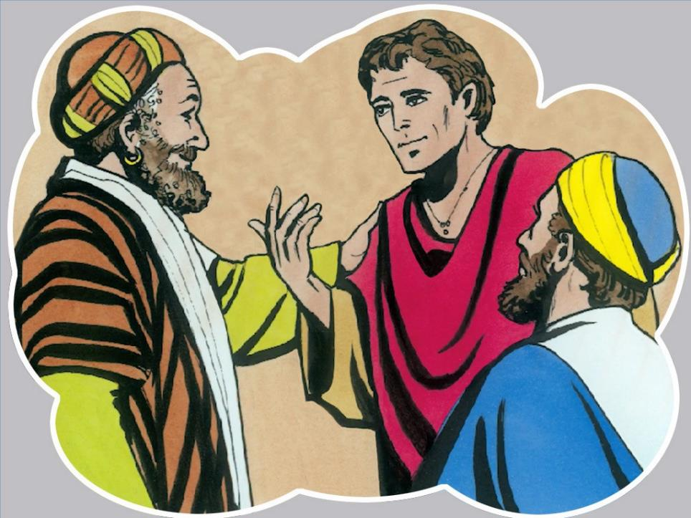
Notes:
‘The younger of son said to his father, “Father, give me the share of the estate that will one day belong to me. I want to have my share now so I can go off to see the world.” The father was sad but eventually he agreed to divided his assets between the two sons.’

Slide 5
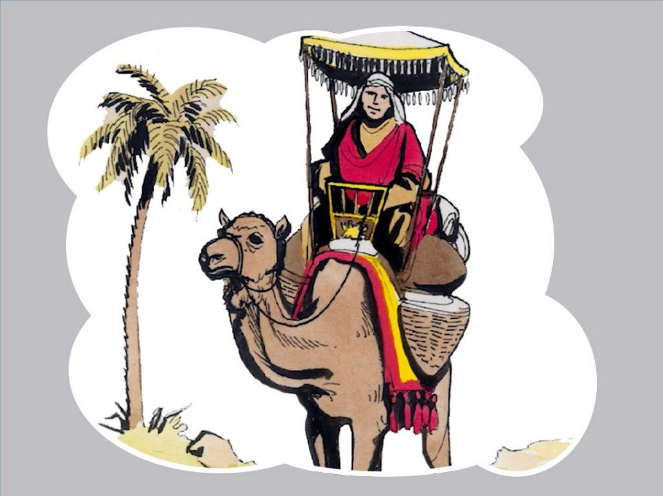
Notes:
‘After a few days, the younger son gathered together all he had and left on a journey to a distant country.’

Slide 6
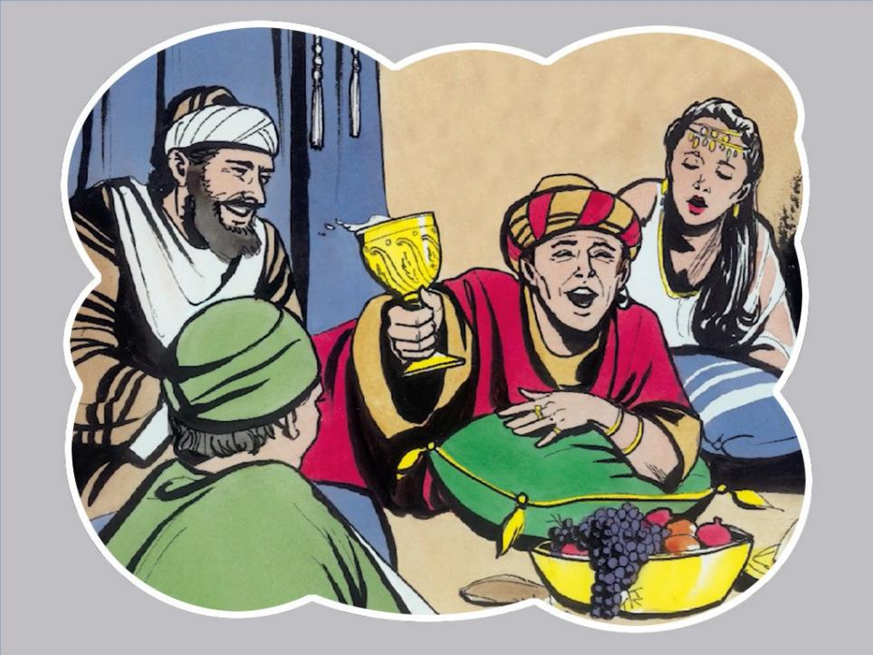
Notes:
‘… and there he wasted all of the money that his father had given him on parties and showing off to others.’

Slide 7
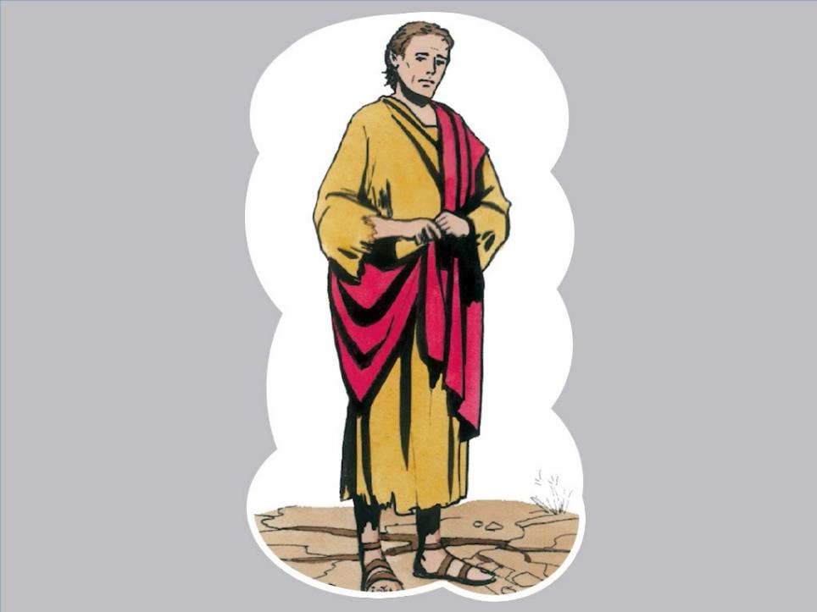
Notes:
‘Then after he had spent everything, a severe famine took place in that country, and he began to be in need.’

Slide 8
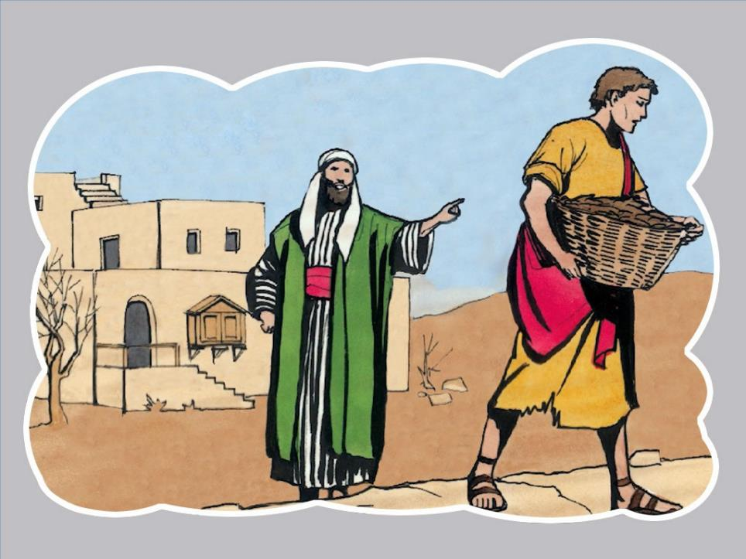
Notes:
‘So he went and worked for one of the citizens of that country, who sent him to his fields to feed pigs.’

Slide 9
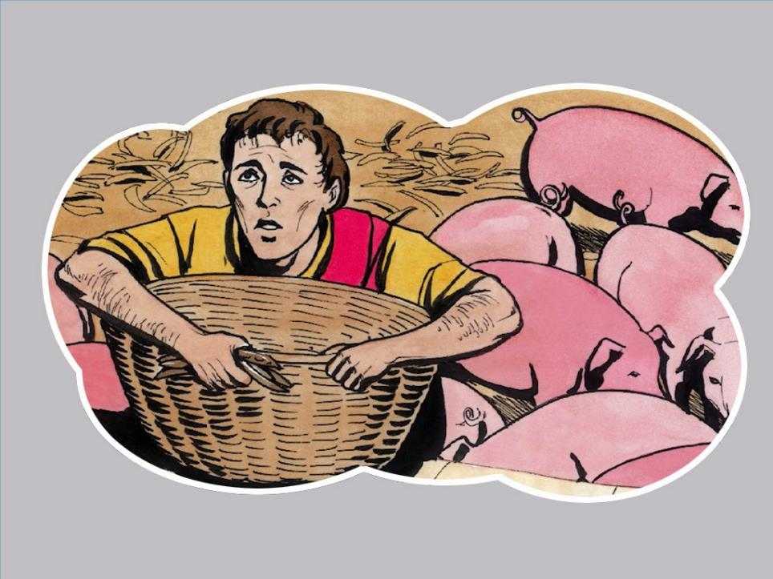
Notes:
‘He was so hungry that he was tempted to eat the food that the pigs were eating. But when he came to his senses he said …

Slide 10
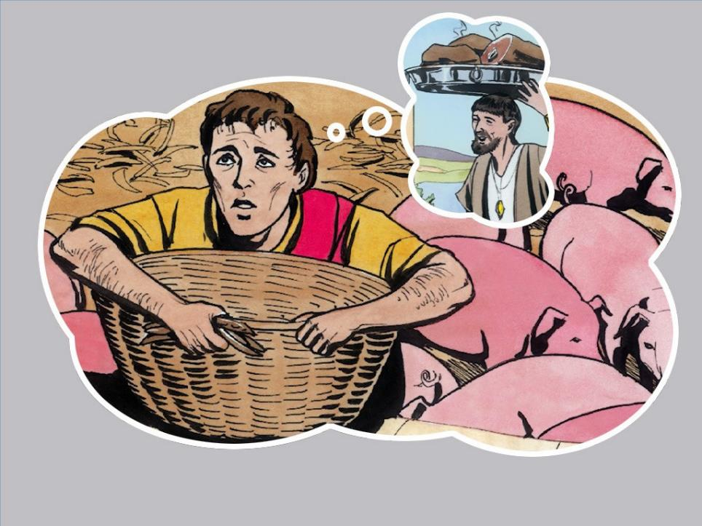
Notes:
‘“How many of my father’s hired workers have food enough to spare, but here I am dying from hunger! I will get up and go to my father and say to him, ‘Father, I have sinned against heaven and against you. I am no longer worthy to be called your son; treat me like one of your hired workers.’”

Slide 11
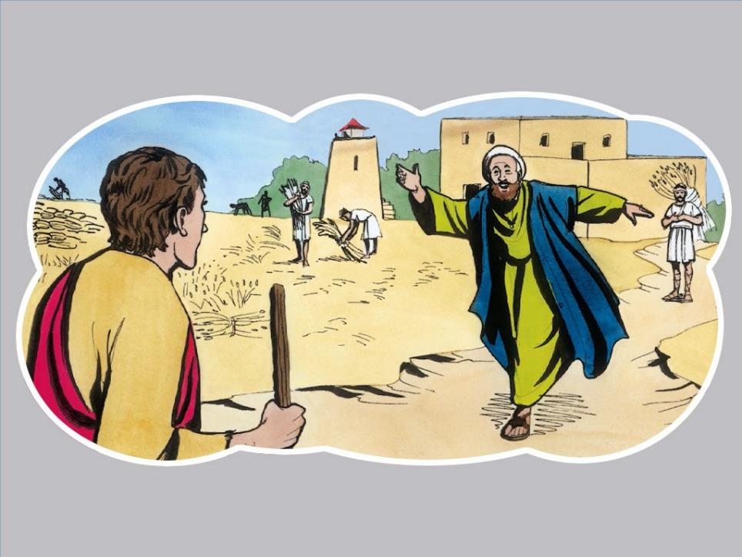
Notes:
‘So he got up and went to his father. But while he was still a long way from home his father saw him, and his heart went out to him; he ran and hugged his son and kissed him.’

Slide 12
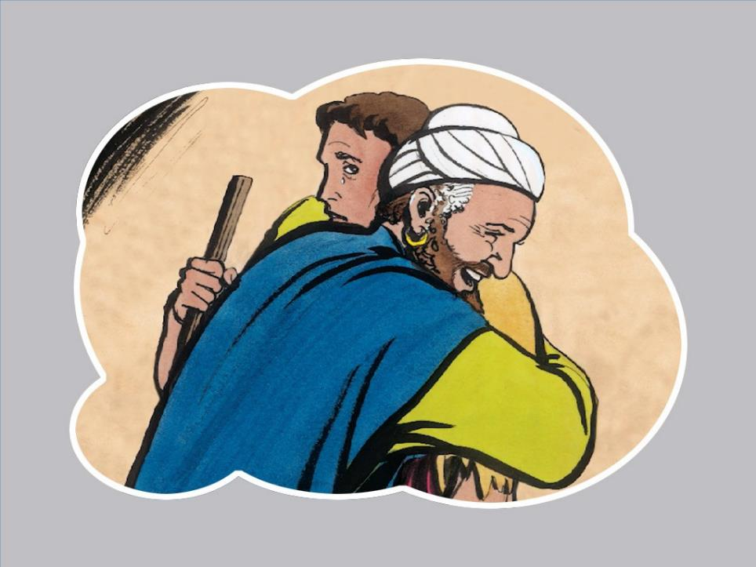
Notes:
‘Then his son said to him, “Father, I have sinned against heaven and against you; I am no longer worthy to be called your son.”

Slide 13
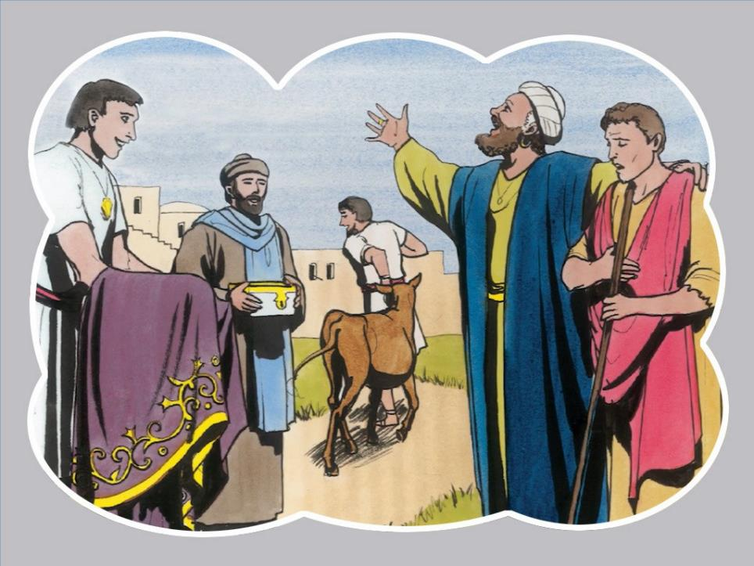
Notes:
‘But the father said t0 his servants, “Hurry! Bring the best robe, and put it on him! Put a ring on his finger and sandals on his feet! Bring the fattened calf and kill it! Let us eat and celebrate, because this son of mine was dead, and is alive again – he was lost and is found!” So they began to celebrate.

Slide 14
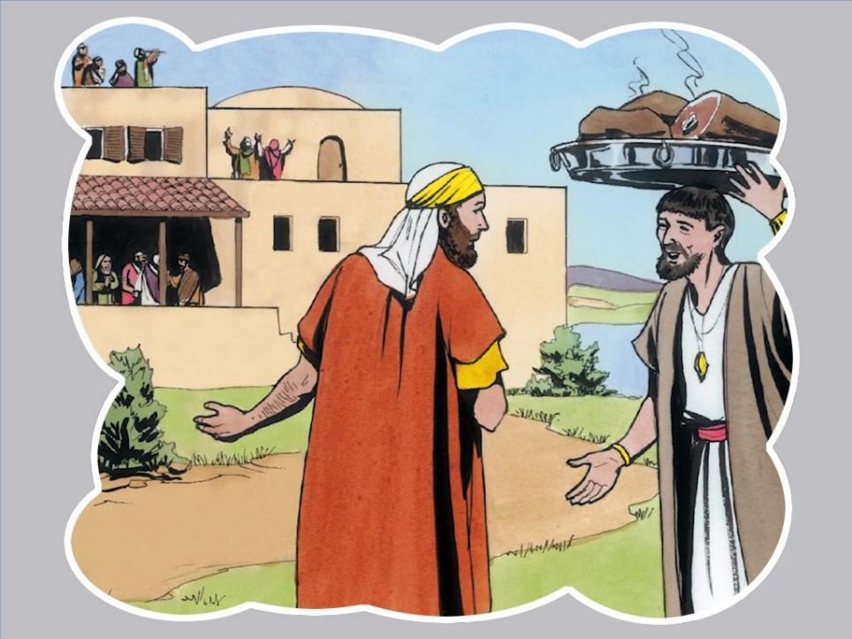
Notes:
‘Now his older son was in the field. As he came and approached the house, he heard music and dancing. So he called one of the slaves and asked what was happening. The servant replied, “Your brother has returned, and your father has held a great feast for him because he got his son back safe and sound.” But the older son became angry and refused to go in.’

Slide 15
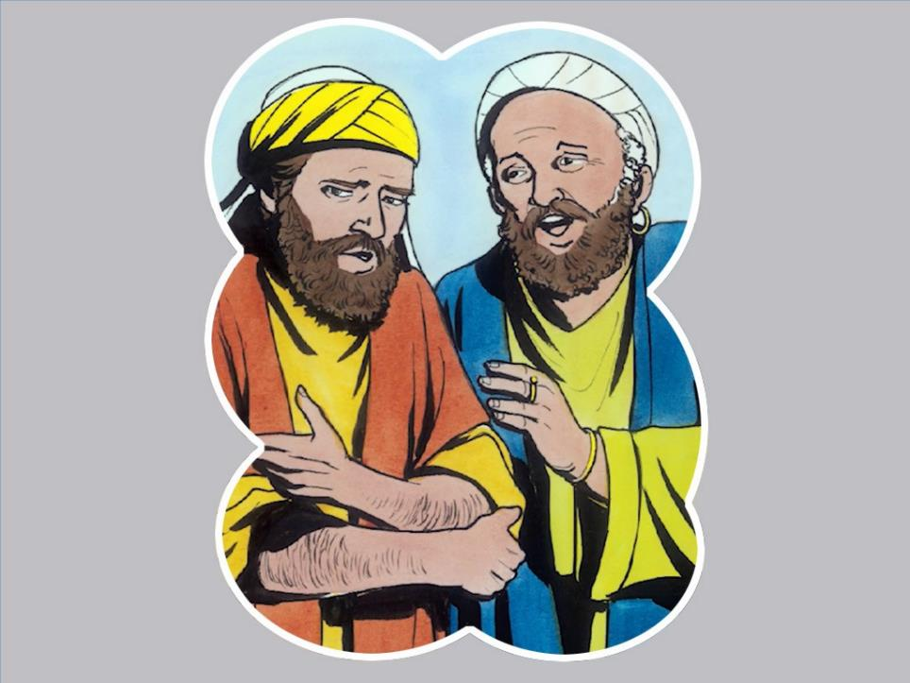
Notes:
‘His father came out and appealed to him, but he answered his father, “Look! These many years I have worked like a slave for you, and I never disobeyed your commands.’

Slide 16
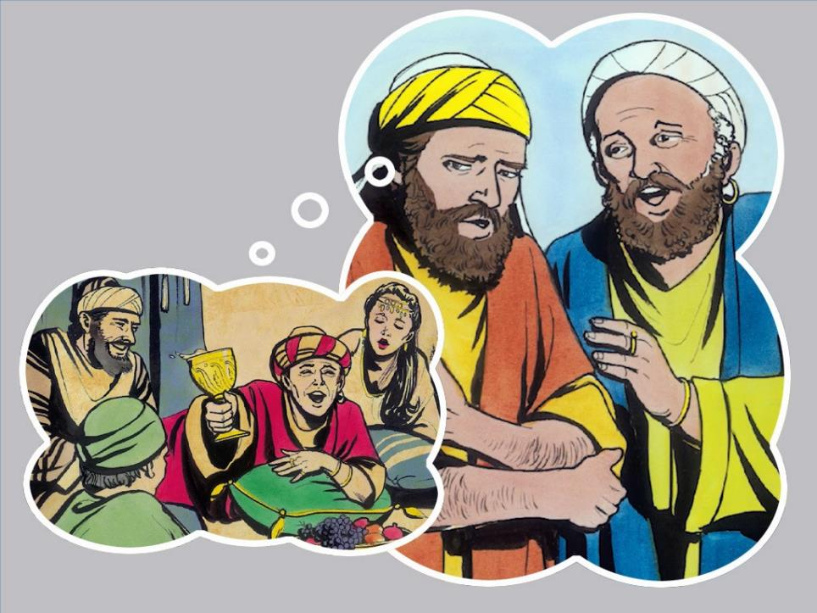
Notes:
‘”You never did anything to praise all of my hard work! But when this son of yours came back, who has wasted all of his share of our estate, you hold a great feast for him. I’m so angry that I can’t bear to join the feast. In fact, I don’t want to have anything to do with anyone anymore – just leave me alone!”

Slide 17
Notes:
‘In the end, the father said to his eldest son, “Son, you are always with me, and everything that belongs to me is yours. It was right to celebrate and be glad, for your brother was dead, and is alive; he was lost and is found.”’

Slide 18


Notes:
Now this is a tricky question but can you think of any connection between the monkey with his had caught in the jug and the oldest son from the story? (Although they were feeling different emotions – the monkey was feeling greed and the eldest son was feeling resentment – they were both trapped by their feelings. They couldn’t let go and move on.)

Slide 19
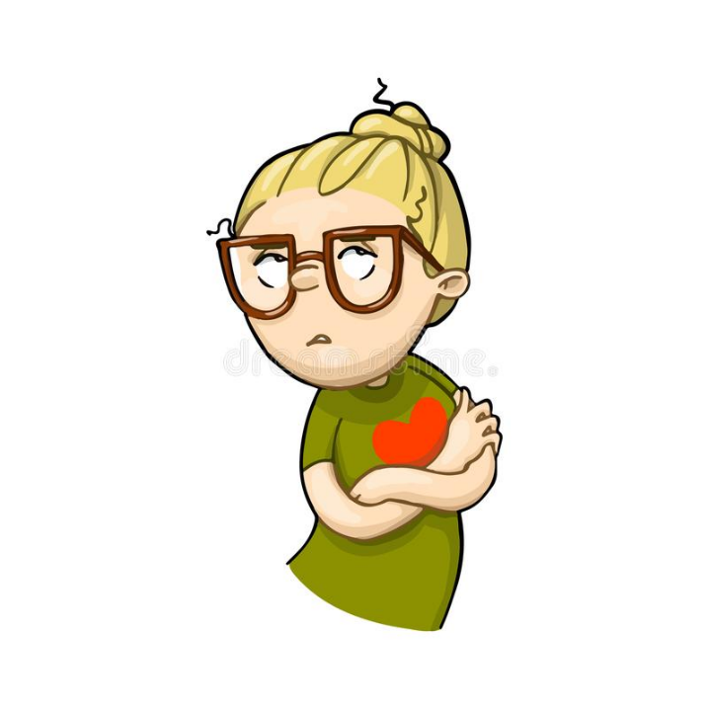
Notes:
Can you think of a time when you have not been able to forgive someone and move on like the eldest son in the story? Sometimes it can be very hard to forgive someone….we can feel that they don’t deserve our forgiveness but if we don’t let go of our resentment then we can become stuck in our unhappiness like the monkey with his hand trapped in the jug.
Perhaps explore this with some examples from the children.

Slide 20
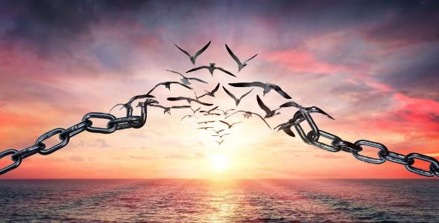
Our Father, who art in heaven,
hallowed be thy name;
thy kingdom come;
thy will be done;
on earth as it is in heaven.
Give us this day our daily bread.
And forgive us our trespasses,
as we forgive those who trespass against us.
And lead us not into temptation;
but deliver us from evil.
For thine is the kingdom,
the power and the glory,
for ever and ever.
Amen.
Notes:
Here is one of our most important prayers that asks God to forgive us as we should forgive others.
Invite the children to say the prayer with you – change the side to the modern version if that is more familiar to the children.

Slide 21

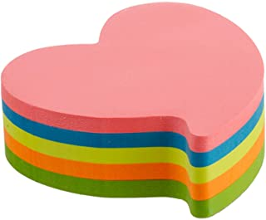
Notes:
As a practical prayer idea that could be used as a ‘sending’ would be to buy some heart-shaped post-its for the spirituality corner in the classroom. These can be torn in half and the children find two halves that match and stick them together (on a display or in a reflection journal) while they pray for a situation where they need to show forgiveness. Alternatively, the children can write prayers on the post-its at your discretion.

