Slide 1
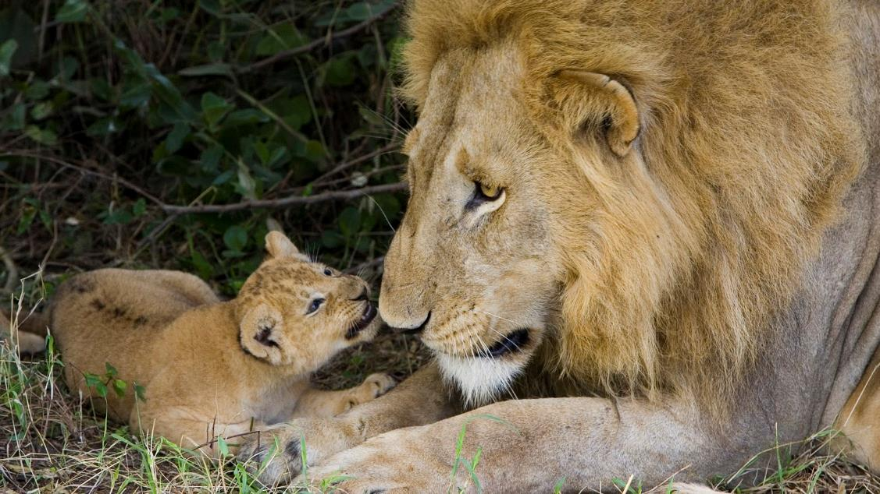
What do you see?
All the following pictures have an animal theme.
Use the questions to help you reflect on different emotions, values and Bible verses.
You may like to look at one picture each day in worship this week.

Slide 2
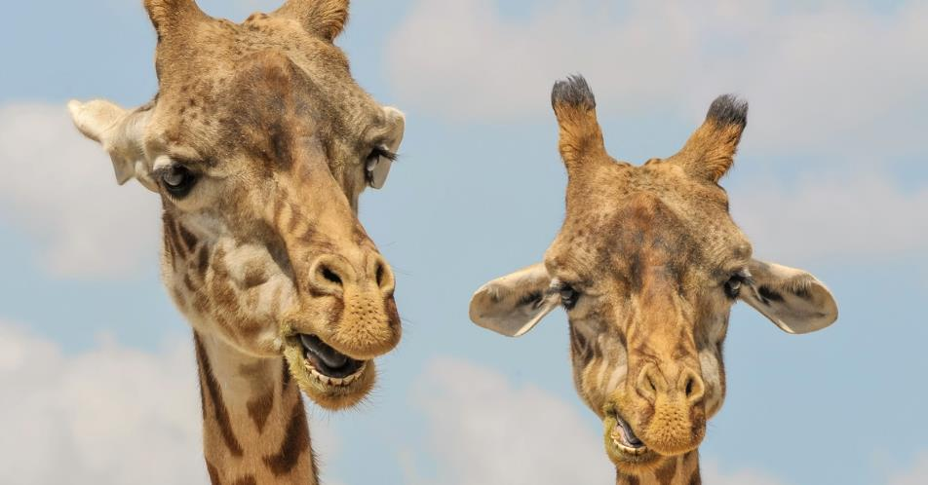
Look very carefully at each picture – the first one is on the next slide.
Click again and you will see a list of questions on the following slide.
There is no need to write your answers down, you can just think or talk about them
These challenges can be used lots of times. There is not just one answer

Slide 3
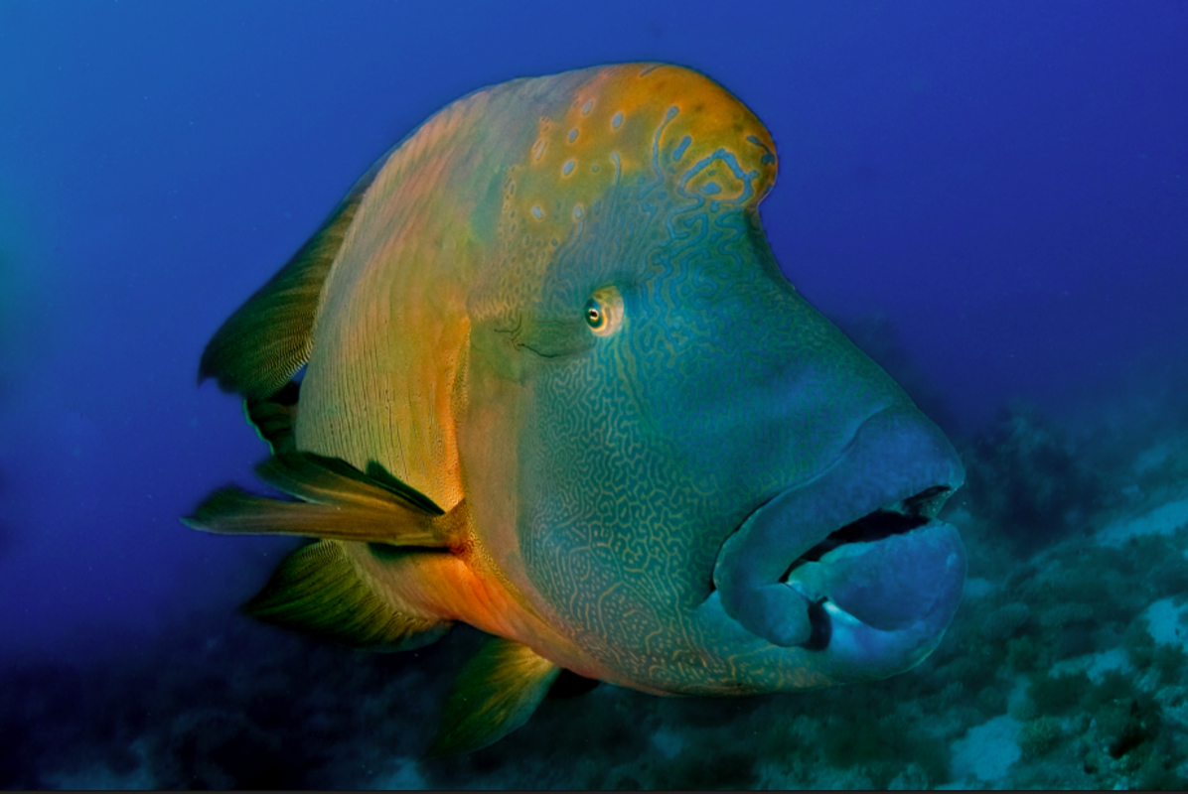

Slide 4
Challenge 1
Read the story starter:
The majestic creature glided gracefully through the perfect, azure waters. Its size and beautiful colours stood out in stark contrast to the murky, grey ocean floor beneath.
Many other creatures that dwelt under the sea looked on with envy at the unusual and startlingly bright colours across it’s sleek body…
Question time!
What does it mean to be envious?
Why might some sea creatures be envious of this fish?
Which sea creatures may not be envious of this fish?
Have you ever been envious of someone else?
Do you think someone has ever been envious of you?
Is it wrong to be envious?
Do you think fish really have feelings?
Should we treat fish differently to the way we treat other people?
The Bible tells us to treat others as we would like to be treated. What does this mean? Can you think of a Bible story to illustrate this? Is it always possible to treat everyone the same?

Slide 5
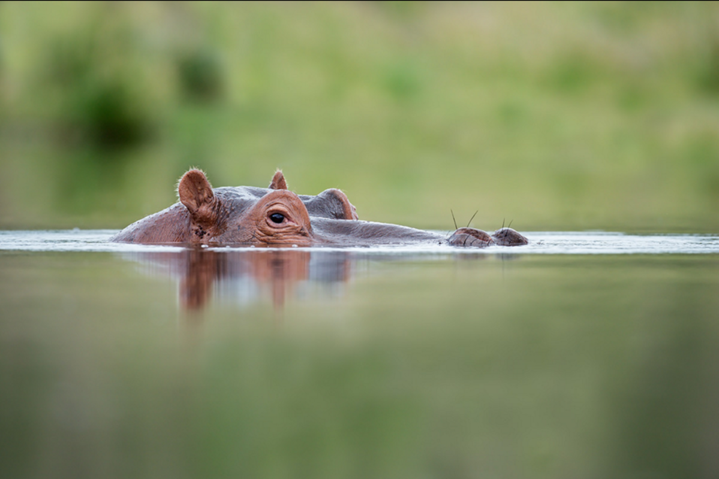

Slide 6
Challenge 2
Question time!
What is the creature in the water?
What is the creature waiting for?
What makes this animal dangerous? What makes it wonderful?
How do you feel about hippos? How do you think hippos feel about humans?
Hippopotamuses are the third largest mammal on the earth, but the numbers of hippos continue to decline due to widespread poaching for meat and ivory from the hippo’s long teeth. Currently, hippos are confined mostly to protected areas, and over the past 10 years their populations have declined between 7-20%.
Challenge!
The Bible tells us to treat animals with kindness and respect. The Book of Job 5:23 describes an ideal a day when human being will be at peace with nature: “For you shall be in league with the stones of the field, and the beasts of the field shall be at peace with you.”
Have a talk about the sentence below:
Poaching animals is against the teachings of Christianity and cannot be justified by any person of faith.

Slide 7
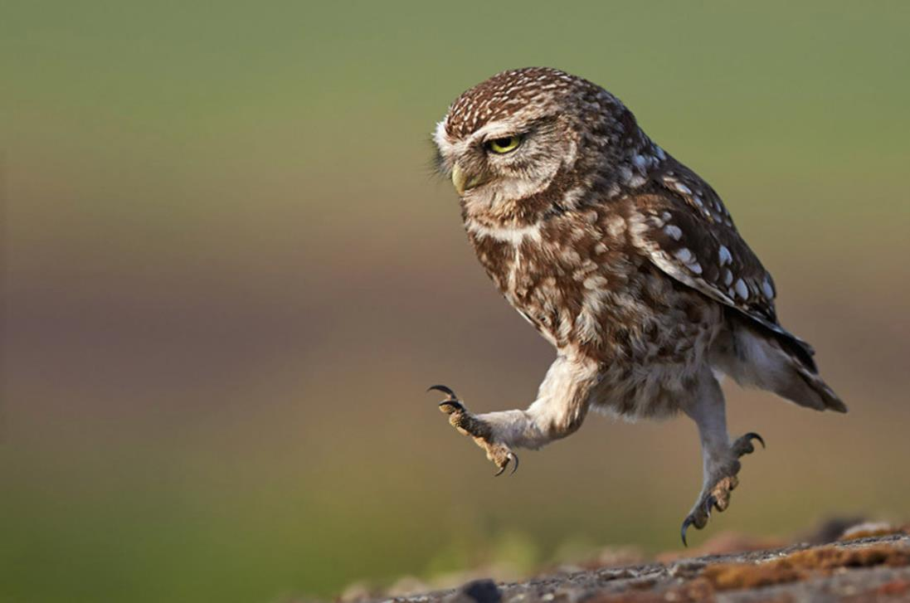

Slide 8
Challenge 3
Read the text below:
As he broke out into a run, his needle-like talons made a sharp, scraping sound against the moss-covered rocks beneath him.
The wind gusting behind him would be beneficial as he took his leap of faith off the cliff top. It was always a risky business, but when a moment like this came around, he had to make it count…
Question time!
What do you think the owl has seen?
How would the ‘wind gusting behind him’ help him?
Why do you think the author has used the term ‘leap of faith’?
The words ‘Leap of Faith’ were first used by a Danish man (Søren Kierkegaard) who used them to describe how people believe in God. He thought that God was spiritual rather than an actual physical man. Therefore people who believe in God were able to ‘jump over’ the fact that they could not physically see God but could still feel his presence and power.
What do you think? Is it difficult to make a ‘leap of faith’? What do you think helps people to make a leap faith?

Slide 9
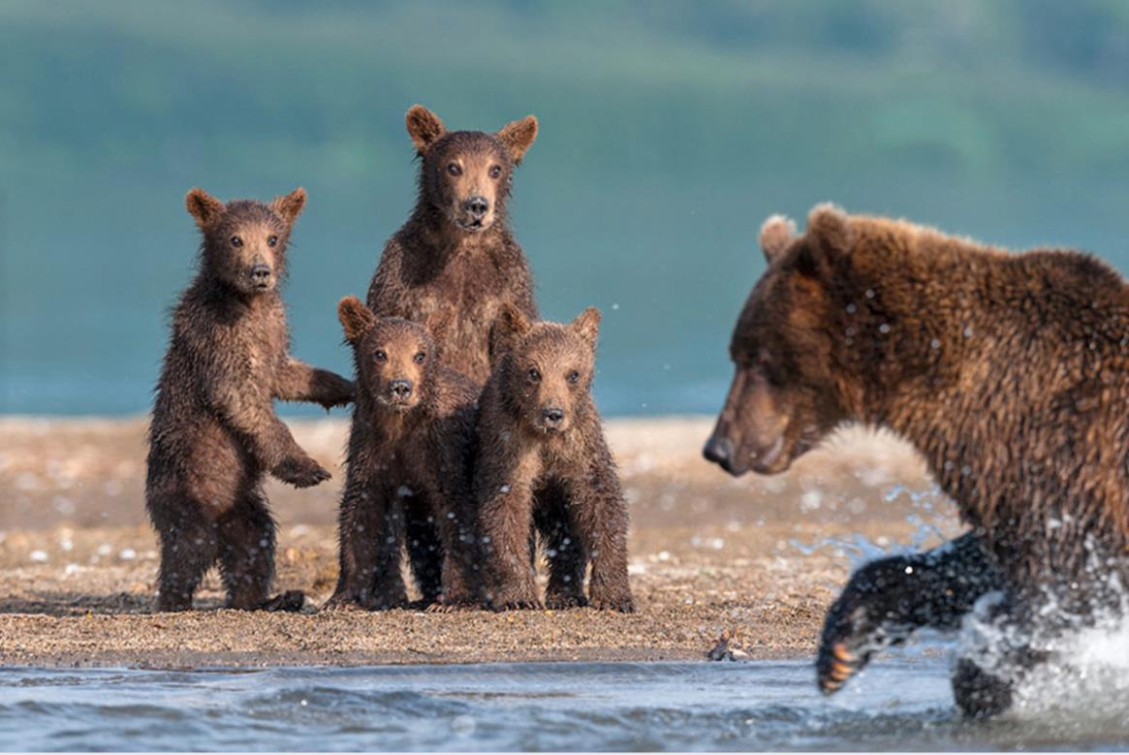

Slide 10
Challenge 4
Question time!
What do you think the bear cubs are thinking?
Why do you think the relationship between the mother and her cubs is so important?
What is the mother bear trying to teach her cubs? Why is this important?#
Why is it important to have a great teacher?
Great teachers can have a huge effect on people they teach. Read the facts below:
A 12-year-old boy from India was accepted into medical school.
A 12-year-old girl from China had her paintings appear in worldwide museum exhibits.
A 12-year-old boy from Pennsylvania was nominated for the Nobel Peace Prize.
A 12-year-old boy from France can read six languages.
When Jesus was 12, He and his parents travelled to Jerusalem for Passover with a big group of their relatives. During this trip, Jesus was left behind. His parents found Him three days later teaching the elders in the Temple. Mary and Joseph were worried about Jesus, but He was exactly where He needed to be. Even at a young age, Jesus knew who He was and who His Father was and He wanted to teach other people how to love each other.
What sort of a teacher do you think Jesus was?
Was being a teacher Jesus’ most important job? Why?

Slide 11
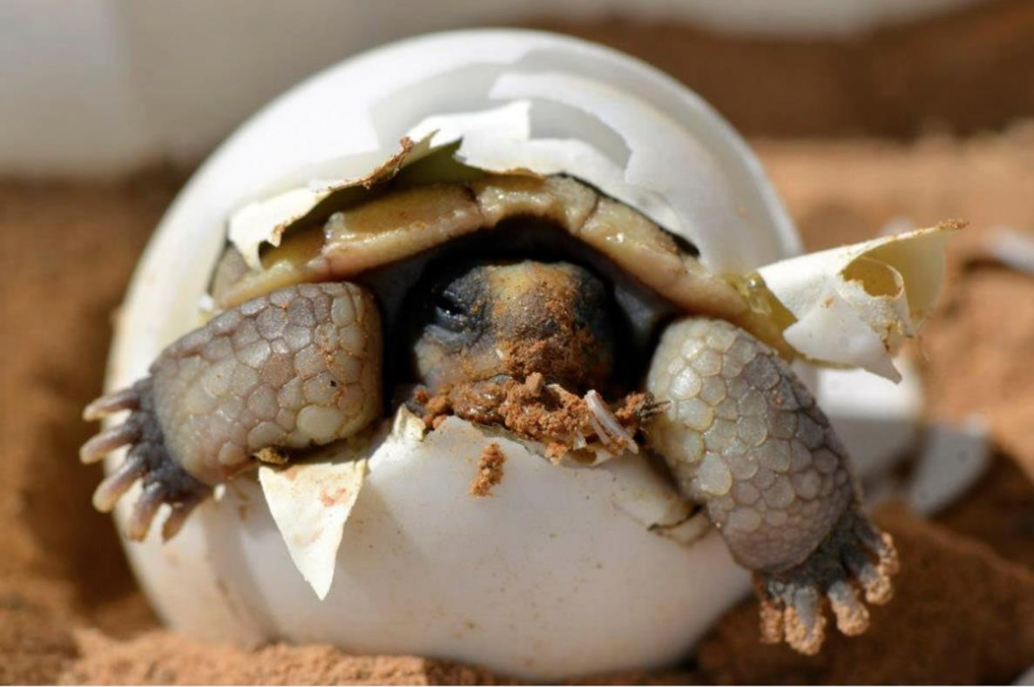

Slide 12
Challenge 5
Question time!
The first moments of a turtle's life are critically important for its chances of survival.
Why do you think this is the case?
This baby turtle is just about to start on the first part of life’s journey. Some bits will be difficult, just like some bits of our lives can be hard.
Have a look at the film clip below about Baptism which Christians believe is the first step in the life of a Christian.
http://www.bbc.co.uk/education/clips/zxd2hyc
Who makes the decision for children to be baptised?
Are there any problems with this? (Children are not making own decision, do they understand the commitment they are making, are they old enough to follow a Christian lifestyle)
Or is it ok for the parents to just state a wish for their child to live this way and be brought up in this way?
Should there be a minimum age for Baptism?

