Slide 1

What do you see?
Look at each of these pictures.
Use the questions to help you reflect on the Christian value of Hope.
You may like to do one picture each day in worship this week.

Slide 2
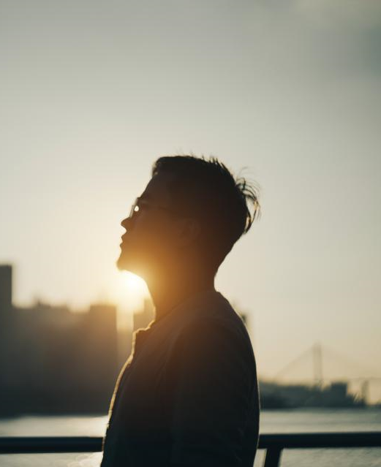
Look very carefully at each picture – the first one is on the next slide.
Click again and you will see a list of questions on the following slide.
There is no need to write your answers down, you can just think or talk about them
These challenges can be used lots of times. There is not just one answer

Slide 4
Challenge 1
In John’s Gospel Chapter 10 Verse 10 Jesus says: I have come that they may have life, and have it abundantly.
Why do you think this picture was chosen to demonstrate these words?
What do you think ‘living life to the full’ means?
Why is it important to live like this?
Is Easter a good time for us to think about living life in the way Jesus wanted? Why?
Jesus has filled your life with lots of people and experiences - think about all you have in your life.
If you learned you had only 100 days left to live, how would you spend those days?
What person do you most admire--and why?
At what time in your life were you the happiest you can remember being?
What is your greatest talent?
What do you consider your greatest achievement to be?
What two people have had the most influence on you? Why?
What do you think is the best way to live life to the full?

Slide 5
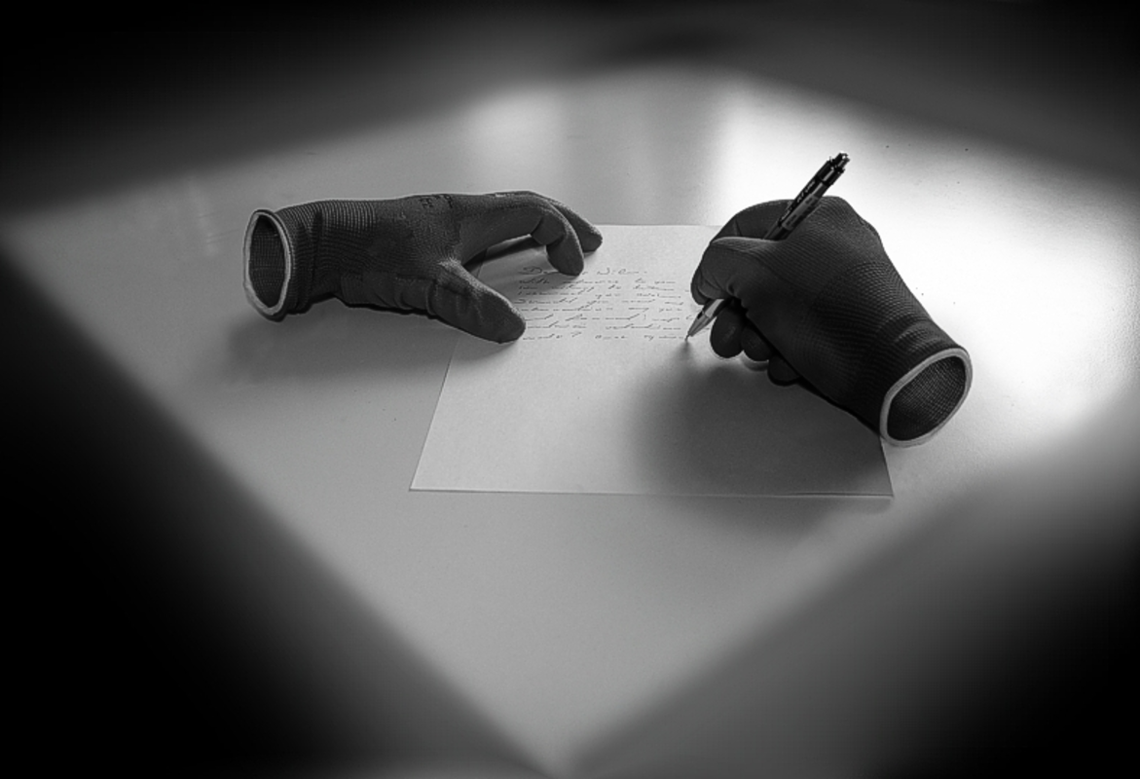

Slide 6
Challenge 2
Question time!
Imagine that Jesus has just been crucified and that God is wearing the gloves in the picture. He is writing a letter to the World.
Why is today the most important day of God’s life?
What do you think God was doing as Jesus was on the cross?
Why did he not save his Son?
How does he feel about Jesus now?
What do you think God is writing in the letter? What might he want to tell us?
Challenge question!
Is it possible to believe in something that we cannot actually see?

Slide 7
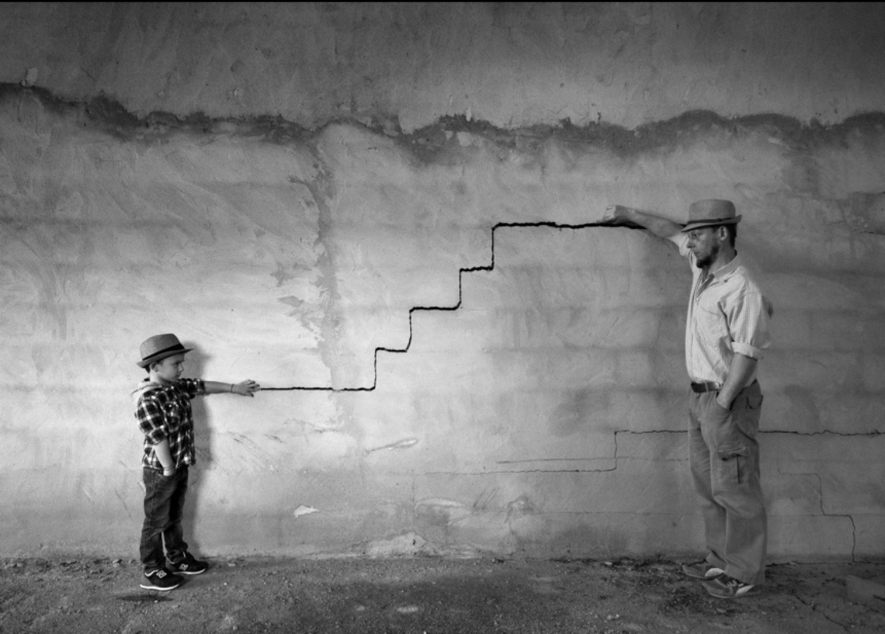

Slide 8
Challenge 3
Question time!
This picture is called ‘Like father, like son’. Why do you think this picture has been chosen to start our discussion about the Easter story today?
How are God and Jesus similar/the same/different to each other?
DidJesus have the same effect over people throughout his life or did his effect on the World get greater as he got older?
Did Jesus have the greatest effect over the World when he died on the cross?
Challenge question!
Was God always in control over Jesus’ life and death?

Slide 9
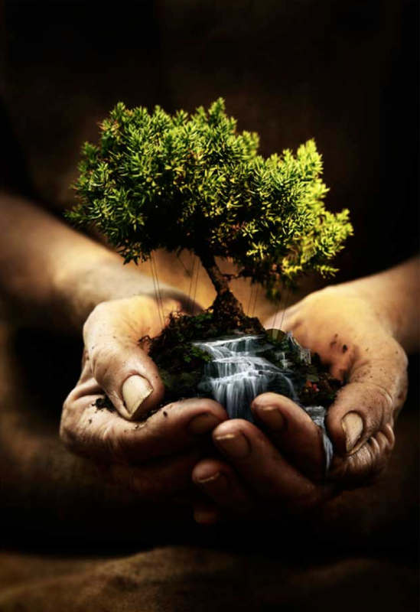

Slide 10
Challenge 4
Question time!
This picture is called ‘The Tree of Life’.
Is the tree small or is the person large?
Who might the person holding the tree be?
What do you think the water represents?
Let’s think of three trees in the Bible:
The Tree of Knowledge, whose fruit Adam and Eve ate in the Garden of Eden.
The tree of the cross, which is the tree that we think about on Good Friday—the tree on which Jesus died.
In the book of Revelation it says, “Then the angel showed me the river of the water of life, bright as crystal, flowing from the throne of God. On either side of the river is the Tree of Life with its twelve kinds of fruit, producing its fruit each month; and the leaves of the tree are for the healing of the nations.”
Some people think that The Tree of Life is a symbol of the end of the Easter story.
Challenge question!
What do you think the ‘healing of the nations means’?

Slide 11
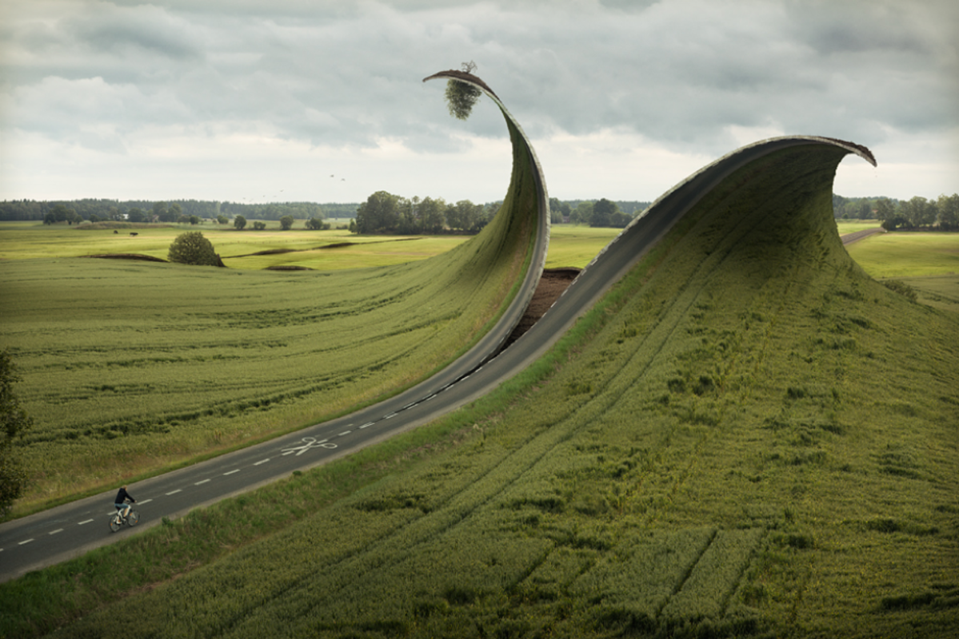

Slide 12
Challenge 5
Question time!
Who is controlling the scissors in the picture?
Why do you think the World is being re-shaped?
After the resurrection, God wanted a new world to begin, one in which people loved one another and sought peace.
If you could change the World right now what would you change?
What would you keep the same?
Challenge question!
Snip..Snip…Snip…The scissors began to tear the countryside apart. Towns, fields, rivers and oceans. Forests, valleys, mountains and lakes. The world began to unravel piece by piece, strand by strand.
This was to be a new beginning.
Remembering all the messages of the Easter story this week - What could God’s new world look like?

