Slide 1
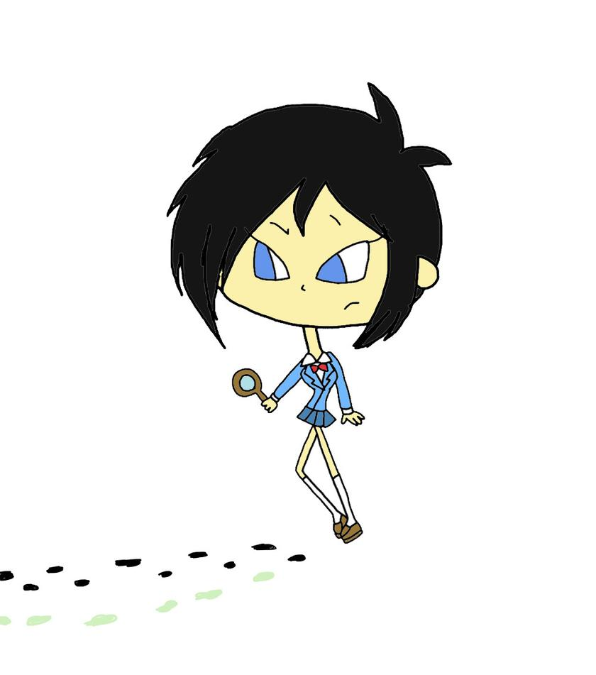
What do you see?
Look at each of these pictures.
Use the questions to help you reflect.
You may like to do one picture each day in worship this week.

Slide 2

How to play………...
Look very carefully at the picture
Click to the next slide where you will see a list of questions.
There is no need to write your answers down, you can just think or talk about them
These challenges can be played lots of times. There is not just one answer

Slide 3
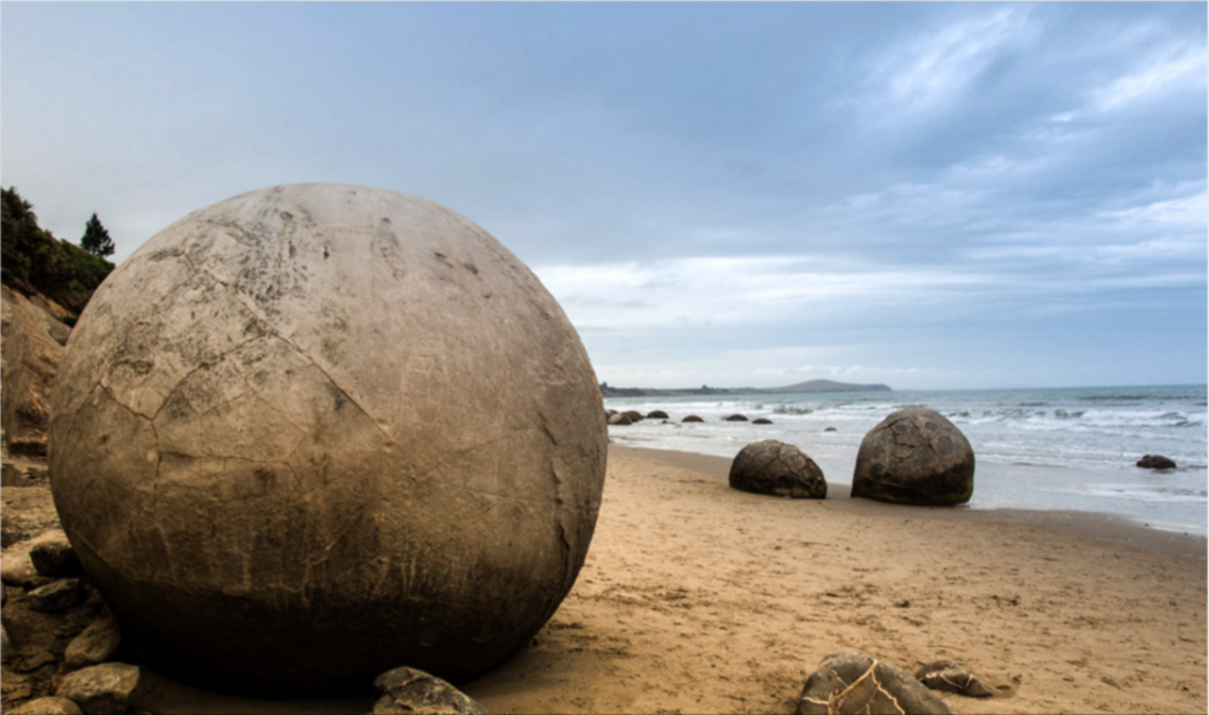

Slide 4
Challenge 1
Question time!
Where might these objects have come from?
Why is the surface of the nearest object cracking?
What is inside the objects?
If you came across one of these, how would you react?
Thinking challenge
If one of these objects burst open and God’s idea of a perfect world was inside, what woud it look like? What would you be able to hear? see? smell?
How would the people inside be treating each other?
What would you not see happening?
How different is this world from the one we live in?
Which world would you prefer to inhabit? Why?
What can you do to make the world more like your idea of God’s perfect world?

Slide 5
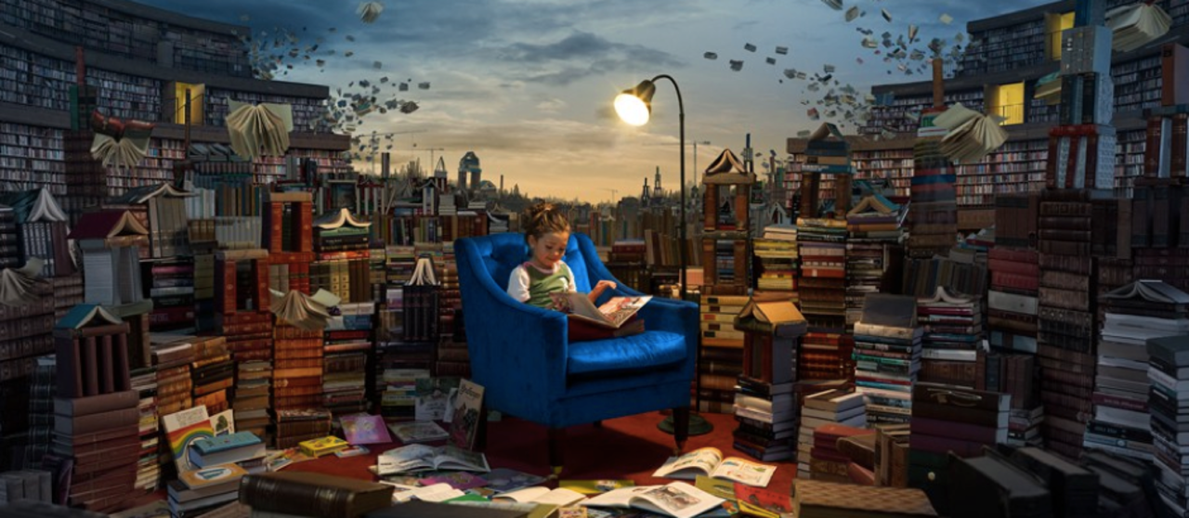

Slide 6
Challenge 2
Perfect picture
How is this library different from a normal library?
If you were to borrow every single book from your local library, would it still be a library?
If you could choose for one of your books to come alive, which one would it be and why?
Why do you think that the Bible is sometimes referred to as ‘the good book’?
If you could be a character in the Bible, who would you like to be and why?
Question time!
If you were asked to design the front cover of the Bible what would you draw?
Have a go at a design (either on paper or in your imagination). Now explain it to someone.
If you have included scenes from Bible stories, why have you picked those particular stories?

Slide 7
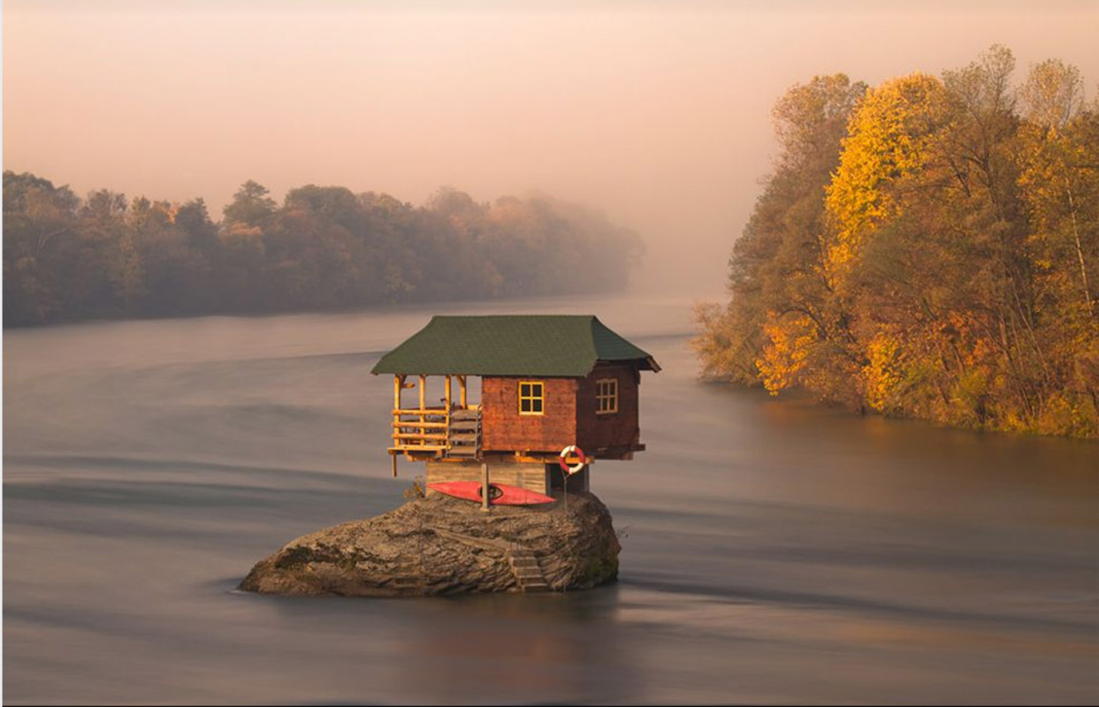

Slide 8
Challenge 3
Picture challenge
This is Ben’s house.
Six months earlier, Ben had lived in the city. Life had been busy; a constant buzz of people and traffic. In some ways, living in the city had been comforting, as if he was part of a huge family, a melting pot of people of all ages and all walks of life. However, Ben had grown tired of that life; it was now time for a change of direction. He moved to this house.
If Ben was standing on his balcony in the picture, do you think he would be smiling? Why?
What can you guess about Ben’s previous life in the city?
How is his life different now?
Question time!
This picture is called ‘solitary existence’ . What do you think that means?
Which of Ben’s two life experiences would you prefer?
Is it good to live alone?
Why do you think Christians often say that they are never really alone?
Do you think that God is always with us? Is that good or bad?
Have you ever felt that God was with you?

Slide 9
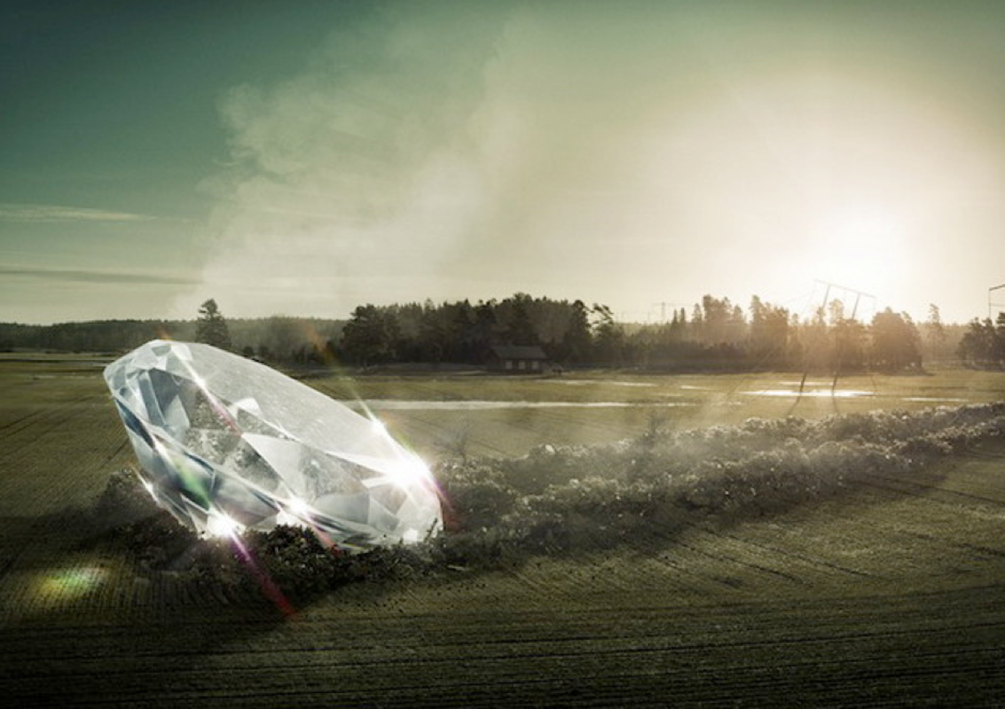

Slide 10
Challenge 4
Question time!
Where do you think this diamond has come from?
How do you think people would react to seeing the diamond if they came across it?
How important do you think being rich is?
If people have more money, does it mean that they are happier?
What do we learn in the Bible about money? (Look at the story of the widow’s mite)
What does that story teach us?
Discussion challenge
Find someone to discuss the sentence below with:
‘Some things are more important than money’

Slide 11
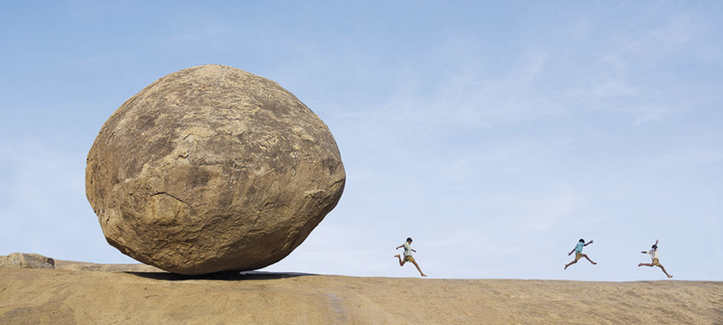

Slide 12
Challenge 5
Perfect picture
What noise do you think the rock might be making as it rolls?
How will the children escape?
Think about the giant pebble chasing the children. Have you ever been faced with a dangerous situation or a big problem?
If so, how did you deal with it?
If you could have any super-power that could help people facing difficult situations, what would it be?
Question time!
If I said Jesus was a kind of superhero, what would you say?
How might a Christian deal with a big problem?
What difference might this make?
What advice would you give to people when dealing with their problems? How can you ask God for help?

